Slide 1
Study of CSR impedance in ThomX with CSRZ code
Alexis Gamelin, Demin Zhou

Slide 2
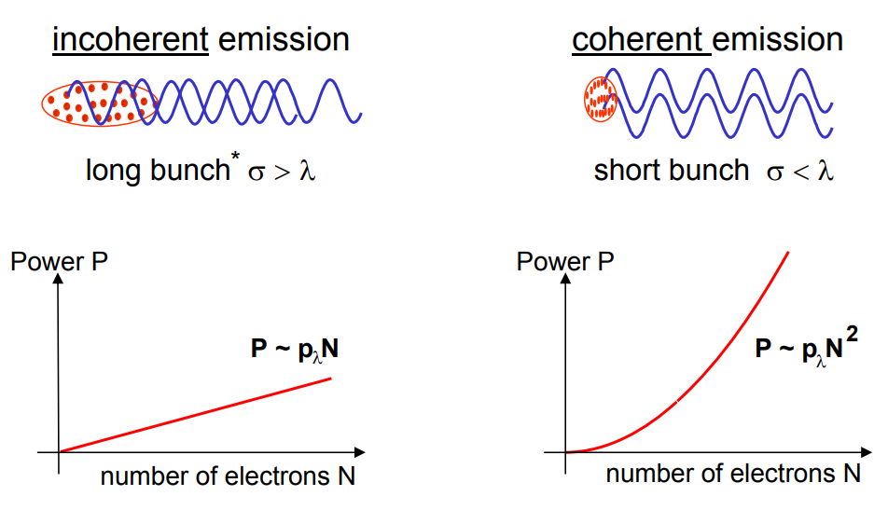
Coherent Synchrotron Radiation
G. Wüstefeld, BESSY, Short Bunches & CSR, EPAC‘08, June 23rd. 2008

Slide 3
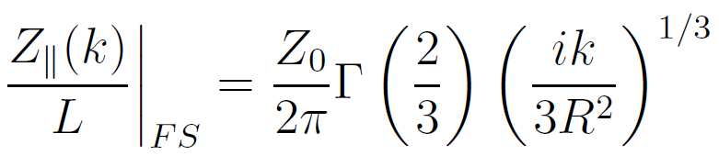

Popular models for CSR impedance
Free space CSR impedance
Parallel plate CSR impedance
For a point charge moving in free space on a circle of radius R, the steady state impedance is:
$$k= \frac{ω}{c}= \frac{2 π f}{c}$$

Slide 4
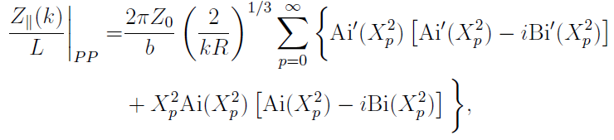

Popular models for CSR impedance
Free space CSR impedance
Parallel plate CSR impedance
For a point charge moving in between two conducting plates in the horizontal plane on a circle of radius R, the steady state impedance is:
b

Slide 5
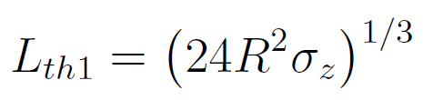


Popular models for CSR impedance
These models neglects:
Transient effects
Transverse size of the beam
Transverse shielding
Resonant behavior
CSR interference
Reality is different from steady state model, in real machine dipoles are interleaved with drifts.
The vacuum chamber act as a waveguide and guided CSR fields can propagate along the beam.
The effect is also called « drift CSR »
Condition to neglect in ring:
Effect should be visible
$$≈180 mm≪L_{b}=296 mm$$
With $σ_{z}=6 ps$

Slide 6

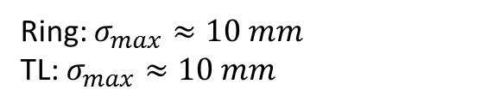

Popular models for CSR impedance
These models neglects:
Transient effects
Transverse size of the beam
Transverse shielding
Resonant behavior
CSR interference
Condition to neglect:
Ring: $σ_{max}≈10 mm$
TL: $σ_{max}≈10 mm$
No effect
With $σ_{z}=6 ps$

Slide 7
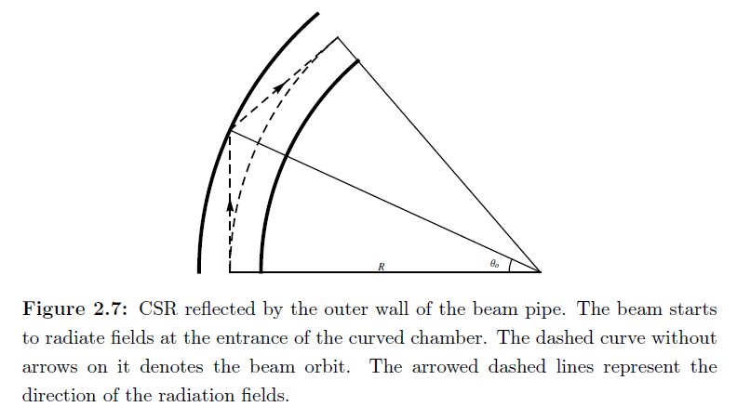
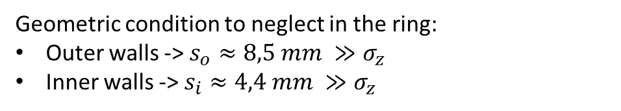
Popular models for CSR impedance
These models neglects:
Transient effects
Transverse size of the beam
Transverse shielding
Resonant behavior
CSR interference
Reflection on outer wall -> Head-Tail effect
Reflection on inner wall -> Tail-Head effect
Geometric condition to neglect in the ring:
Outer walls -> $s_{o}≈8,5 mm ≫σ_{z}$
Inner walls -> $s_{i}≈4,4 mm ≫σ_{z}$
$$σ_{z}≈6 ps≈2 mm$$
At injection:
Effect should be visible

Slide 8


Popular models for CSR impedance
These models neglects:
Transient effects
Transverse size of the beam
Transverse shielding
Resonant behavior
CSR interference
For long dipole chambers, some modes can be strongly excited by the beam and dominate the CSR impedance
Condition to neglect in ring:
$$≈246 mm≫L_{b}=296 mm$$
Effect should be visible
Distance between vertical walls

Slide 9
Popular models for CSR impedance
These models neglects:
Transient effects
Transverse size of the beam
Transverse shielding
Resonant behavior
CSR interference
CSR fields emitted in each dipoles can interact and interfere
Condition to neglect in ring -> ? (depends on geometry)

Slide 10
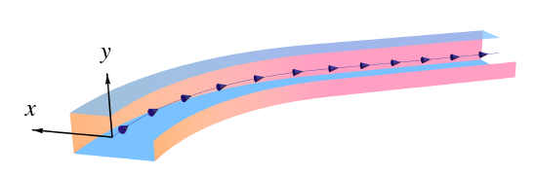
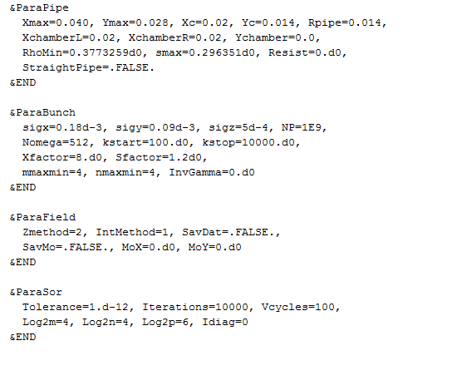
CSRZ code by Demin Zhou
Compute the CSR impedance by numerical integration of Maxwell equations in the paraxial approximation
For a rectangular beam pipe on arbitrary trajectory
Assume Gaussian bunches
Input file:
Zmethod = 1 -> integration end at fixed position
Zmethod = 2 -> integration to infinite length

Slide 11
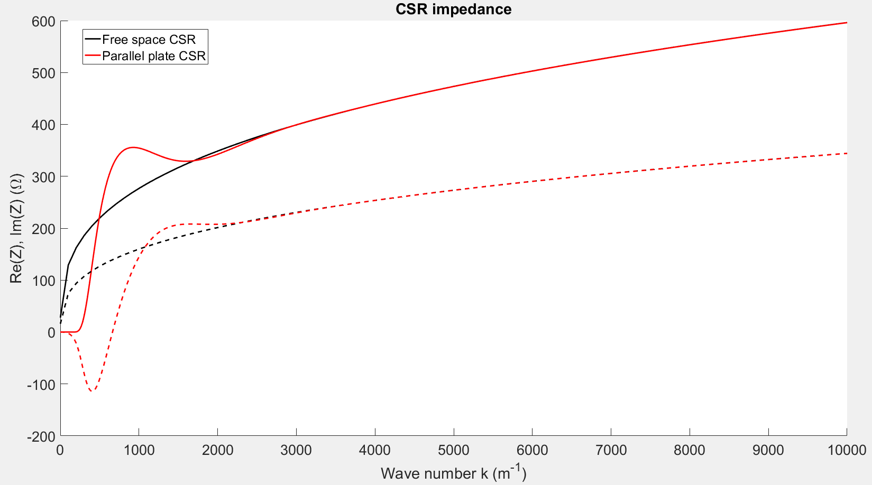
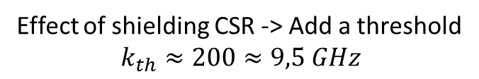

ThomX ring: 1 bend
Effect of shielding CSR -> Add a threshold
$$k_{th}≈200≈9,5 GHz$$
$$k=\frac{ω}{c}$$
~47 GHz

Slide 12
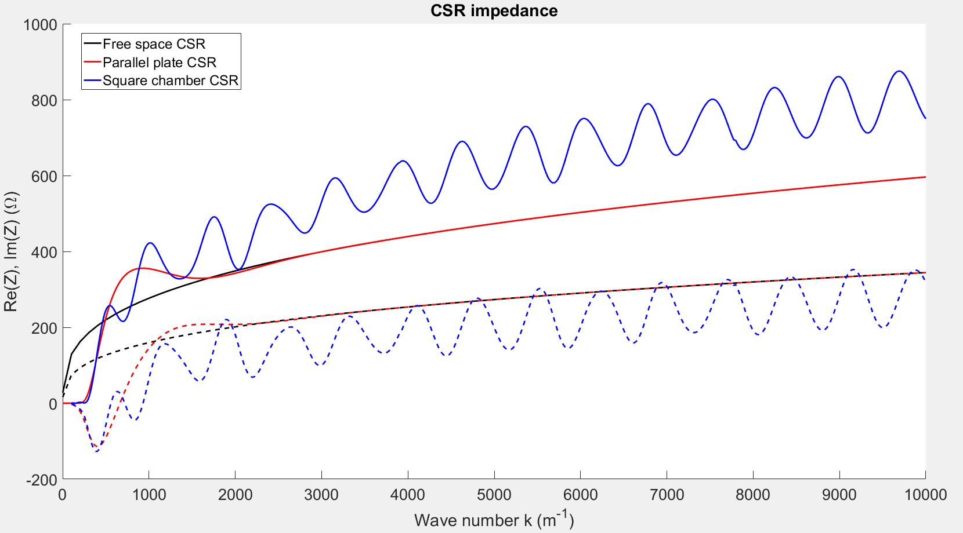
ThomX ring: 1 bend
Resonant behavior
Transiant effects

Slide 13
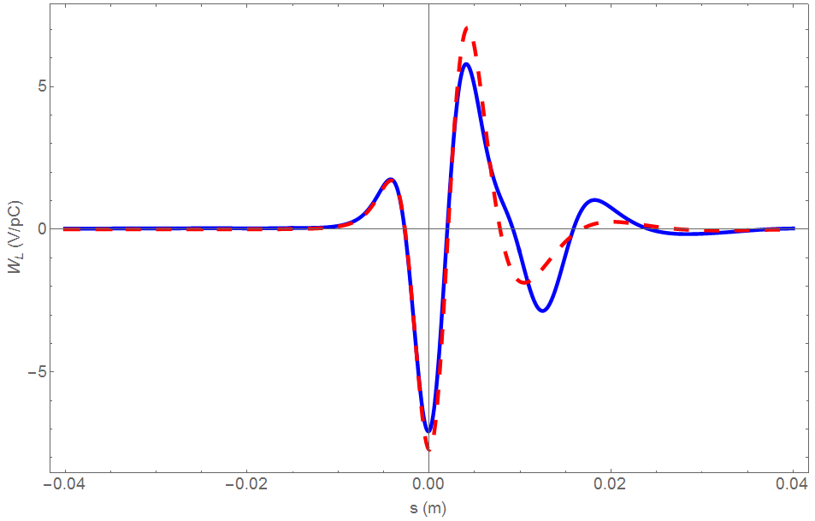
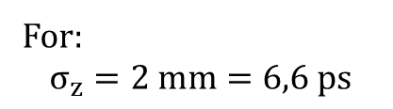
ThomX ring: 1 bend
Parallel plate CSR
Rectangular chamber CSR
For:
$$σ_{z}=2 mm=6,6 ps$$
Inner wall: negligeable
Outer wall and resonances
Transient effects

Slide 14
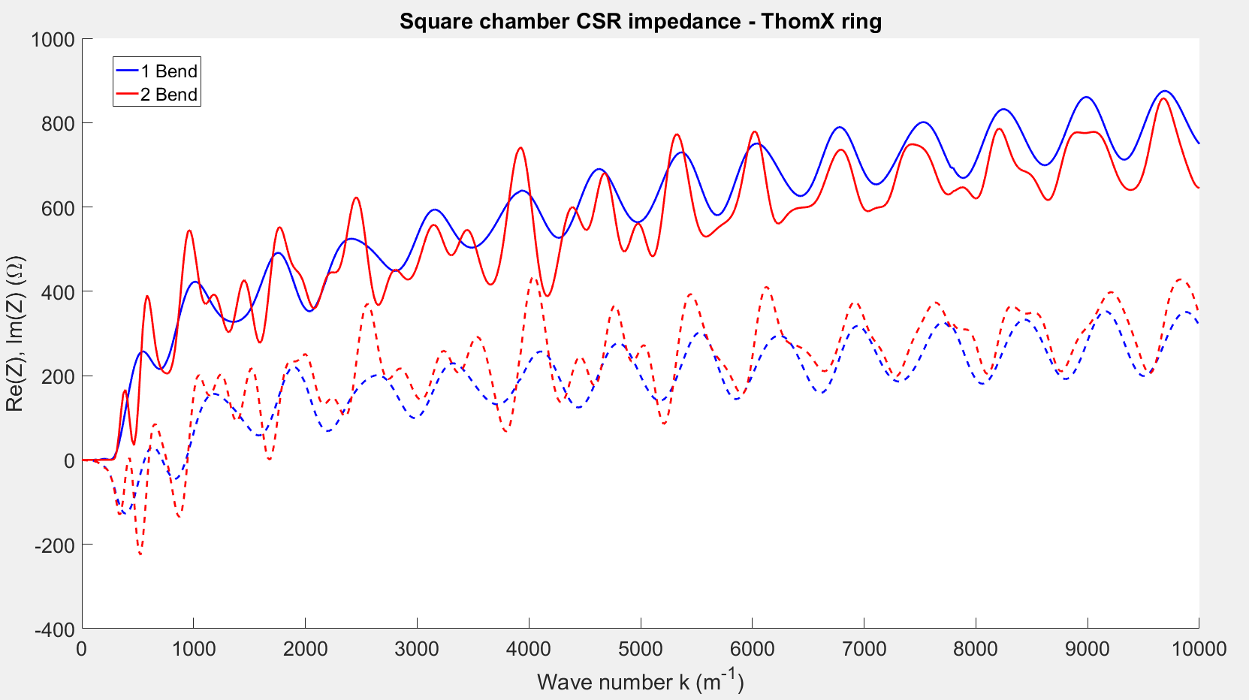
ThomX ring: 2 bend
Constructive interference
Destructive interference
CSR impedance of 2 bend divided by 2 for comparison

Slide 15
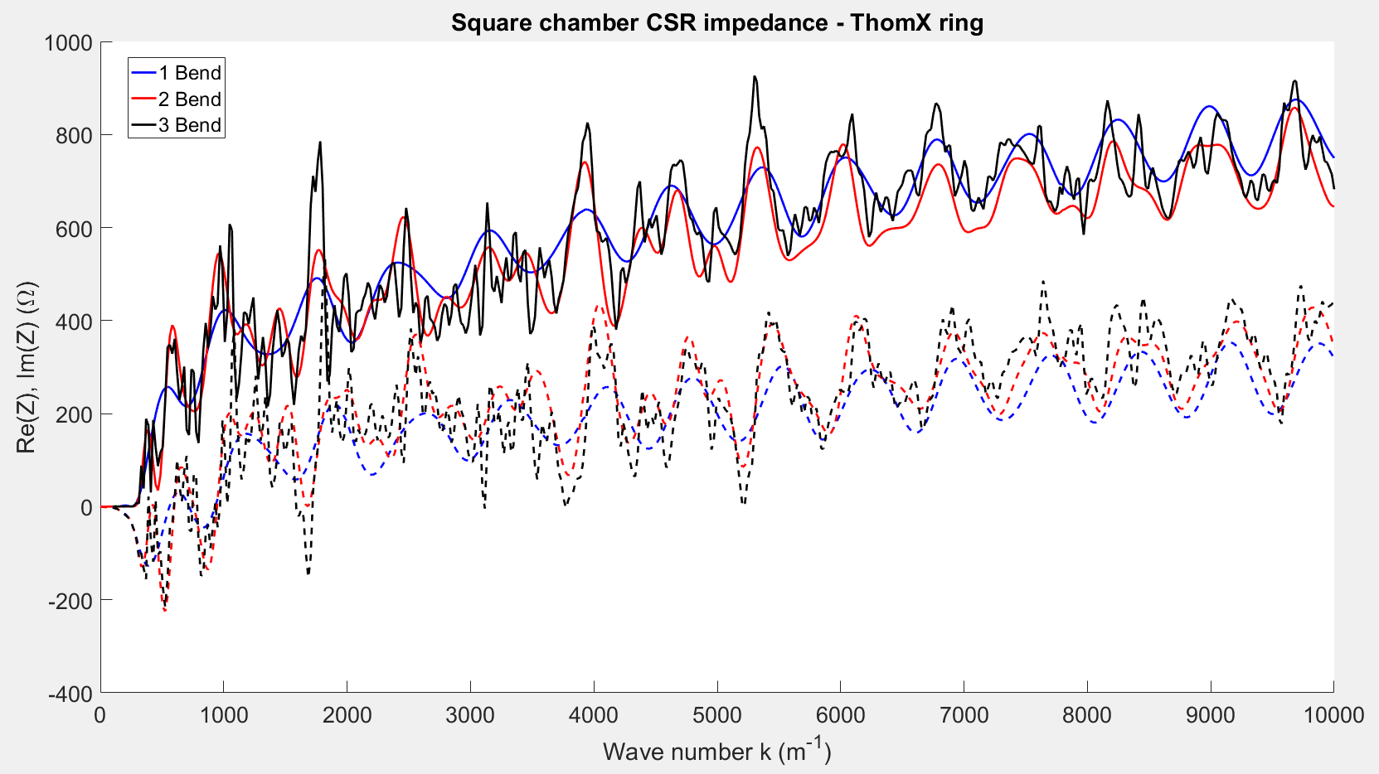
ThomX ring: 3 bend

Slide 16
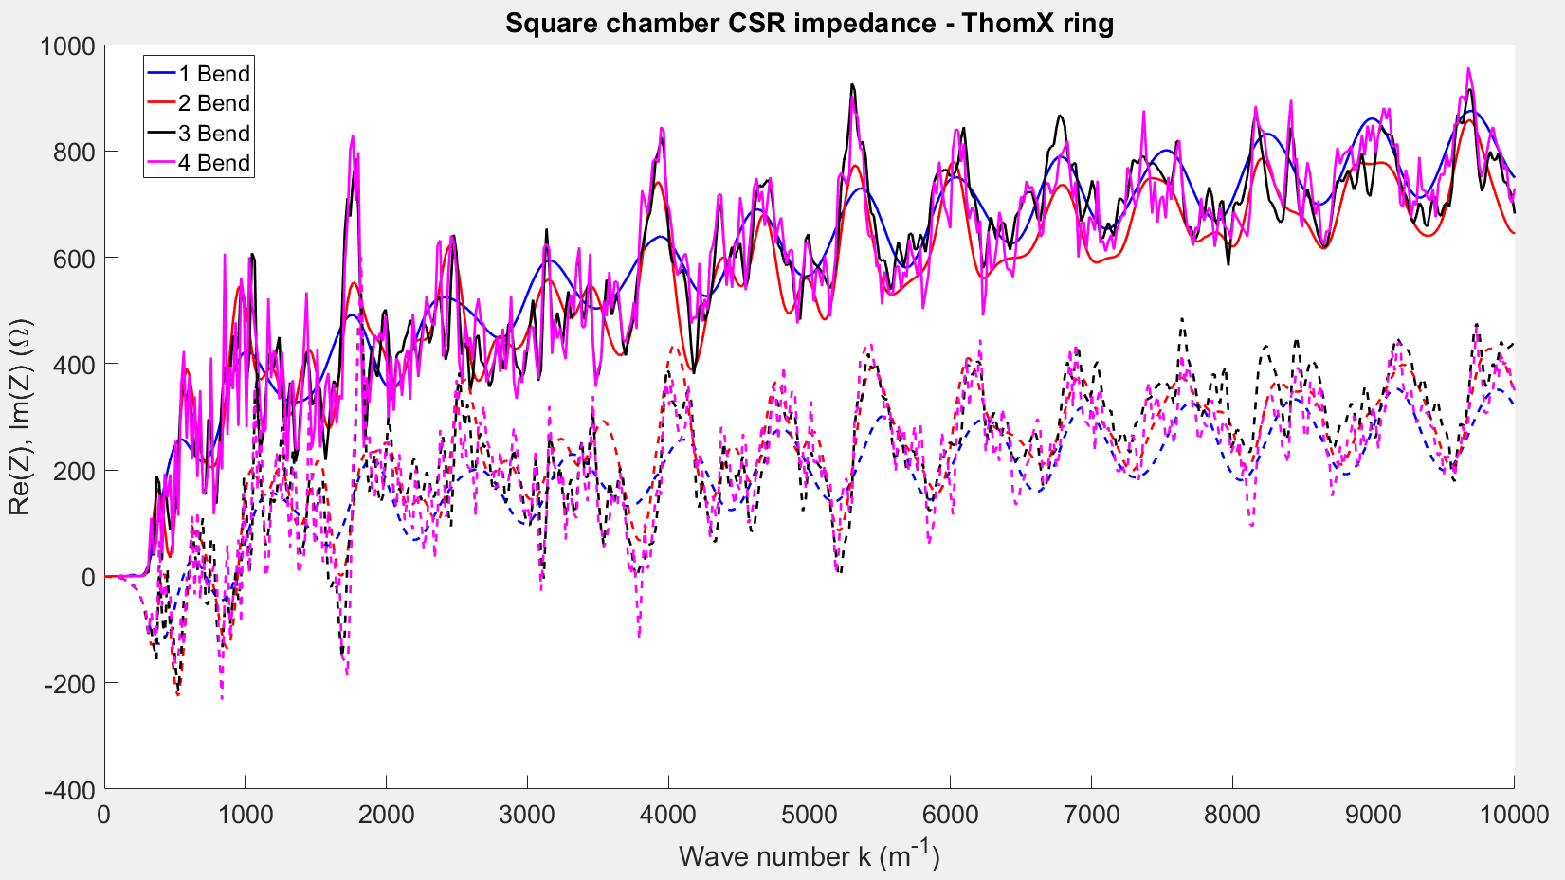
ThomX ring: 4 bend

Slide 17
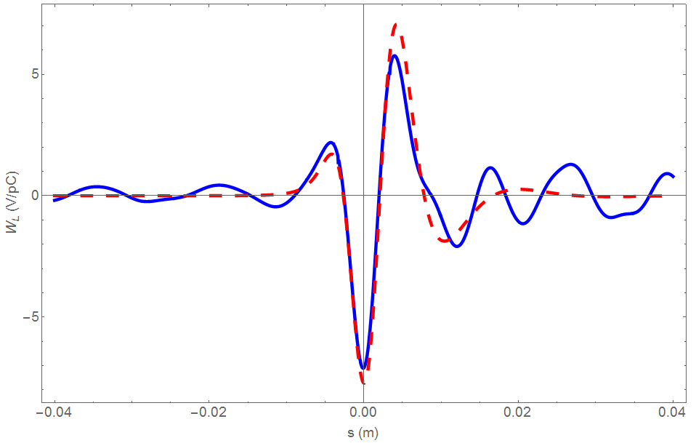
ThomX ring: 4 bend
Parallel plate CSR
Rectangular chamber CSR
For:
$$σ_{z}=2 mm=6,6 ps$$
Interferences

Slide 18
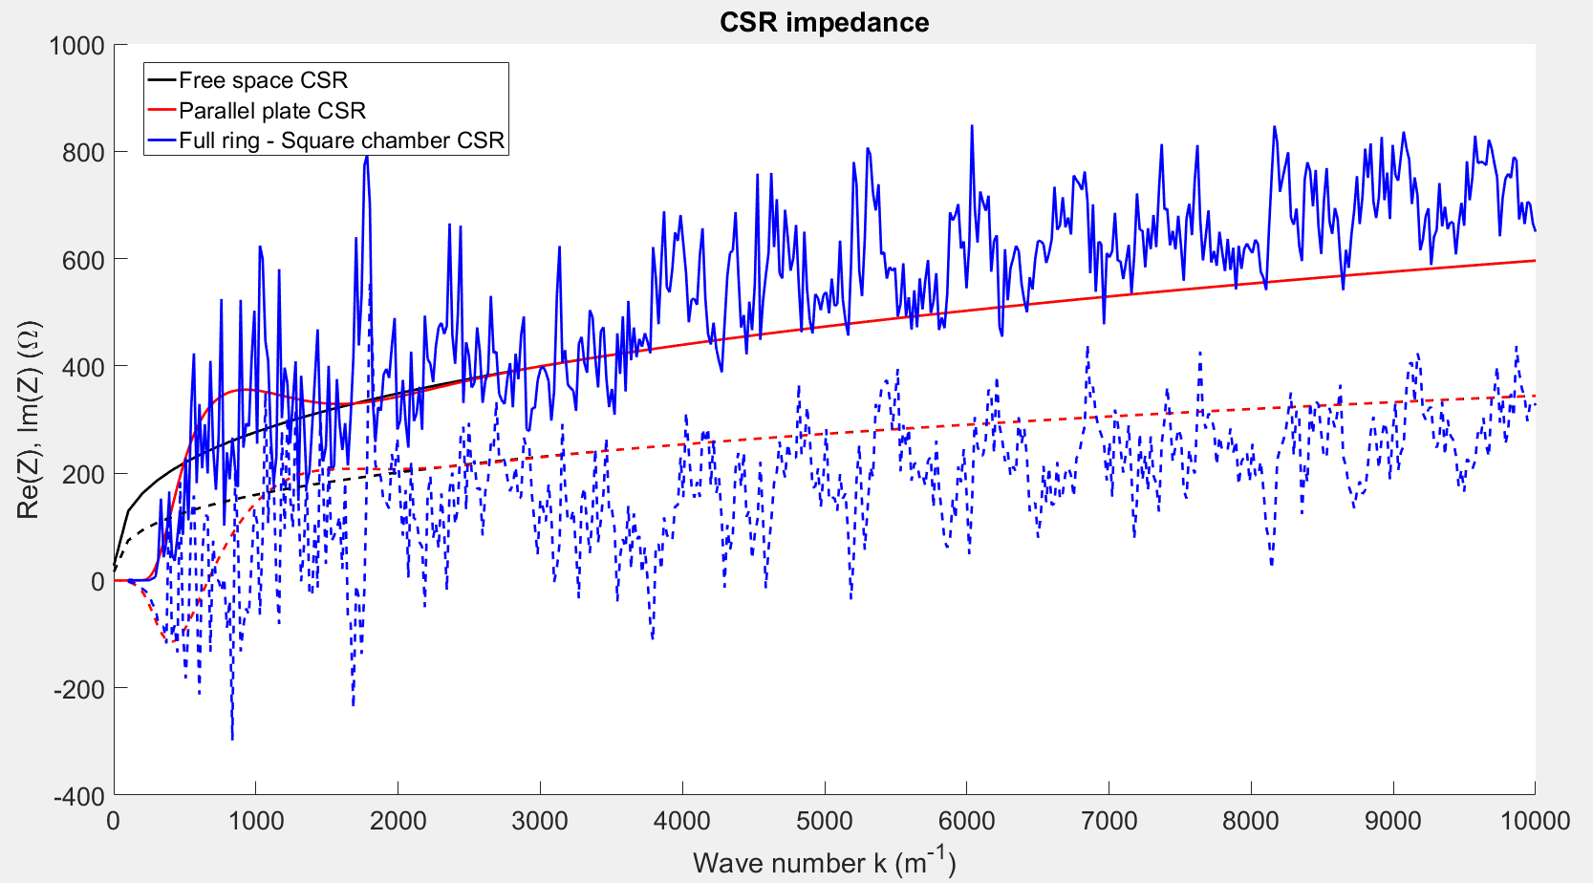
ThomX ring: Full ring
Computation running for 650h
According to Demin Zhou: this type of spectrum has been measured experimentally with THz monitors -> real effect

Slide 19
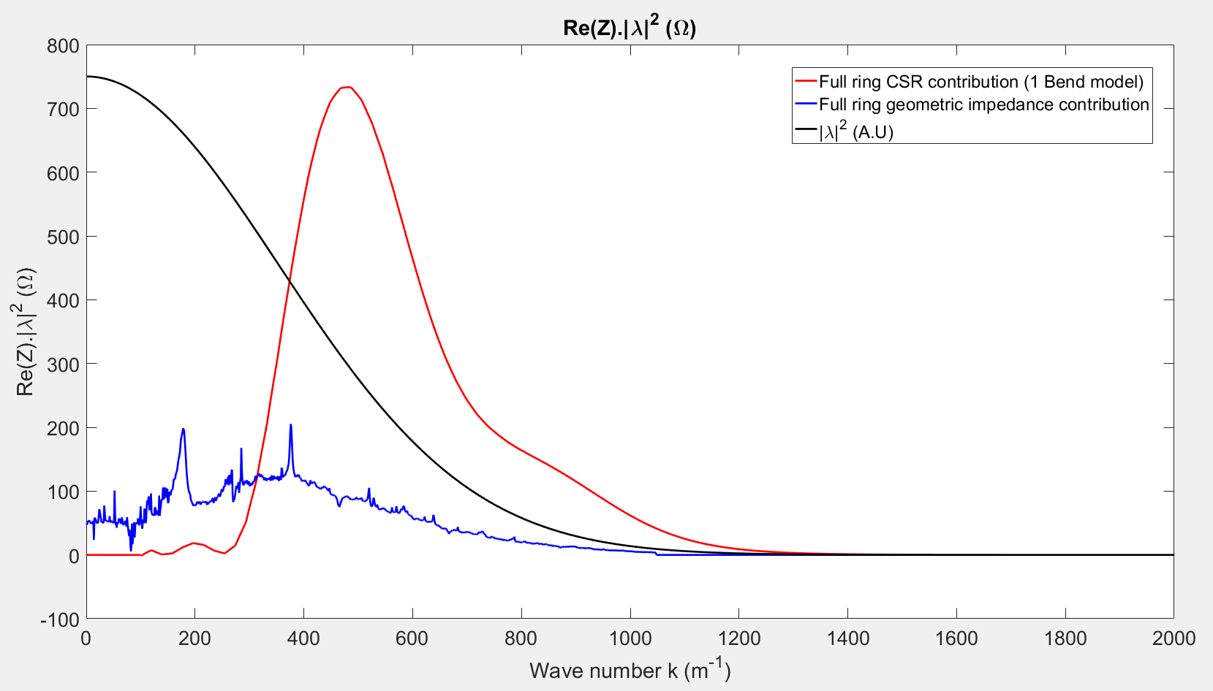
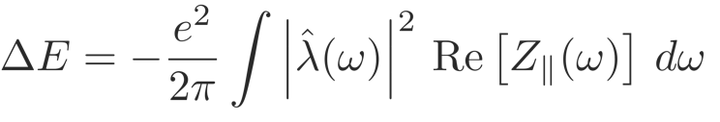

Why should we care : impact on beam dynamics
$$σ_{z}=2 mm=6,6 ps$$
Total energy loss per bunch

Slide 20
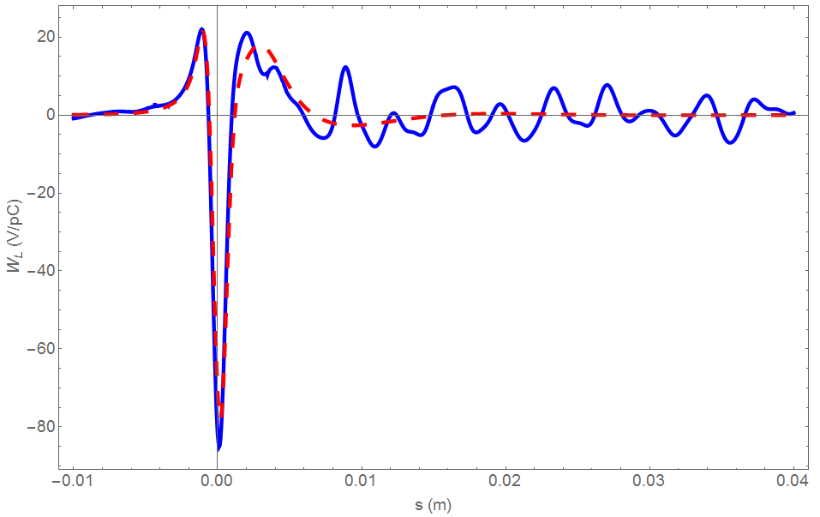
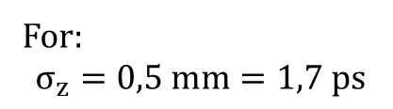

ThomX ring: 4 bend
For:
$$σ_{z}=0,5 mm=1,7 ps$$
Peak amplitude x 15 compared to $σ_{z}=2 mm$
Parallel plate CSR
Rectangular chamber CSR

Slide 21
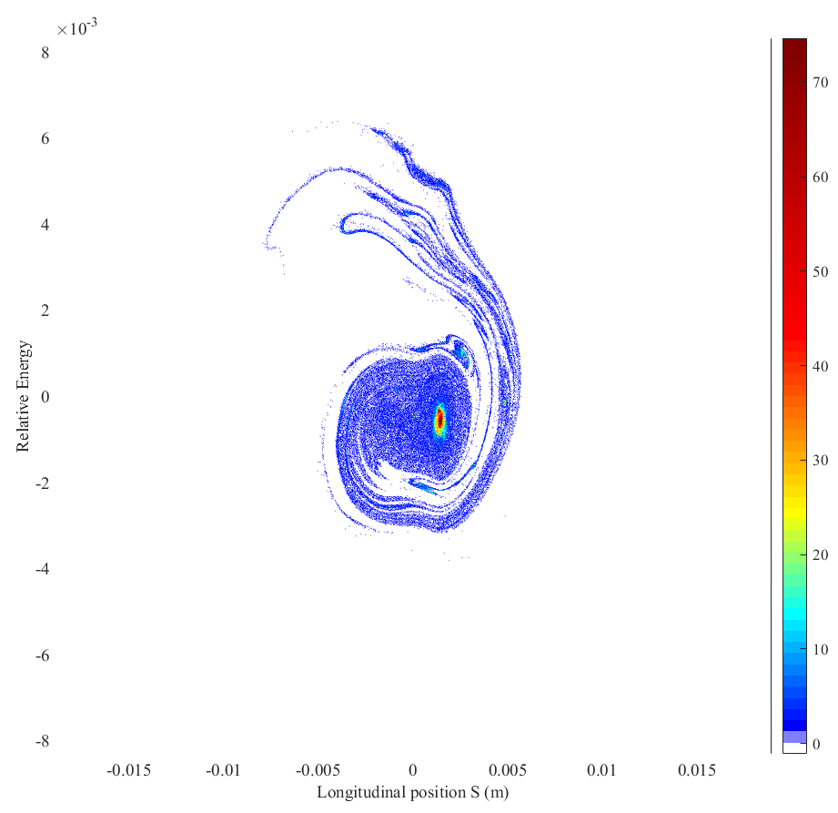
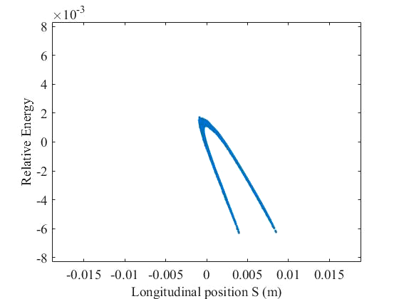
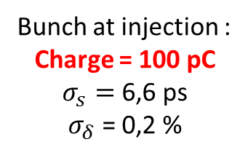
Why should we care : impact on beam dynamics
In ThomX -> Injection without longitudinal matching
With CSR PP, space charge and impedance
1000 tours
With CSR PP, space charge and impedance
1000 tours
Quick filamentation
Bunch quickly fill the RF acceptance
Bunch at injection :
Charge = 100 pC
$σ_{s}=$6,6 ps
$σ_{δ}$ = 0,2 %

Slide 22
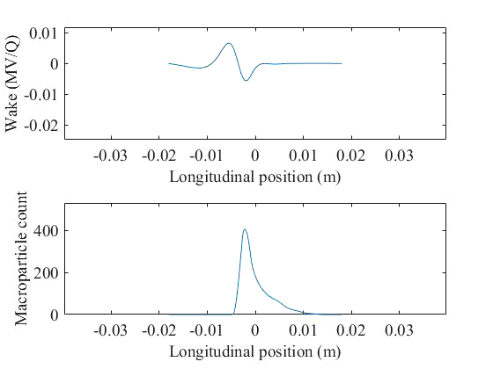
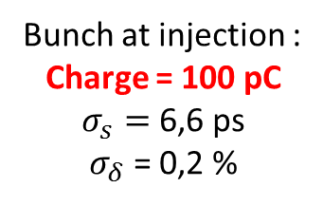
Why should we care : impact on beam dynamics
Toy simulation 10 000 particles with CSR PP
100 tours
Bunch at injection :
Charge = 100 pC
$σ_{s}=$6,6 ps
$σ_{δ}$ = 0,2 %
Beam not Gaussian in longitudinal
Head-Tail and Tail-Head effets important !

Slide 23
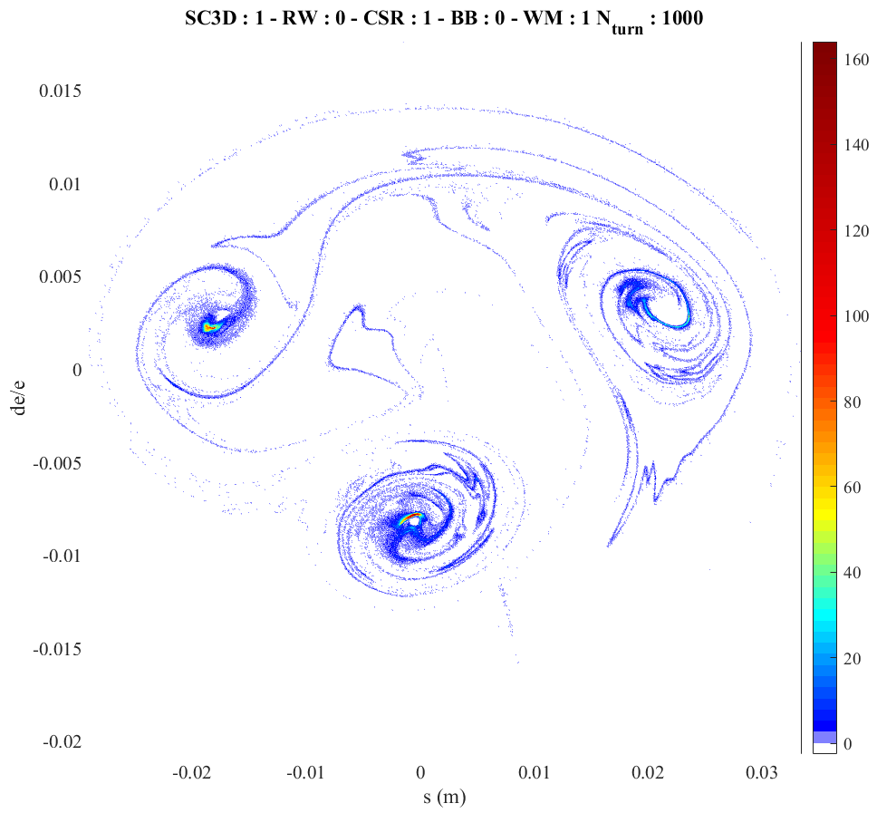
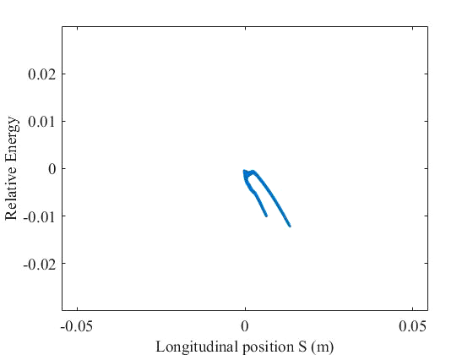
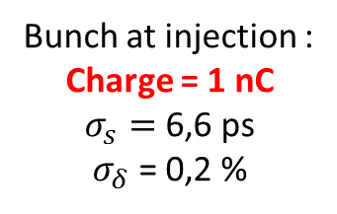
Why should we care : impact on beam dynamics
With CSR PP, space charge and impedance
1000 tours
With CSR PP, space charge and impedance
1000 tours
Bunch splits in 3 parts
CSR instability
CSR ∝ N²
Bunch at injection :
Charge = 1 nC
$σ_{s}=$6,6 ps
$σ_{δ}$ = 0,2 %

Slide 24
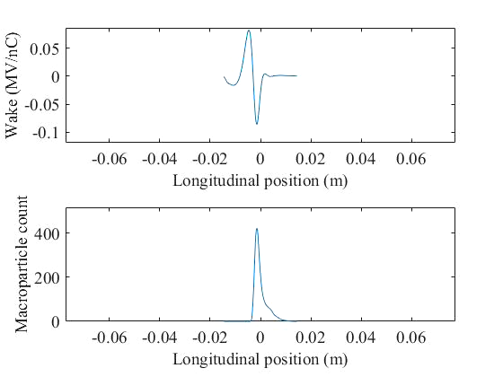

Why should we care : impact on beam dynamics
Toy simulation 10 000 particles with CSR PP
100 tours
Bunch at injection :
Charge = 1 nC
$σ_{s}=$6,6 ps
$σ_{δ}$ = 0,2 %
Beam not Gaussian in longitudinal
Head-Tail and Tail-Head effets important !

Slide 25

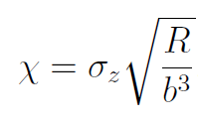
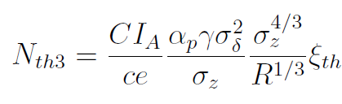




Micro Wave Instability (MWI)
MWI threshold driven by CSR PP:
$$≈812 pC$$
With:
$$σ_{z}=6,6 ps$$
$$σ_{δ}=0,2 \%$$

Slide 26
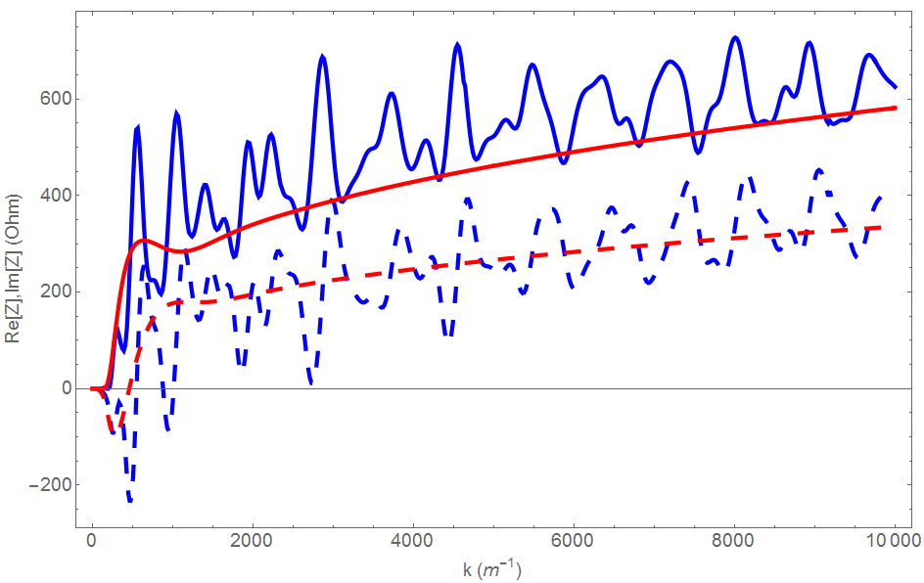
TL 2 bend model
Parallel plate CSR
Rectangular chamber CSR

Slide 27
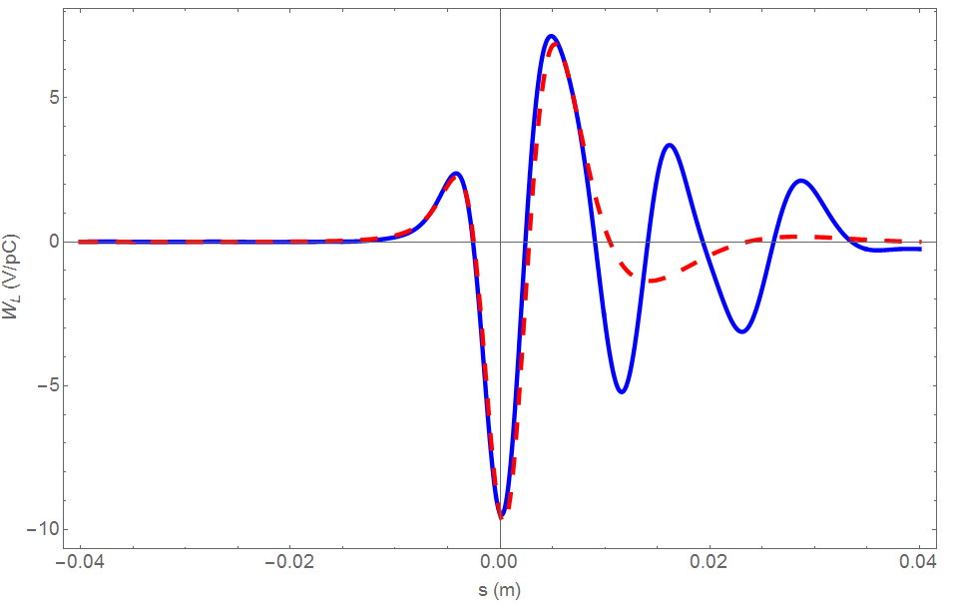

TL 2 bend model
Parallel plate CSR
Rectangular chamber CSR
$$σ_{z}=2 mm=6,6 ps$$

Slide 28
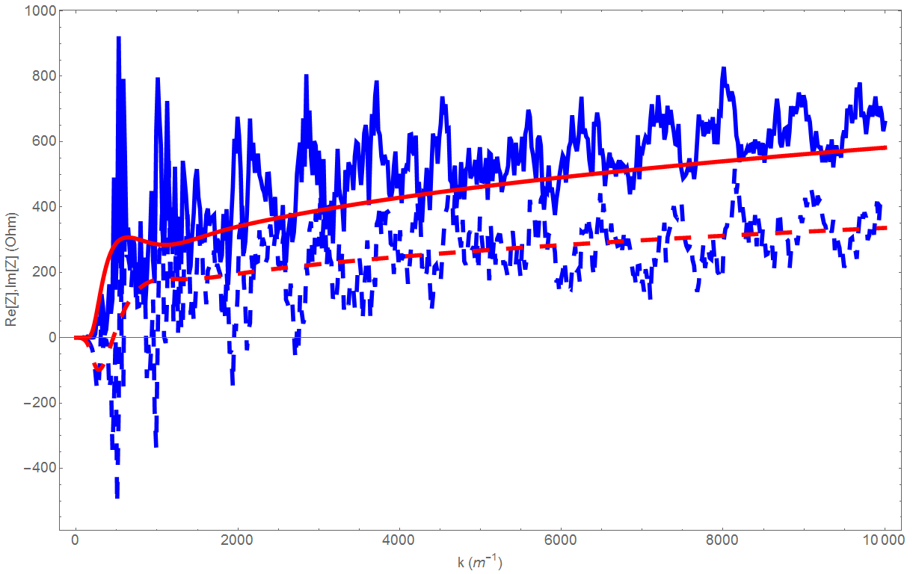
TL 4 bend model
Parallel plate CSR
Rectangular chamber CSR

Slide 29
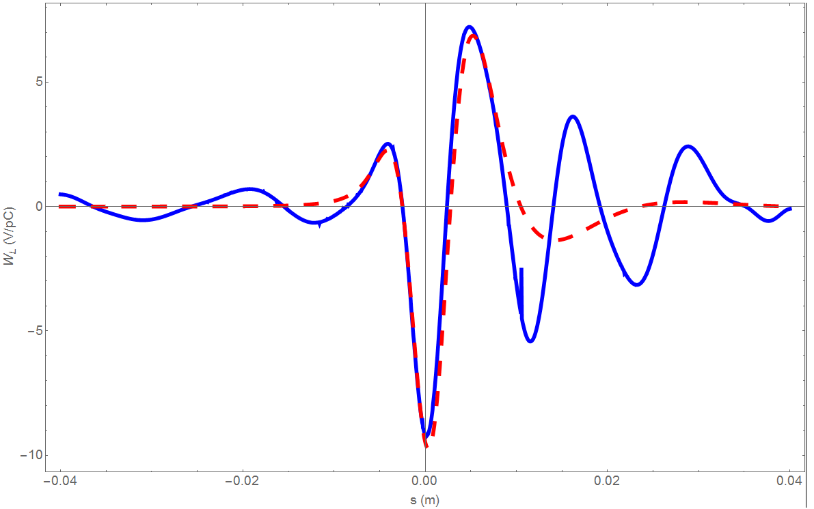
TL 4 bend model
Parallel plate CSR
Rectangular chamber CSR
$$σ_{z}=2 mm=6,6 ps$$

