Slide 1
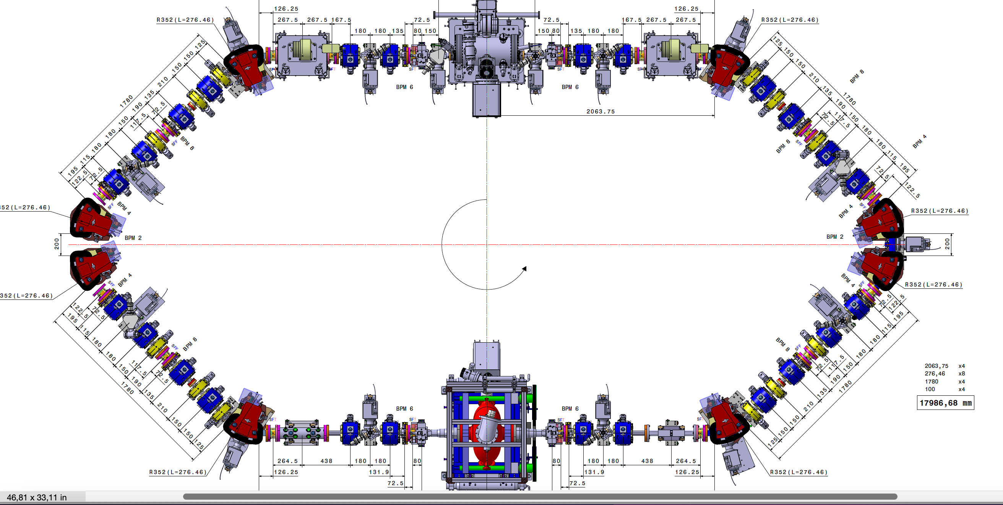
RI-C1/STR.01
RI-C2/STR.06
RI-C1/STR.02
RI-C2/STR.05
RI-C1/STR.03
RI-C2/STR.04
RI-C1/BPM.02
RI-C1/BPM.01
RI-C2/BPM.06
RI-C1/BPM.03
RI-C1/BPM.04
RI-C2/BPM.05
RI-C1/BPM.05
RI-C2/BPM.04
RI-C1/BPM.06
RI-C2/BPM.03
RI-C2/BPM.01
RI-C2/BPM.02
RI-C1/STR.04
RI-C2/STR.03
RI-C1/STR.05
RI-C2/STR.02
RI-C1/STR.06
RI-C2/STR.01
For complete names add DG for BPM (eg: RI-C1/DG/BPM.02) and PS for steerers (eg: RI-C1/PS/STR.01).
For steerers, add –H.01 for the horizontal component and add –V.01 for the horizontal component.

