Slide 1
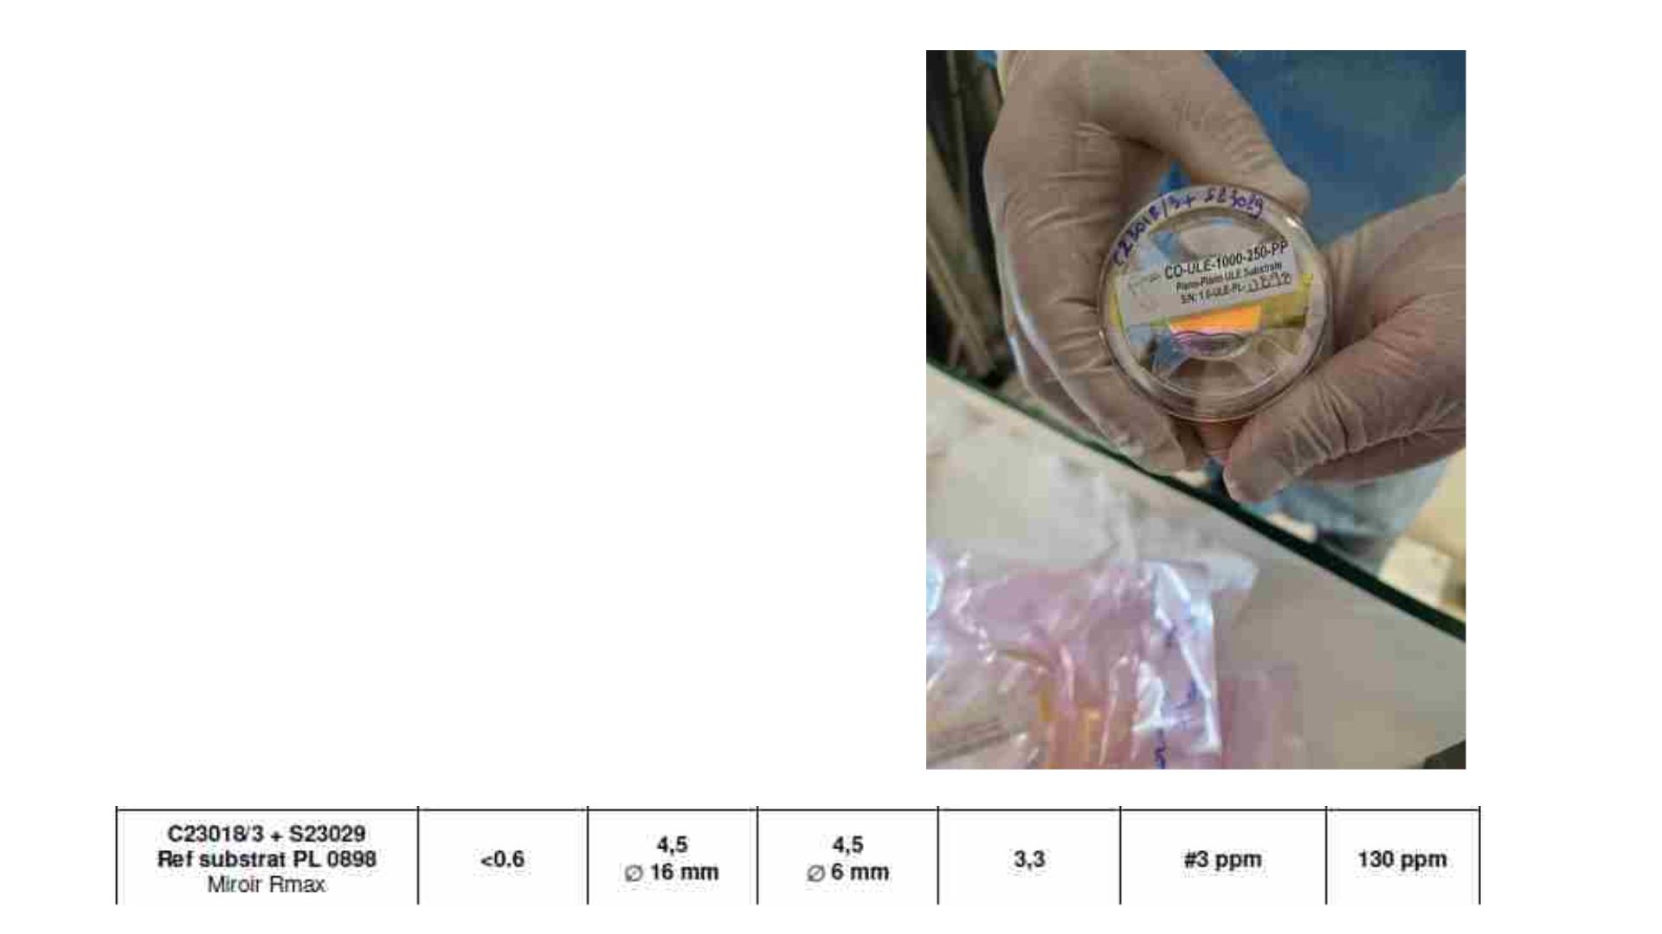
Taking images of mirrors sent my LMA
One mirror of each patch (group)
We choose the lowest-quality mirror
Image taken are of order :
• Front face
• Front face cleaned
• Back face cleaned
• Front face cleaned less exposure time

Slide 2
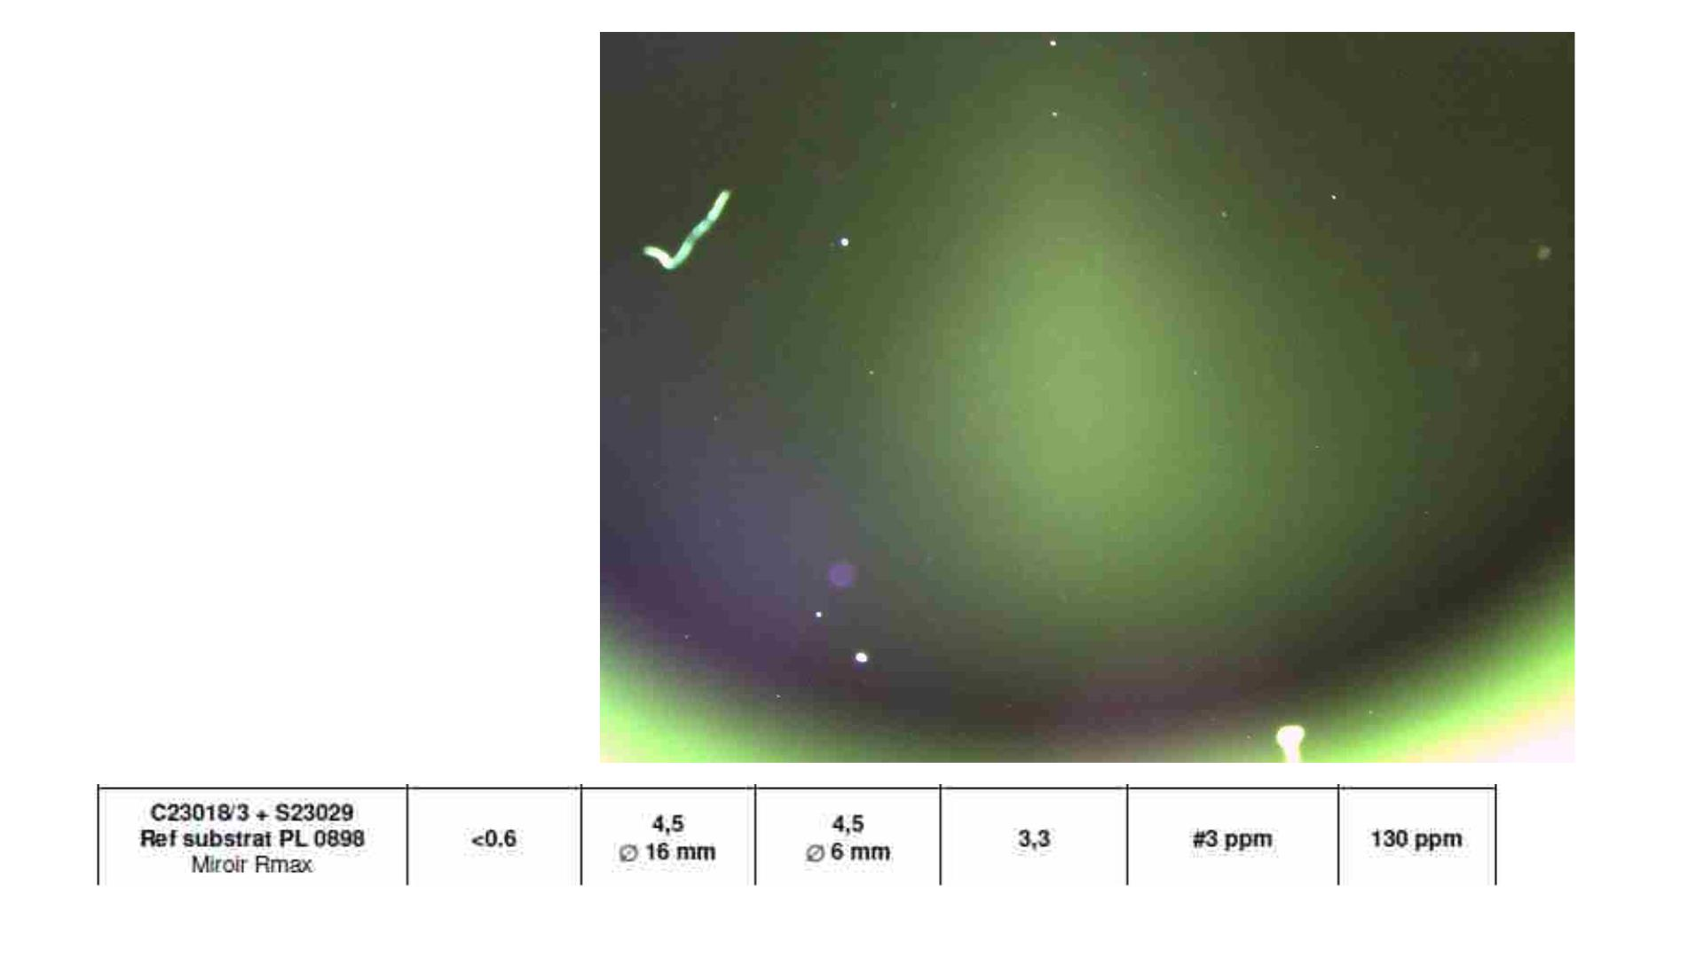
Image of the same front face of
one of the mirrors from the new
patch received
(Image exposure time is
increased)
Miroirs PLANS en ULE

Slide 3
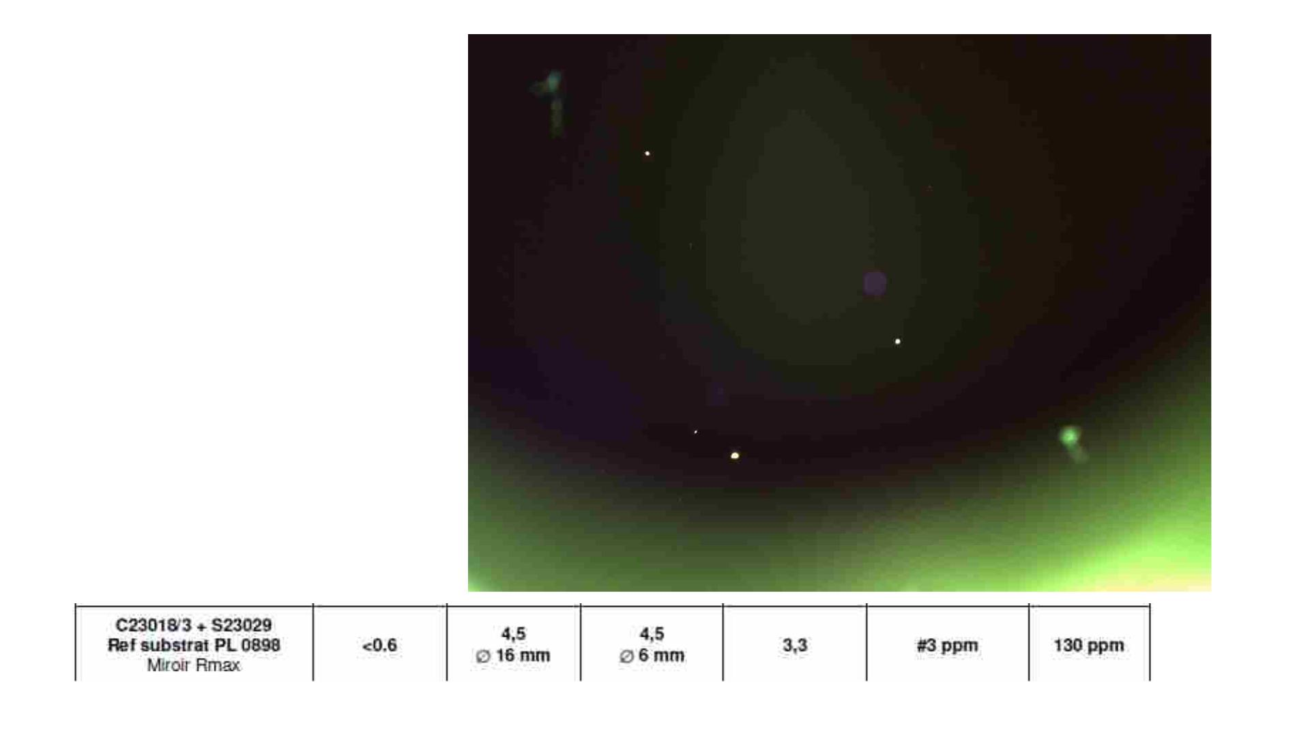
Image of the same front face of
one of the mirrors from the new
patch received
(Image exposure time is
increased)
The front surface cleaned using
pure alcohol and optical tissue
Miroirs PLANS en ULE

Slide 4
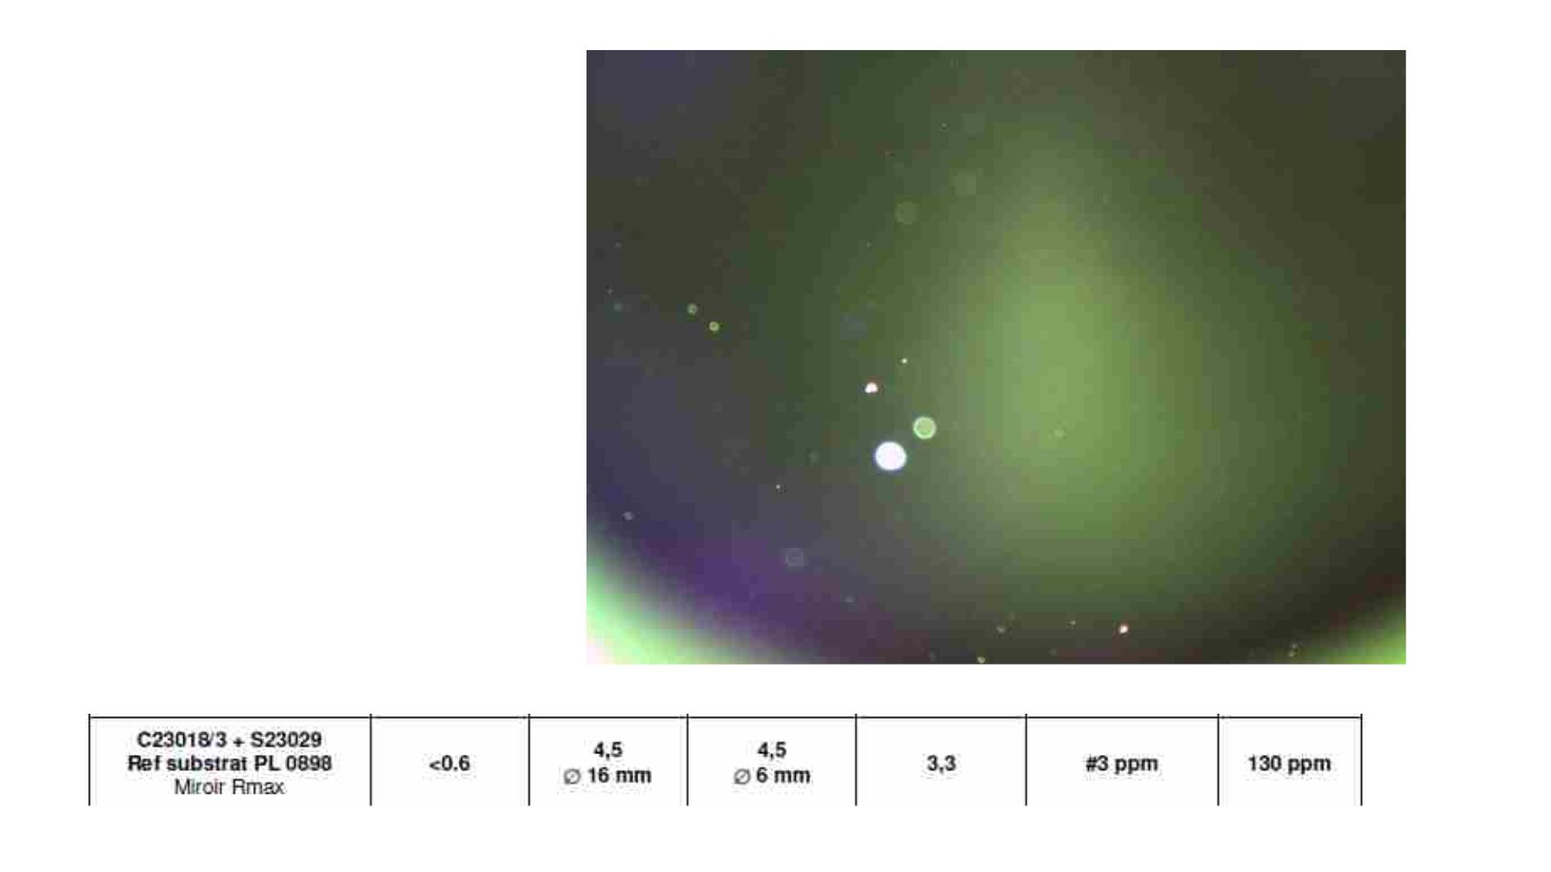
Image of the back face of one of
the mirrors from the new patch
received
(Image exposure time is
increased)
Miroirs PLANS en ULE

Slide 5
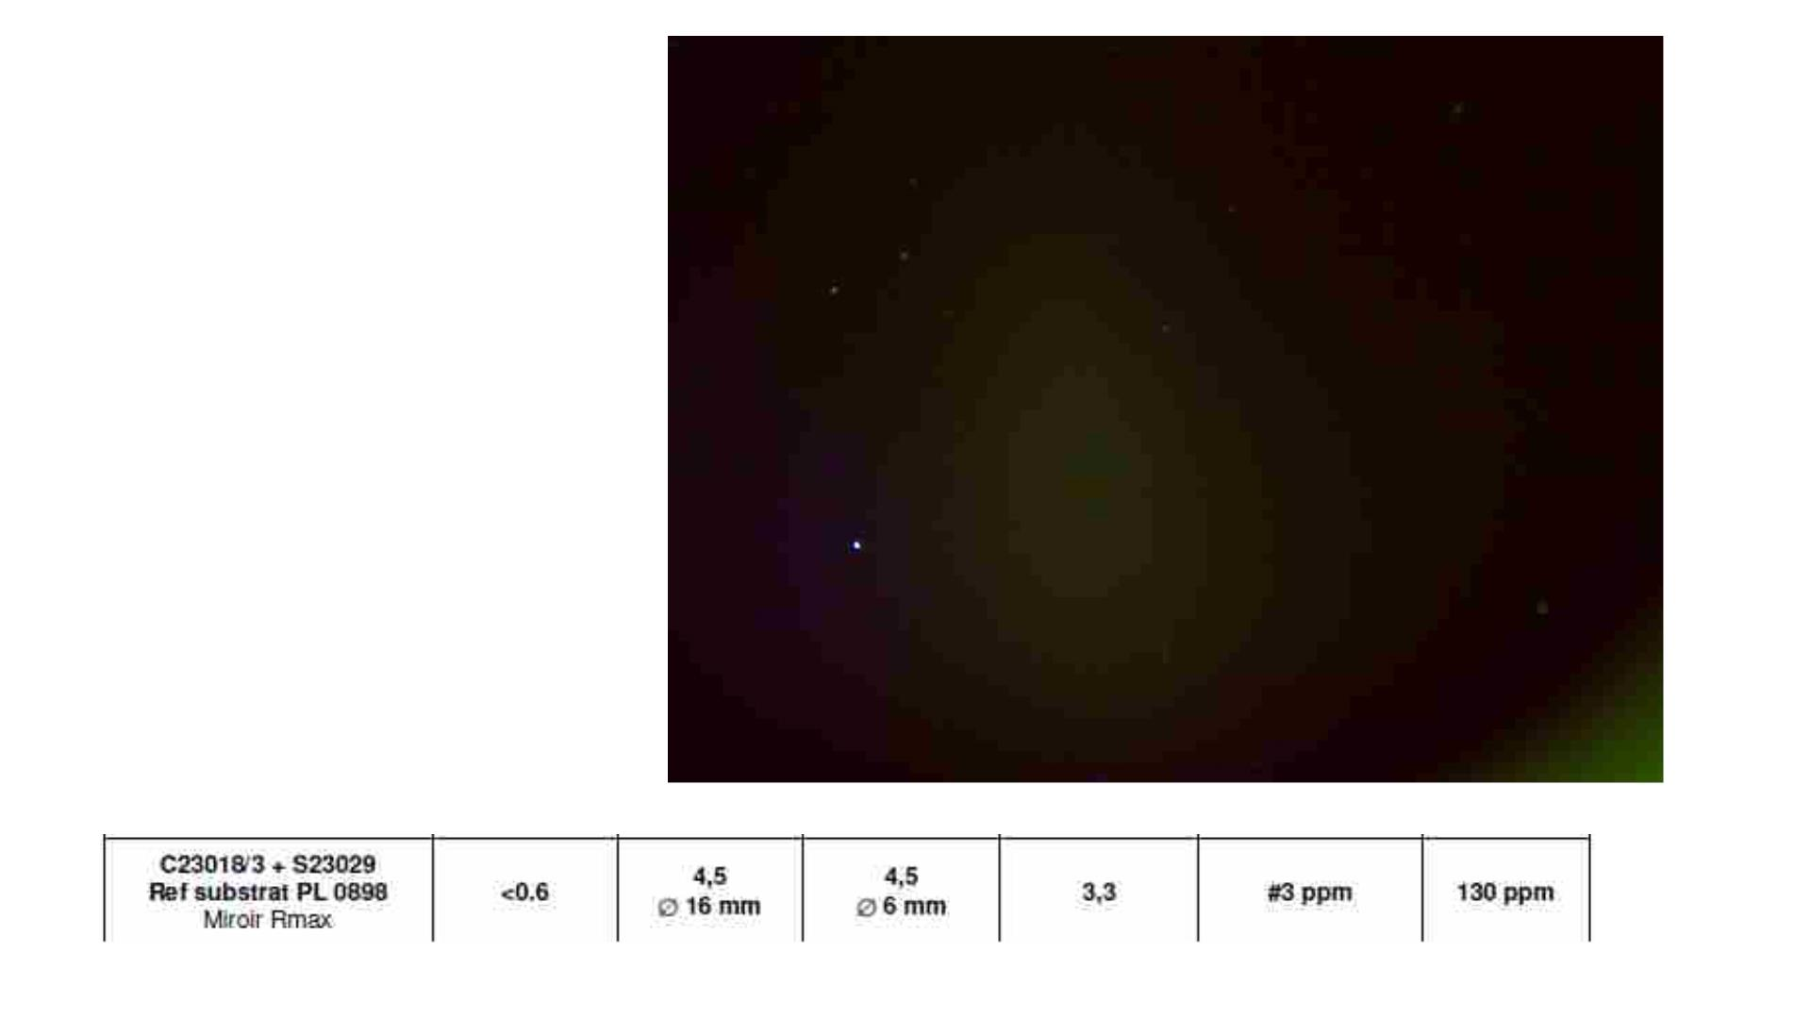
Image of the front face of one of
the mirrors from the new patch
received
Miroirs PLANS en ULE

Slide 6
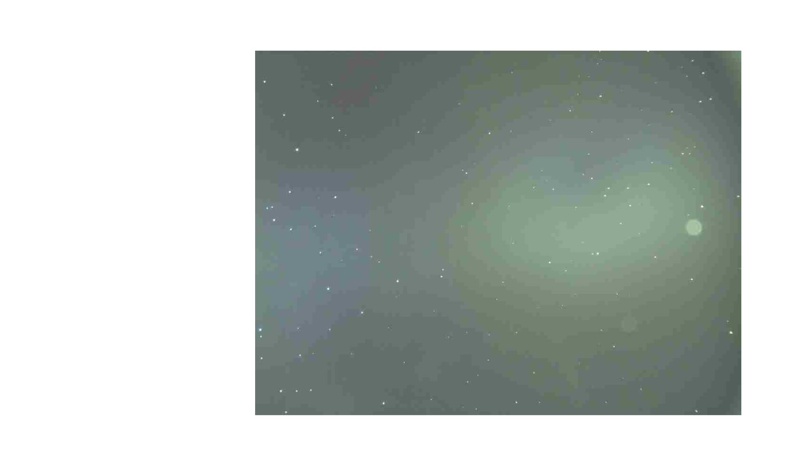
The image shows the
metal deposit between the
coating layers
From the old mirrors we
have received from LMA

