Slide 1
M1
M2
Θ1
Θ2
L1
D1
Θ’3
Θ’’3
L2
L4
D2
D
Θ2
Θ1
L3
M3
M4

Slide 2
Data :
Frep = 160,3084MHz
D = 7 cm
L0 = 1,01 m
DR = 12 cm
L3 = 0,505m
Equations :
M1
M2
Θ1
Θ2
L3
LM4
LM3
DR = 120 mm
L4
L2
Scan parameter :
Theta1
D = 70 mm
Θ1
Θ2
M3
M4
L1
LM2
LM1
Unknown :
Theta 2
L1
L2
L4
LM1
LM2
LM3
LM4
L0 = 1010 mm

Slide 3
M1
Θ1
Θ2
M2
LM4
LM3
Solution zone for the Theta1 angle
with a minimum space of 15cm (LMk)
between mirrors and box sides
and a minimum space of de 8 cm
between mirrors on the same side
DR = 120 mm
D = 70 mm
L4
L2
Θ2
Θ1
M3
L1
M4
LM2
LM1
L0 = 1000 mm
LRT = 1.8701 m
D = 70 mm
theta1 = 117.2422 mrad
theta2 = 205.9544 mrad
L1 = 424.378 mm
L2 = 342.2958 mm
L3 = 505 mm
L4 = 598.4245 mm
L0 = 1.02 m
DR = 120 mm
LM1 = 150.0136 mm
LM2 = 445.6084 mm
LM3 = 239.3298 mm
LM4 = 275.6702 mm
LM3-LM1 = 89.3163 mm
LM2-LM4 = 169.9382 mm

Slide 4
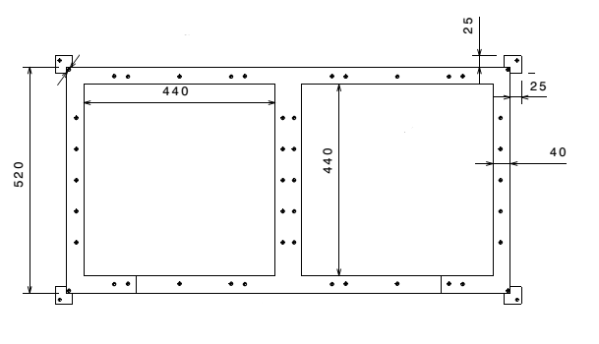
SBOX optical setup with 1:10 scale
SBOX size : 1020 x 520 mm
Windows diameter : 20mm (small) / 40mm (large)
Mounts width : 60mm
M4
M3
L3
D=70mm
DR=120mm
M2
L1
M1
220mm
L0 = 1020 mm
130mm

