Slide 1
Finesse and Gain

Slide 2
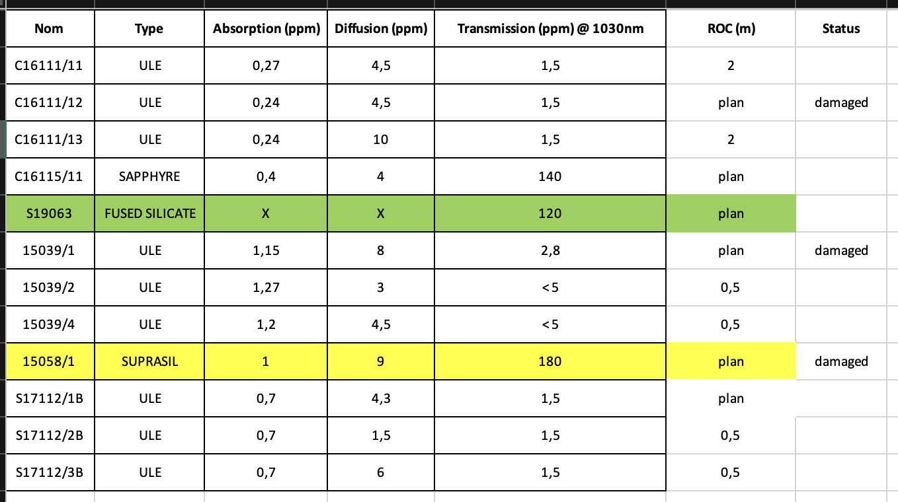
Thomx mirrors
Kbox mirrors

Slide 3
Current results and some context
F=19000 max with 4 mirrors (M3/M4 Kbox, M2 Kbox , M1 ThomX).
To have similar linewidth as Gamma Factory (F=10000, Frep=40MHz), we need F=55000 at 216MHz → still a factor three above.
We also would like to test high power → >200kW ?
We have at least 50W laser amplifier with easily 60% coupling : 30W effectively.
To reach >300kW we thus need G>10000.
Difficult to reach with 4-mirror optical cavity

Slide 4
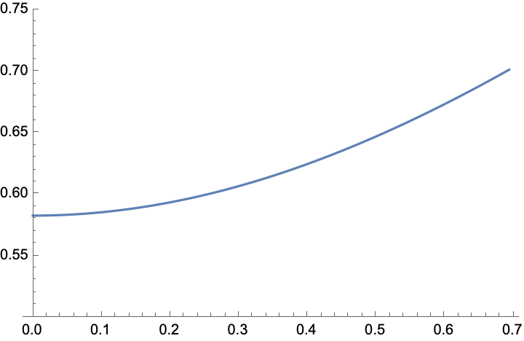
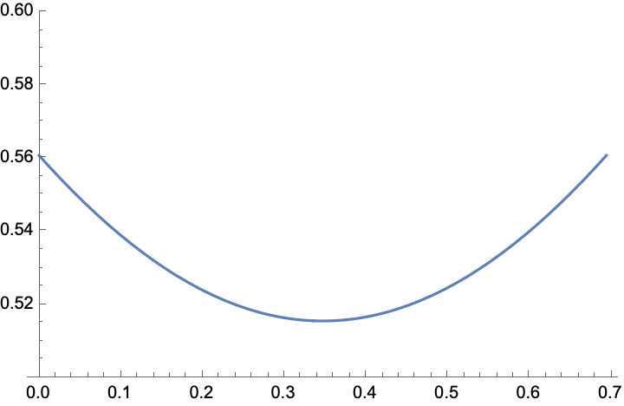
2-mirror cavity
216MHz ←→ 1.3889m ←→~70cm in between 2 mirrors
  It fits inside the Kbox I think
Planar-spherical geometry with ThomX sphere is stable
Spherical-spherical with ThomX mirrors also
w(z) [mm]
P-S
S-S
z

Slide 5
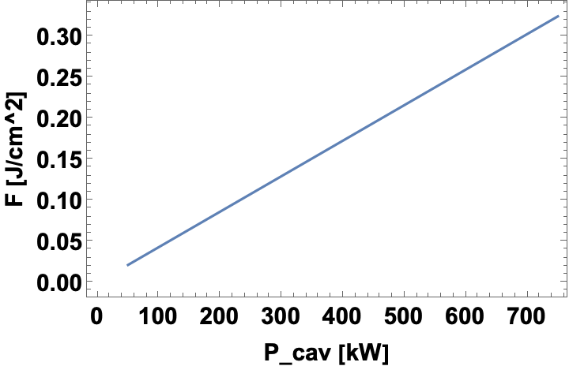
Finesse
P-S:
  F0=45530; G0=25205;
  →750kW (theoretically) good margin for high power
S-S: F0=340000;G0=17000;
  Ultimate finesse test but less power will be stored
  Interesting to try for the fun + public related to very high finesse in pulsed regime with CEP tuning ? Can see how it behaves ?
  We could also see at high average power the effect of thermal lens while going through ULE for the input mirror.

Slide 6
A proposal for discussion
2 mirror cavity
Try first high power → power record ? A nice paper but have to manage the deformation of the mirrors…)
Try very high finesse → paper more difficult to sell (FP cavity locking on Erbium)
Planning of presence in optical room ?
Things to do for ThomX:
  No e-beam in august

