Slide 1
Cleaning of M2 using Ethanol + pure water to increase Finesse
Cleaned M2 using Acetone and ethanol then pure water on the spincoater

Slide 2
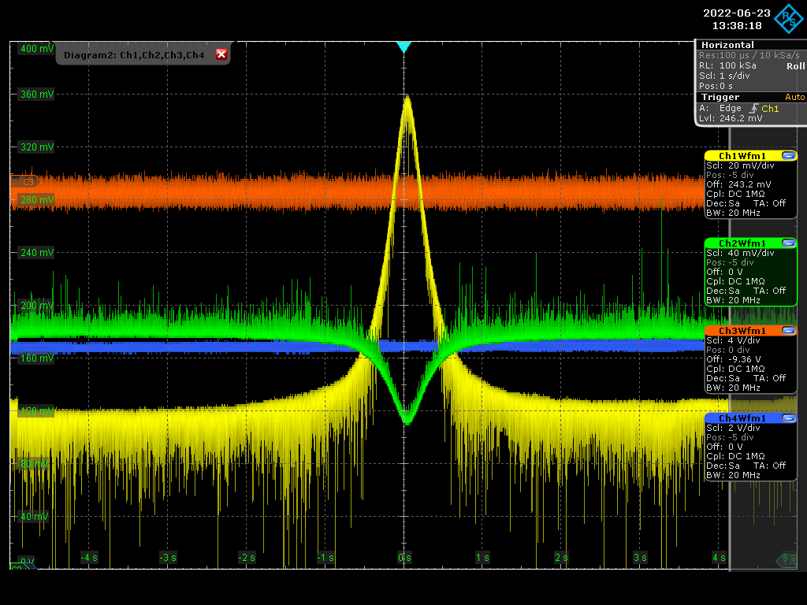
Finesse Measurement using CW
Sweep time 10 seconds
From 216.550 – 216.750 MHz
FSR =~ 216.64
Yellow: transmission
Green: Reflection
Red: Error Signal
Blue: Piezo feedback Voltage

Slide 3
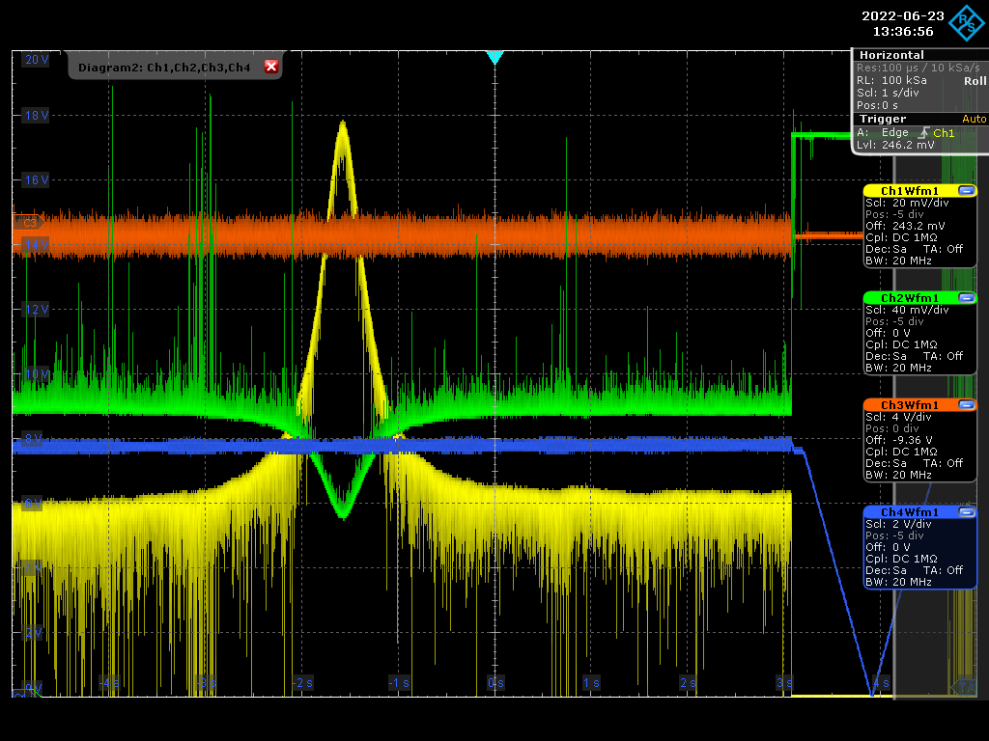
Finesse Measurement using CW
Showing the time sweep for finesse measurement
The coupling
The lock and delock regions
Yellow: transmission
Green: Reflection
Red: Error Signal
Blue: Piezo feedback Voltage

Slide 4
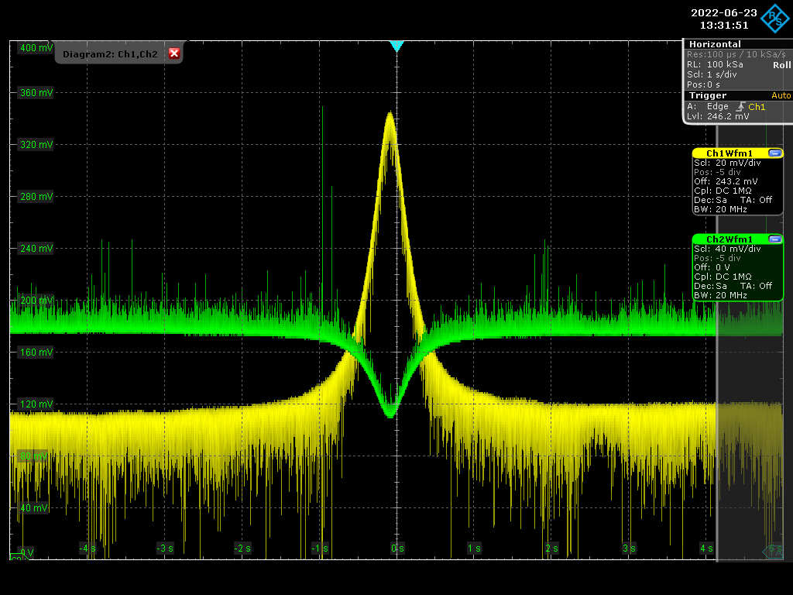
Finesse Measurement using CW
Yellow: transmission
Green: Reflection

Slide 5
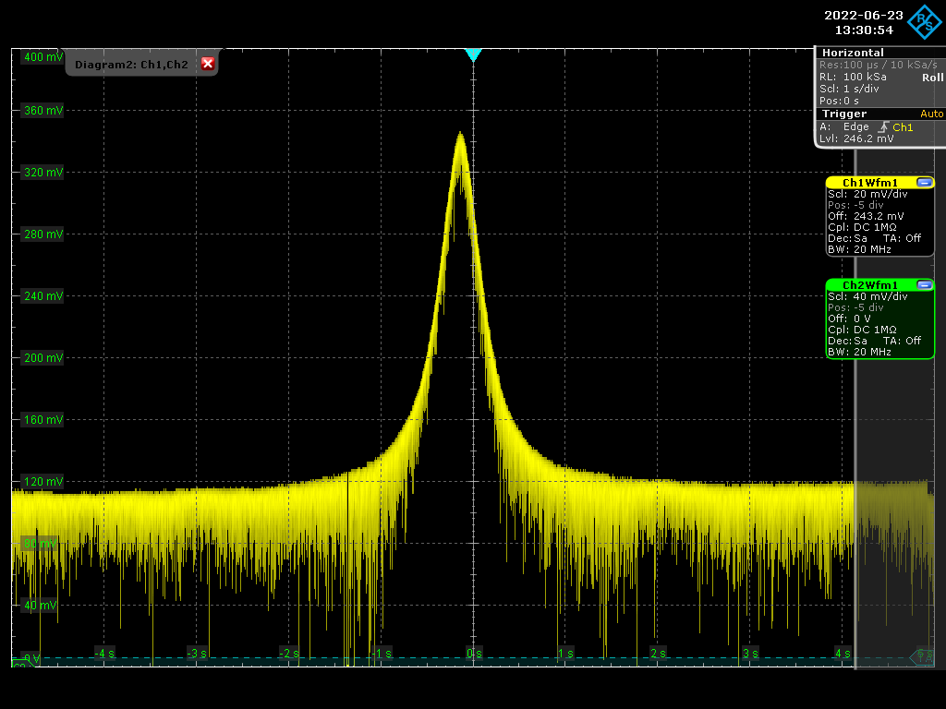
Finesse Measurement using CW
FWHM (KHz) = 11.3063
Finesse = 19162.7831
FWHM (KHz) = 11.1739
Finesse = 19389.753
FWHM (KHz) = 11.2574
Finesse = 19245.9256
FWHM (KHz) = 11.1554
Finesse = 19422.0206
Finesse Average = 19247.064
FWHM (KHz) = 11.3943
Finesse = 19014.8391

Slide 6
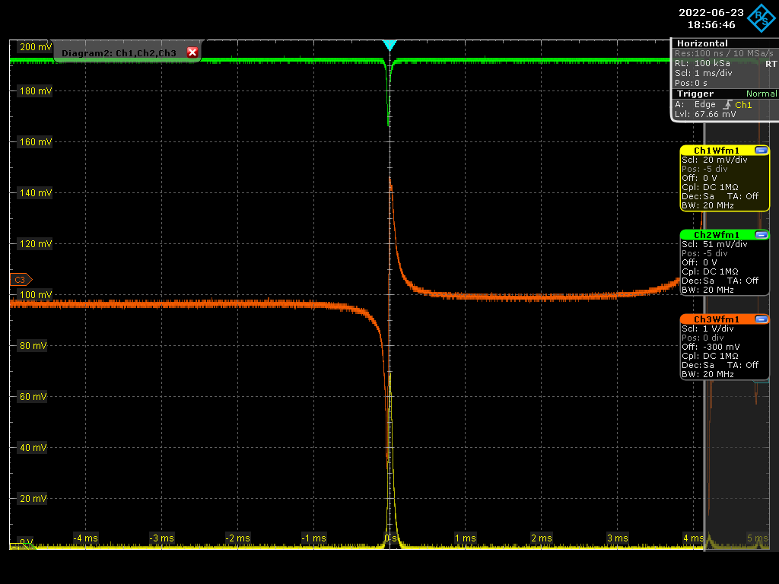
Lock using the MENHIR – Error Signal

Slide 7
Lock using the MENHIR

Slide 8
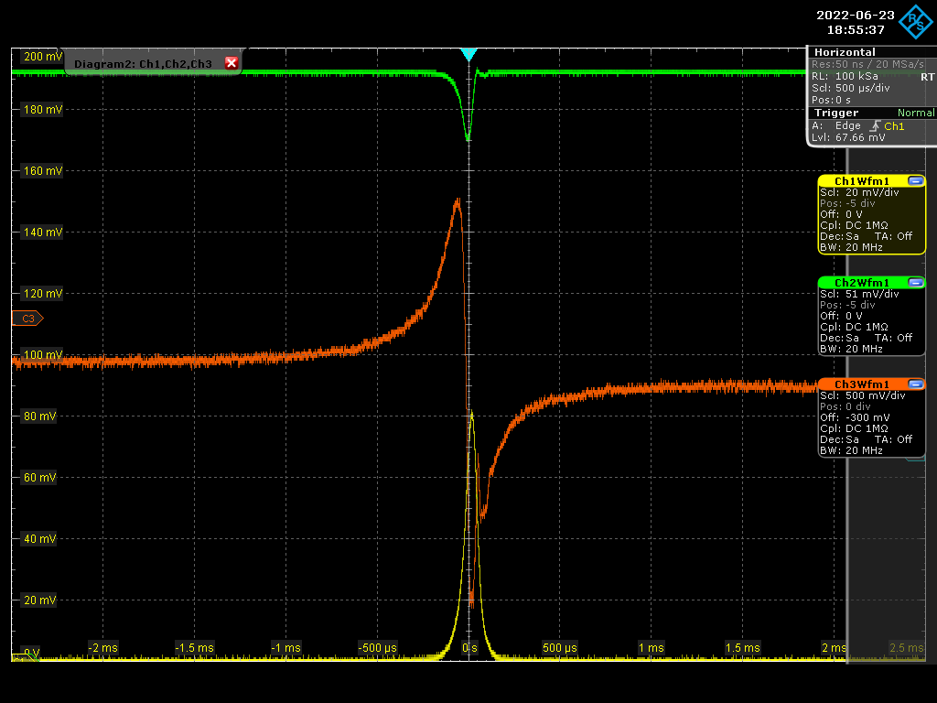
Lock using the MENHIR – Error Signal

Slide 9
Lock using the MENHIR – error signal

