Slide 1
MENHIR Ultrafast Laser
216.66 MHz Lock into
a Bow Tie Optical Cavity Sbox
Manar AMER
ALEA Group

Slide 2
Outline
Introduction to Sbox
Adaptation to MENHIR Frequency
Finesse Measurement
Injection Setup
Measured Data
Laser Lock
Increase of finesse (by Mirror Transmission Changing/Cleaning)

Slide 3
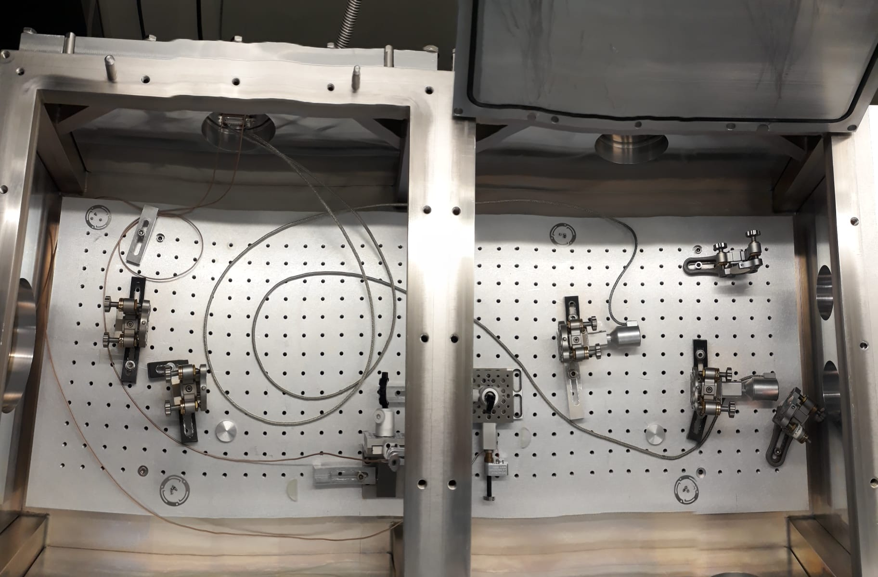
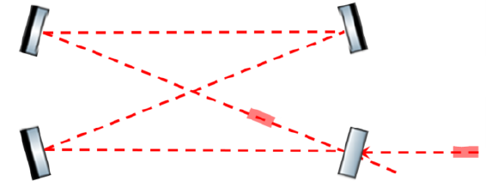
Sbox
A bow – tie optical cavity used for research and development for ThomX* experiment Optical Cavity
Original FSR = 133.33 MHz
M4
M3
Spherical
Spherical
Planar
Planar
M2
M1
Previous Cavity setup
*https://thomx.ijclab.in2p3.fr/

Slide 4
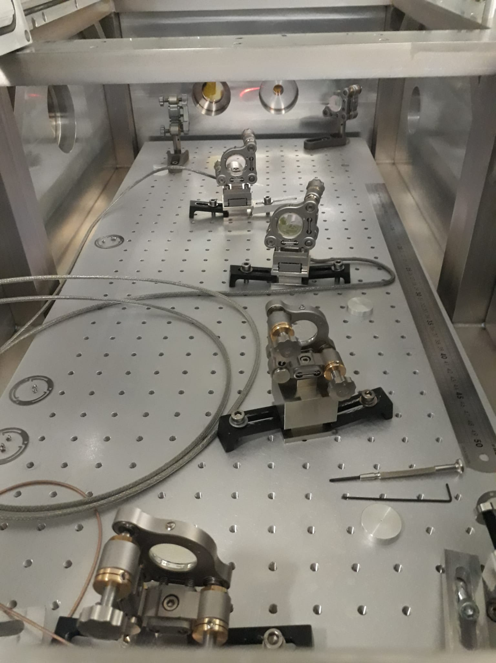
Sbox - Adaptation to MENHIR Frequency
New Setp to match MENHIR Frep
FSR = 216.6625 MHz
Distance Between Spherical Mirrors did not change
  M3-M4 = 620
  M1-M2 = 16.1 (adjusted with motor to match the Frep)

Slide 5


Dimensions of Sbox to lock 216.66 MHz
1010.2 mm
145 mm
518 mm
350 mm
70 mm
69 mm
75 mm
180 mm
320 mm
161 mm
526 mm
55 mm
15 mm

Slide 6



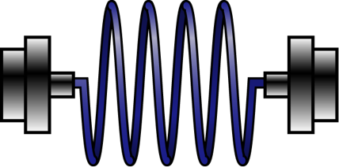

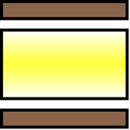







Setup – Finesse Measurement – CW laser
Ma1
S4
S3
PD
60 cm
30 cm
CW Koheras
AOM
EOM2
EOM1
Beam Profiler
~ 40 cm
P2
P1
Iris
$$λ/2$$
Fiber
+ collimator
Ma2
Iris
$$λ/2$$
PDH
diffuser
Photodiode
PD

Slide 7


Setup – Pulsed Laser Injection
Ma1
S4
S3
PD
60 cm
30 cm
Beam Profiler
EOM1
~ 40 cm
P2
P1
Iris
$$λ/2$$
Fiber
+ collimator
Fiber
Isolator
Ma2
Iris
Pulsed
MENHIR
$$λ/2$$
PDH
diffuser
Photodiode
PD

Slide 8
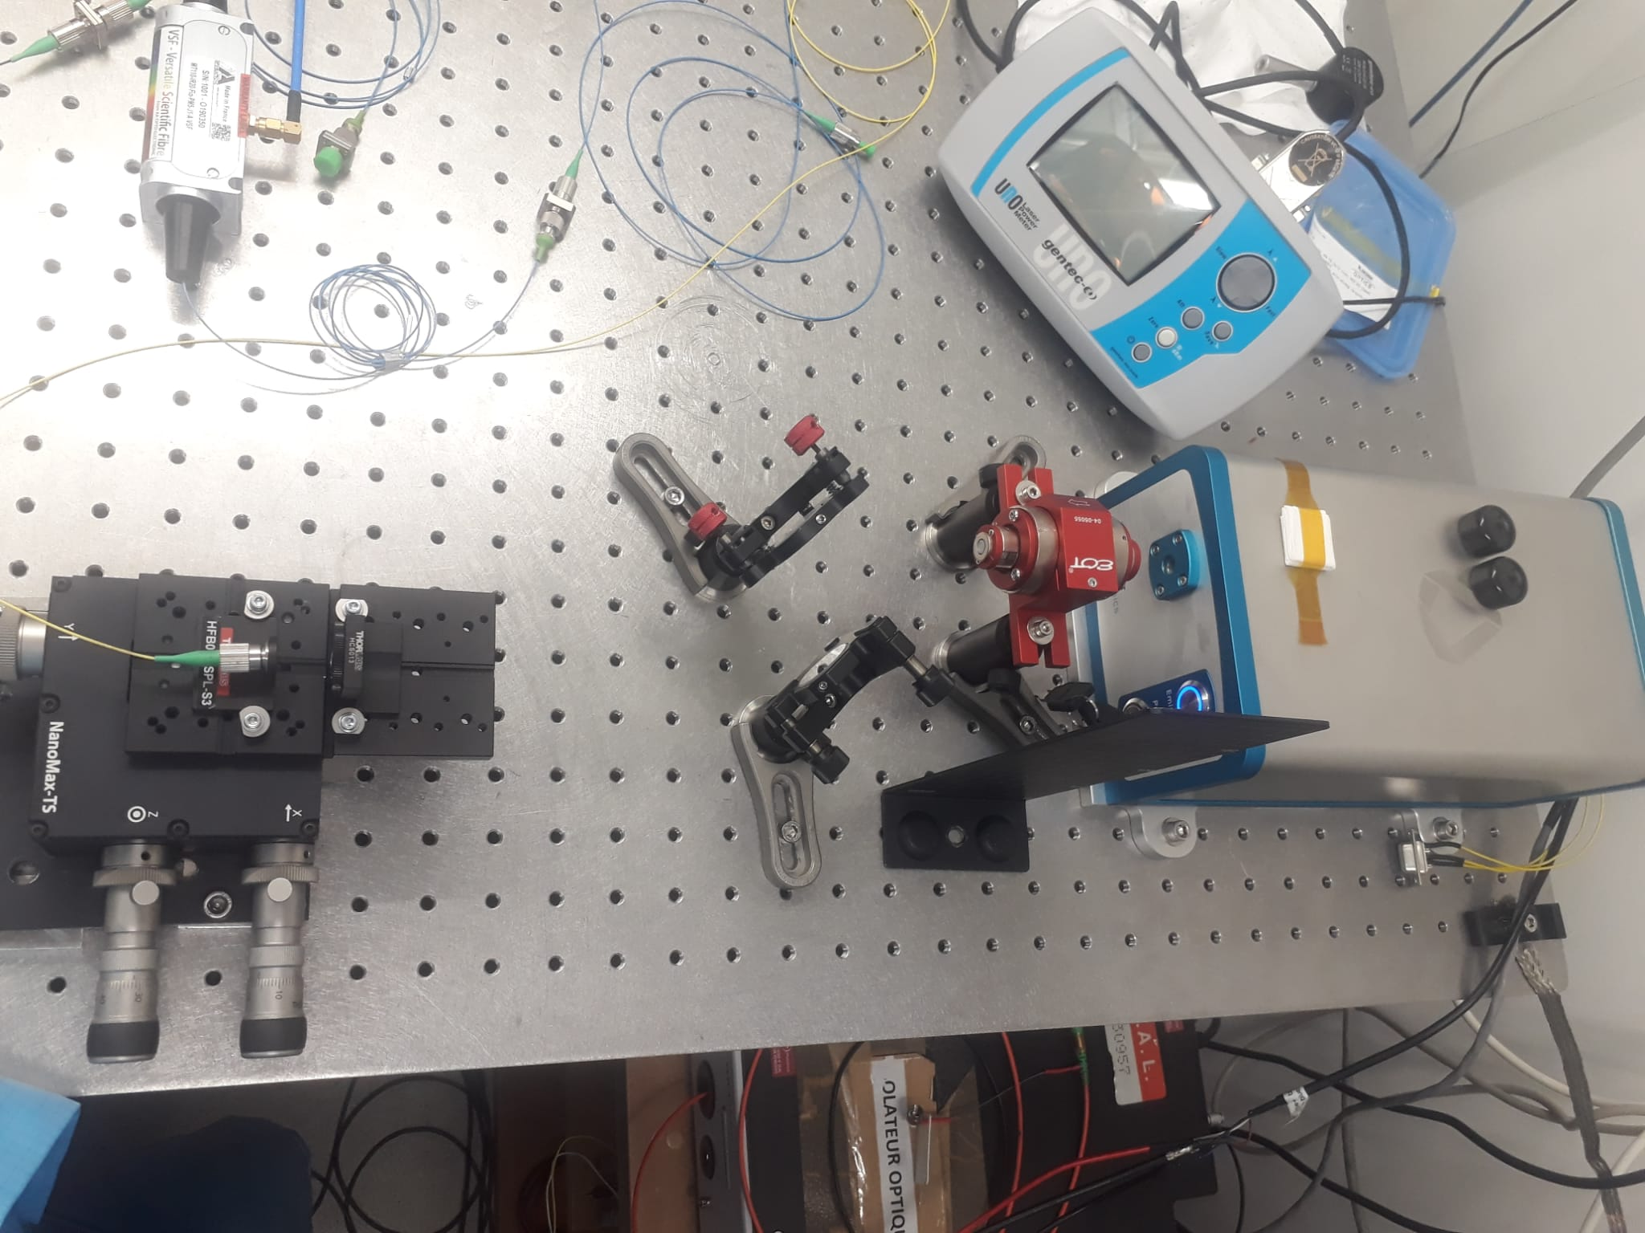
Injection of Pulsed Laser into Finber
Fiber
Isolator
Pulsed
MENHIR

Slide 9
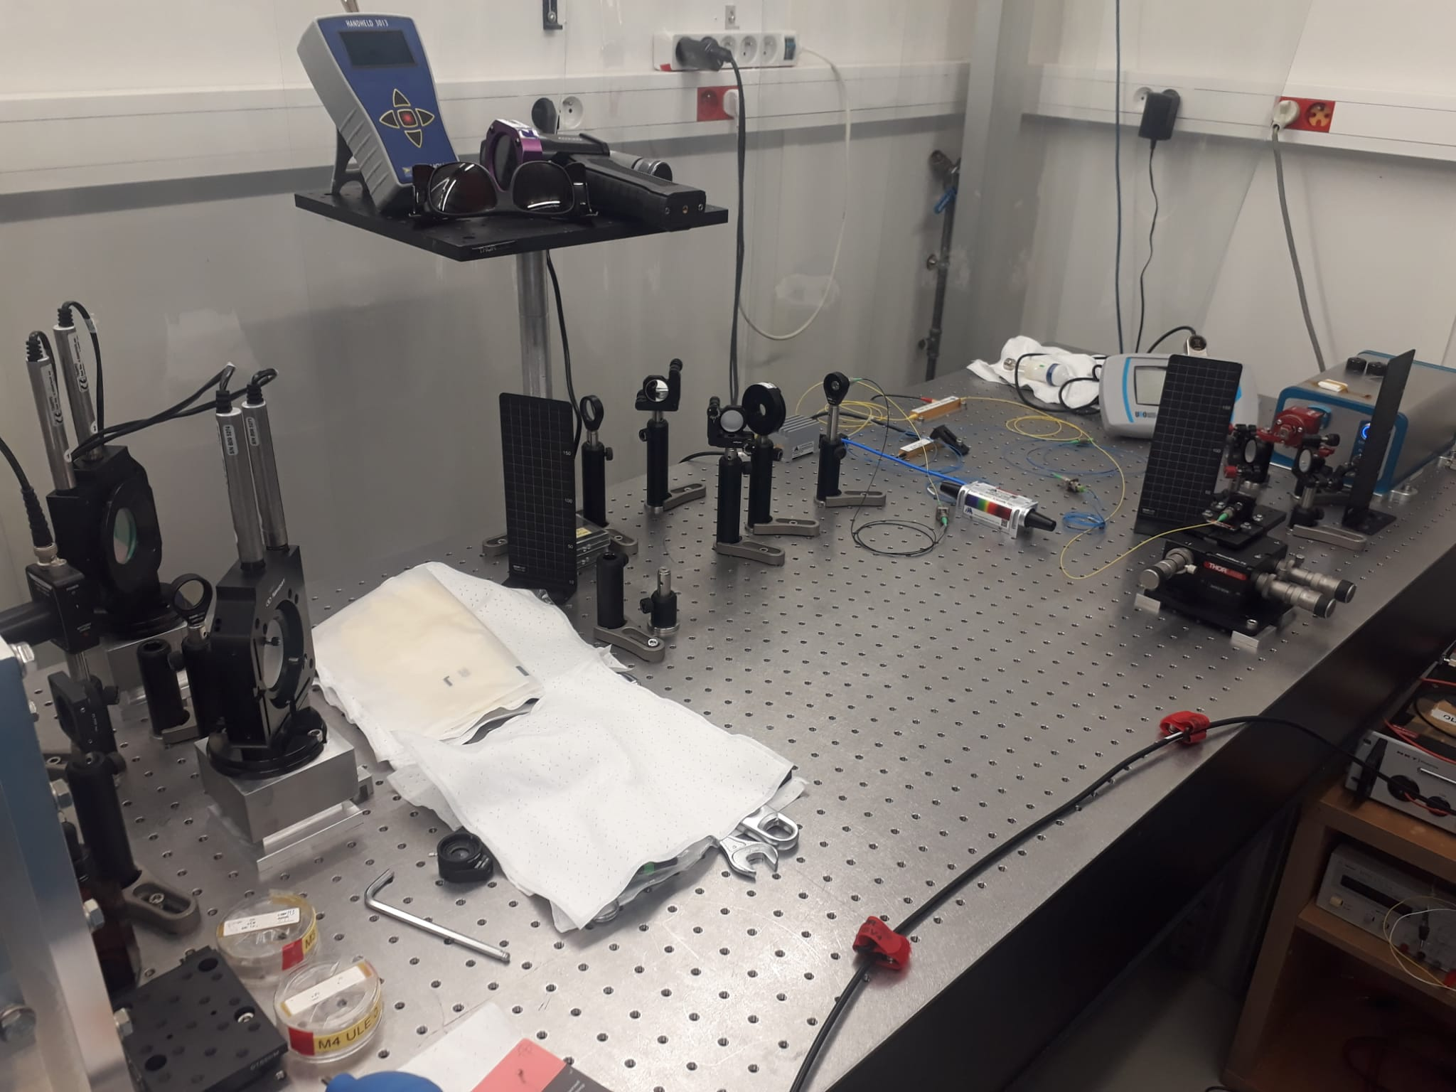
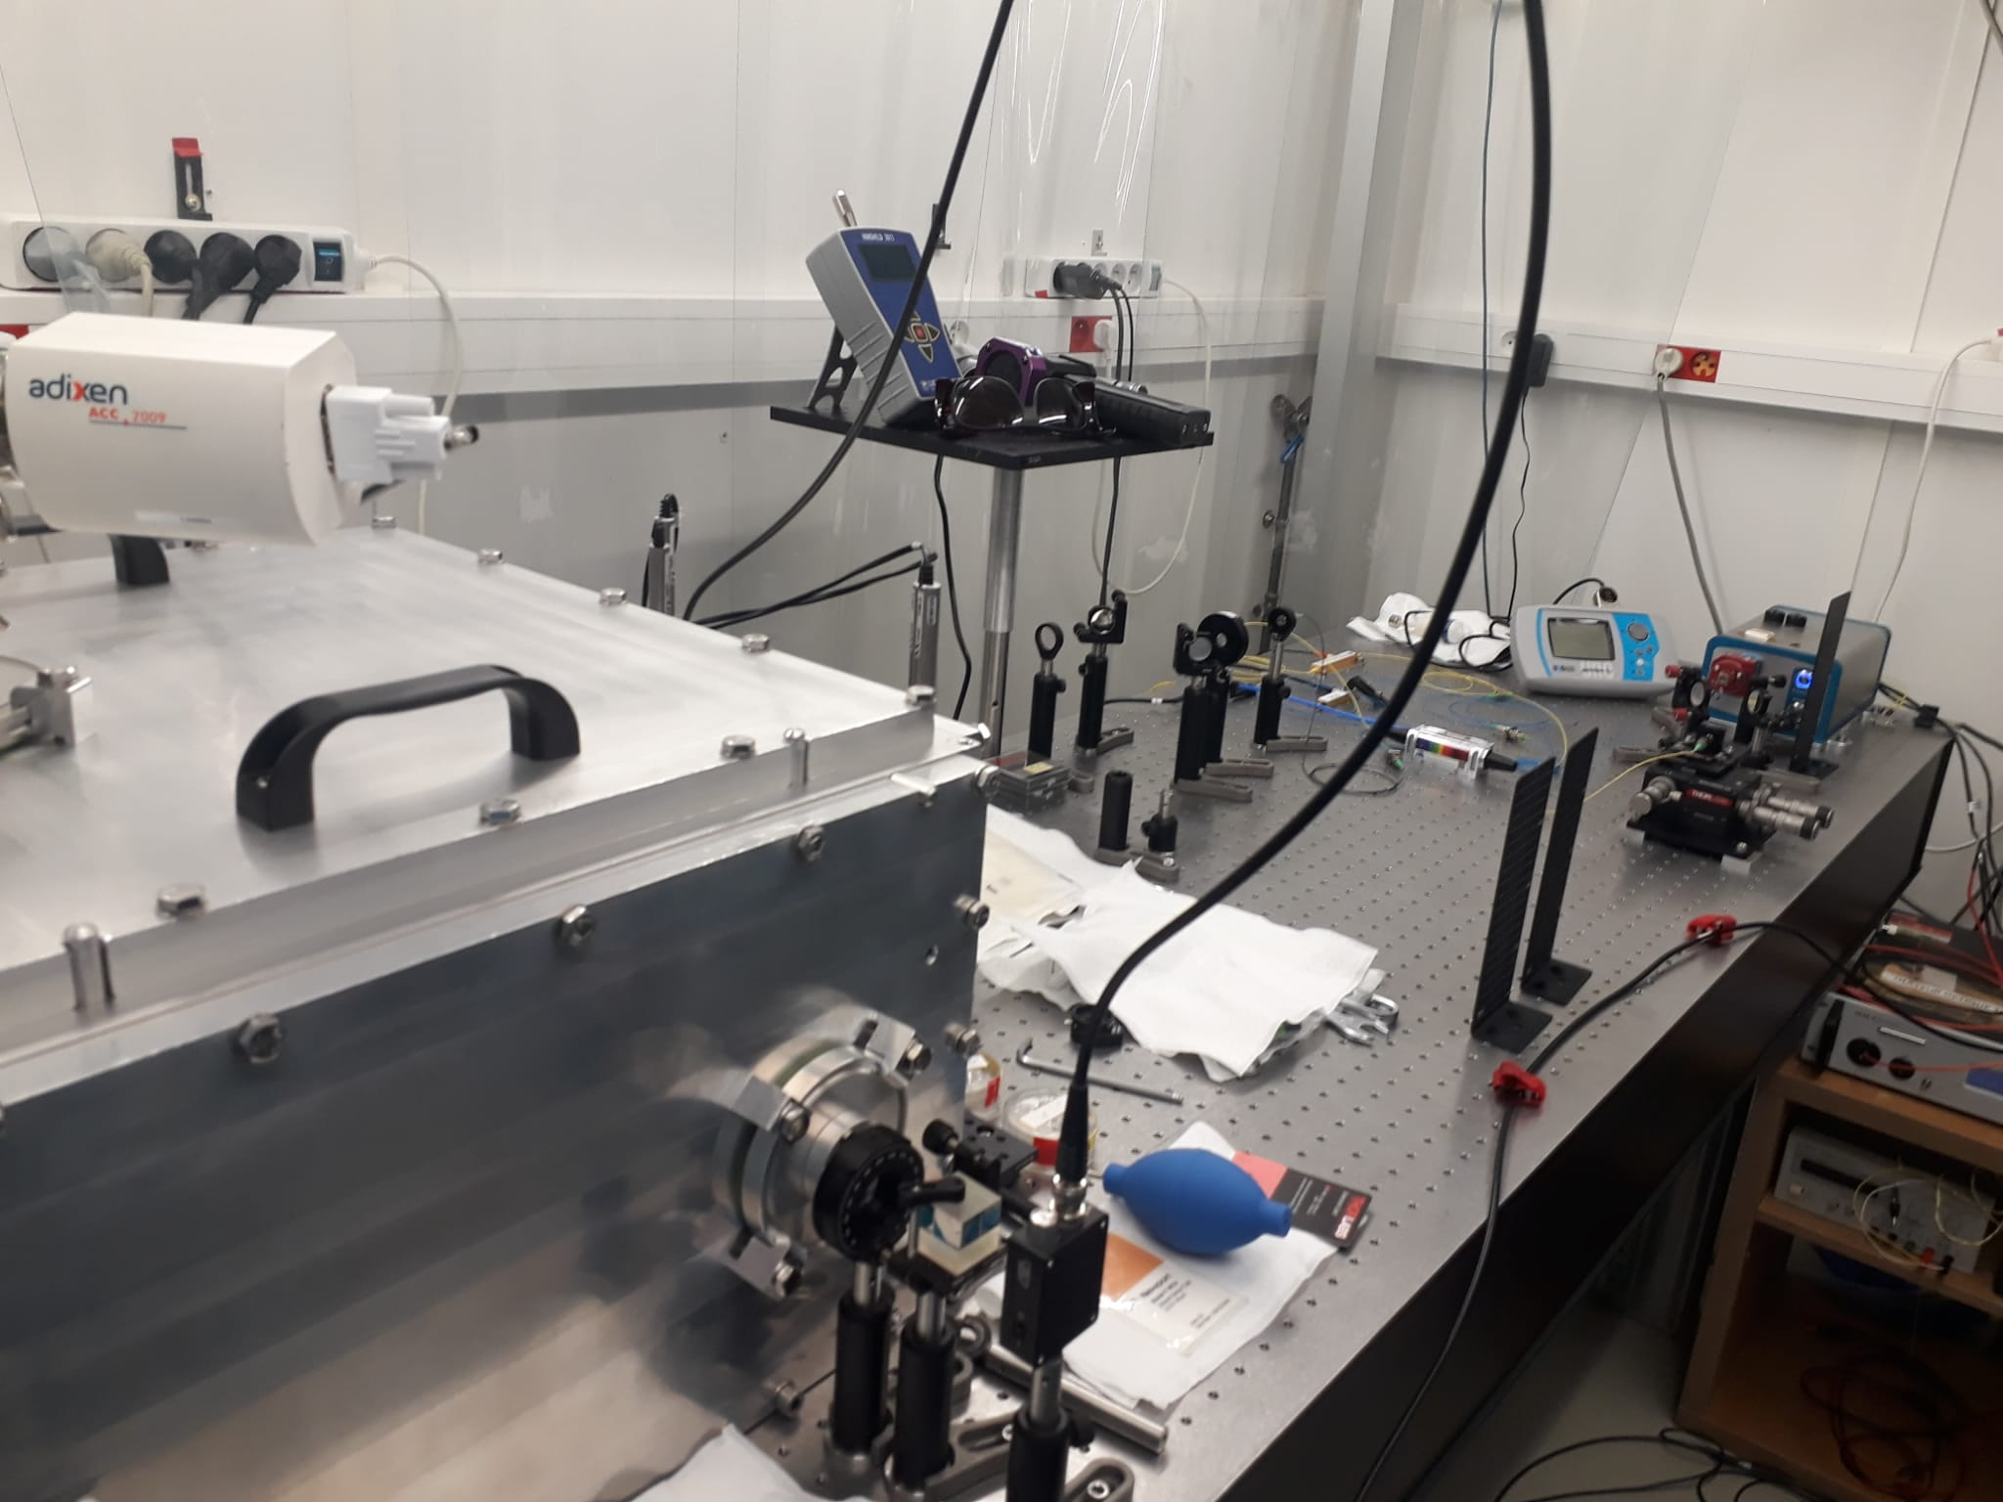
Optical Table Setup
here

Slide 10
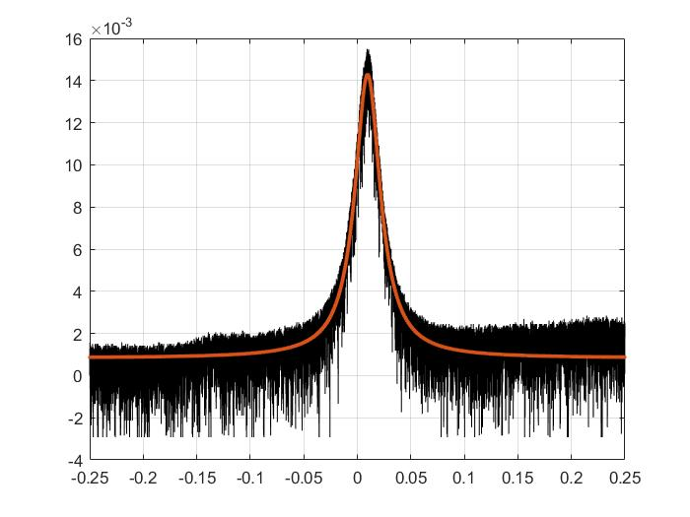
Finesse Measurement – using CW laser
Sweep time = 1 sec
Range = 3 MHz
FWHM = 86.44 KHz
Finesse = 2506.4706

Slide 11
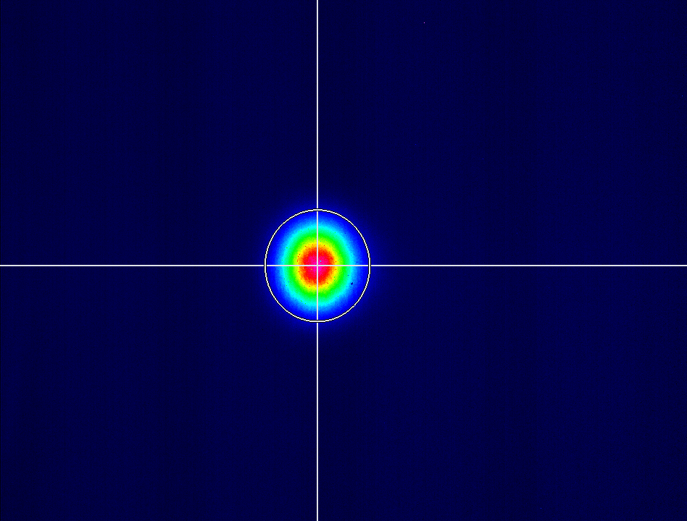
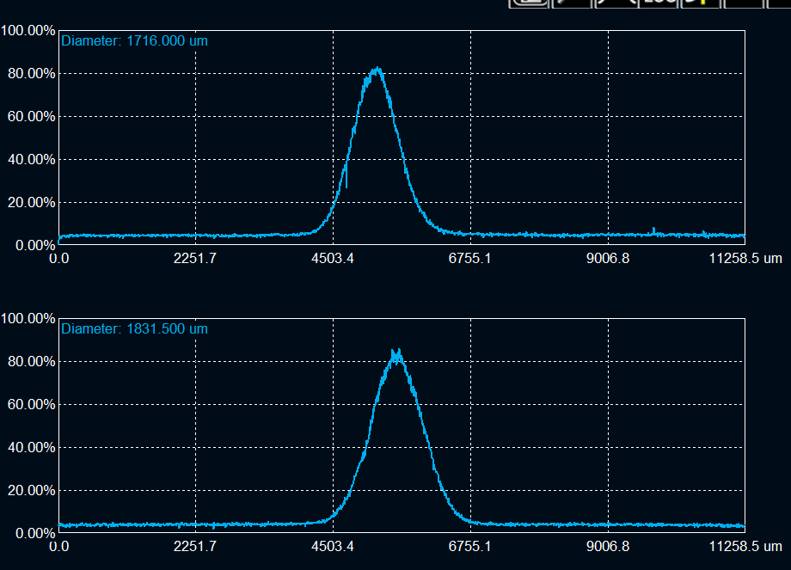
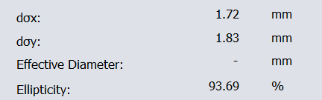
Fundamental Mode at Transmission
Locking of the MEHNIR Laser
Cavity under pressure 9.5*10-2 mbar
cavity FSR ~ 216.66 MHz
Laser Frep = 216.6625 MHz
Fundamental mode

Slide 12
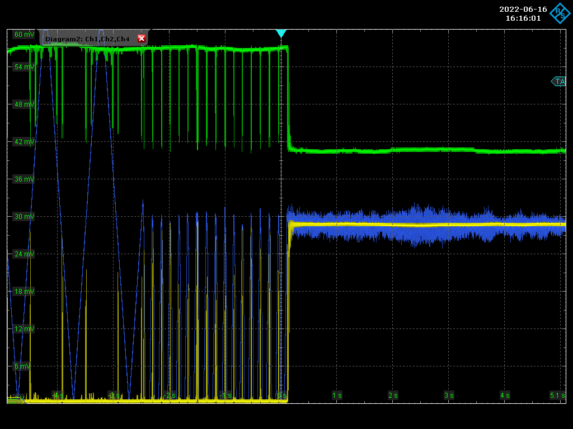
First Lock of MENHIR
The lock is shown for the pulsed laser ,
  where the total divisions on the oscilloscope screen correspond to 100% (The zero is placed at the bottom of the screen)
The coupling between the transmission and reflection ~ 25%
Three regions are shown
  Searching for lock
  Almost locked
  locked laser
Yellow: transmission
Green: Reflection
Blue: Piezo feedback Voltage

Slide 13
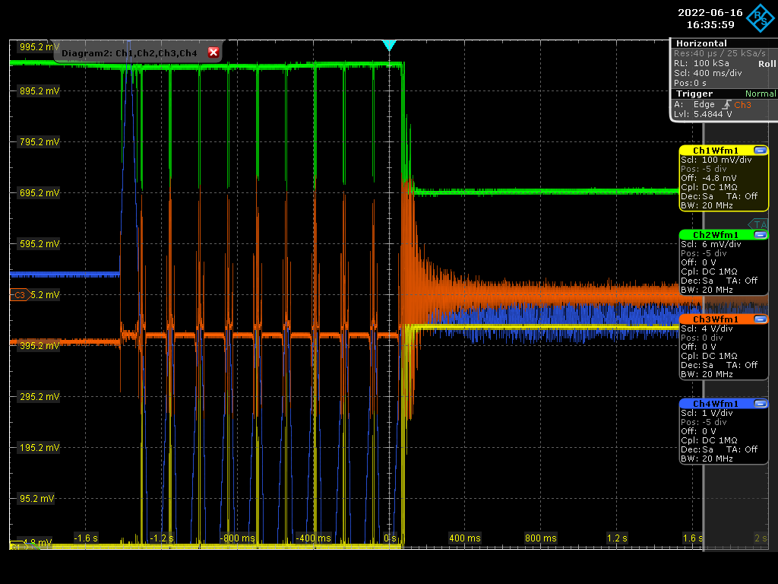
Lock of MENHIR - Error signal
A zoom on the lock that shows the error signal contained in the airy peak before the lock
A note on the error signal that when locked there offset, Not understood yet.
Three regions are shown
  No frequency regulation
  Almost locked
  locked laser
Yellow: transmission
Green: Reflection
Red: Error Signal
Blue: Piezo feedback Voltage

Slide 14
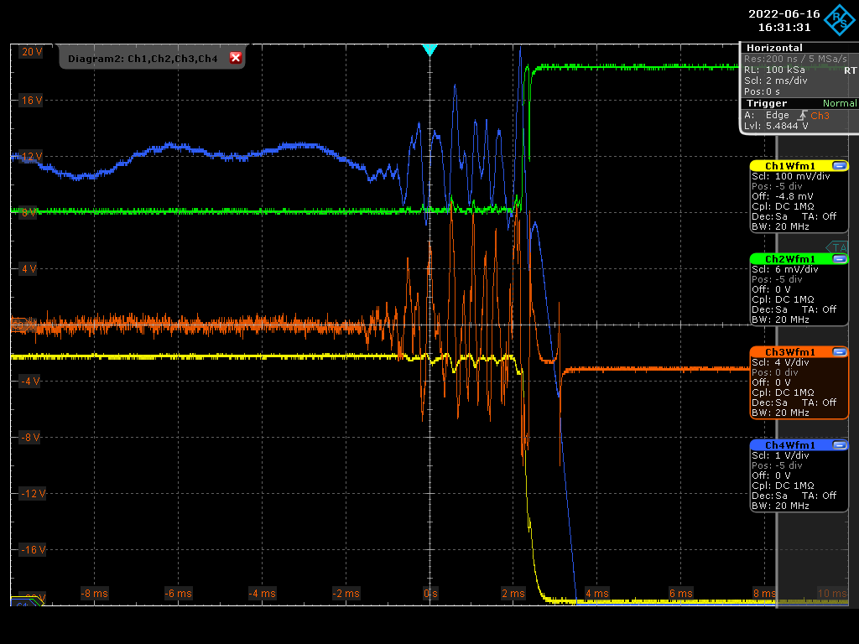
Lock of MENHIR - Error signal
The lock is shown for the pulsed laser
A closer zoom on the lock showing the
The blue signal correspond to the feedback voltage compensation on the piezo
  first region locked (Oscillation comping from outside noise compensation)
  Second , disturbance in lock
  Third , regulation signal is off
The red signal shows the clean error signal at the crossing point between lock and no lock
Yellow: transmission
Green: Reflection
Red: Error Signal
Blue: Piezo feedback Voltage

Slide 15
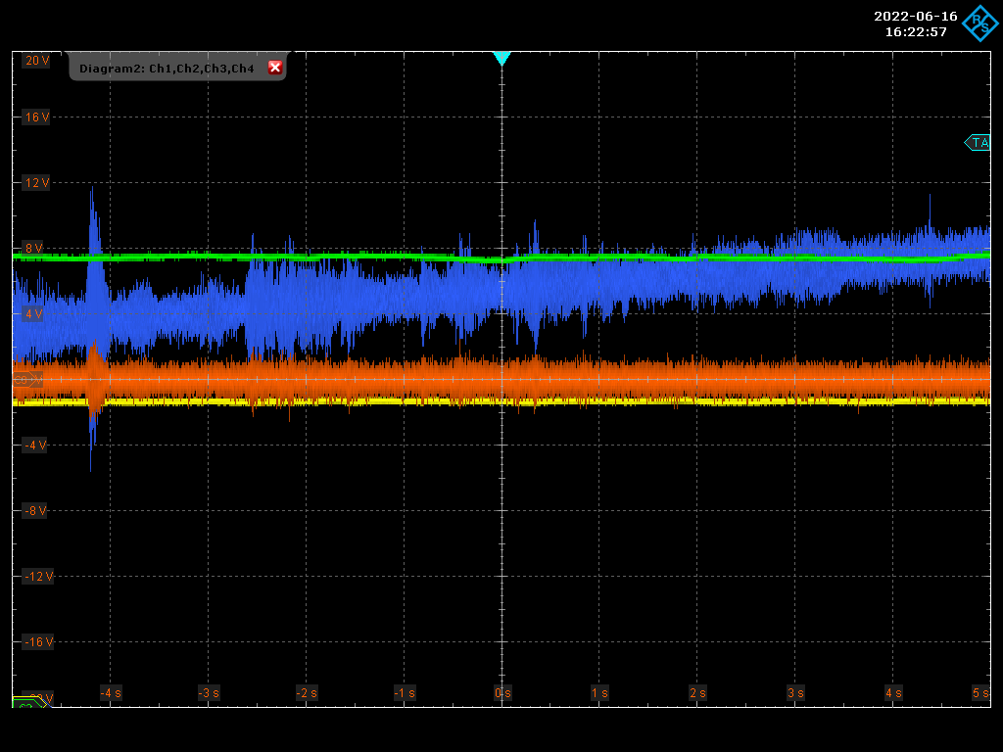
Lock of MENHIR - Piezo Sound Extraction
Vibrations on Blue signal is the compensation for when we where taking near the laser
The change in average value over time could be due to thermal effects
  We have to constantly change it to be kept in the range of the Fundamental mode.
Yellow: transmission
Green: Reflection
Red: Error Signal
Blue: Piezo feedback Voltage

Slide 16
Change of Mirror for Higher Finesse 1
Changed mirror from Transmission 2500 ppm to 500 ppm

Slide 17
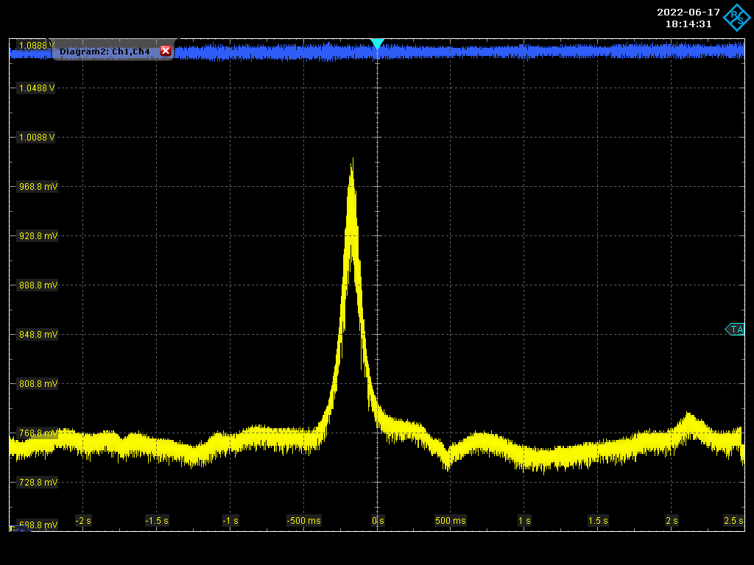
Finesse Measurement – using CW laser
Raw transmission signal shown on the oscilloscope before Finesse extraction
Yellow: transmission
Blue: Piezo feedback Voltage

Slide 18
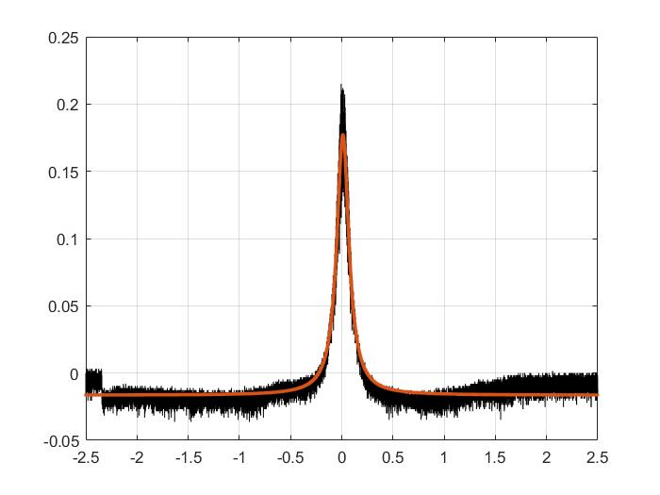
Finesse Measurement – using CW laser
Sweep time = 5 sec
Range = 1 MHz
FWHM = 28.8036 KHz
Finesse = 7521.981

Slide 19
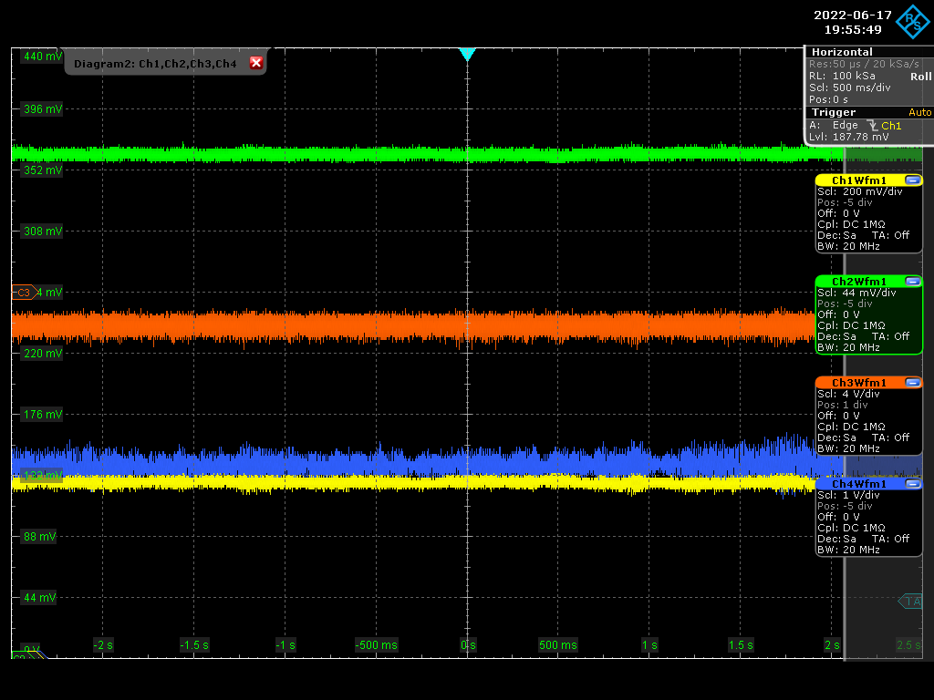
Change of Mirror for Higher Finesse – Lock over time
Yellow: transmission
Green: Reflection
Red: Error Signal
Blue: Piezo feedback Voltage

Slide 20
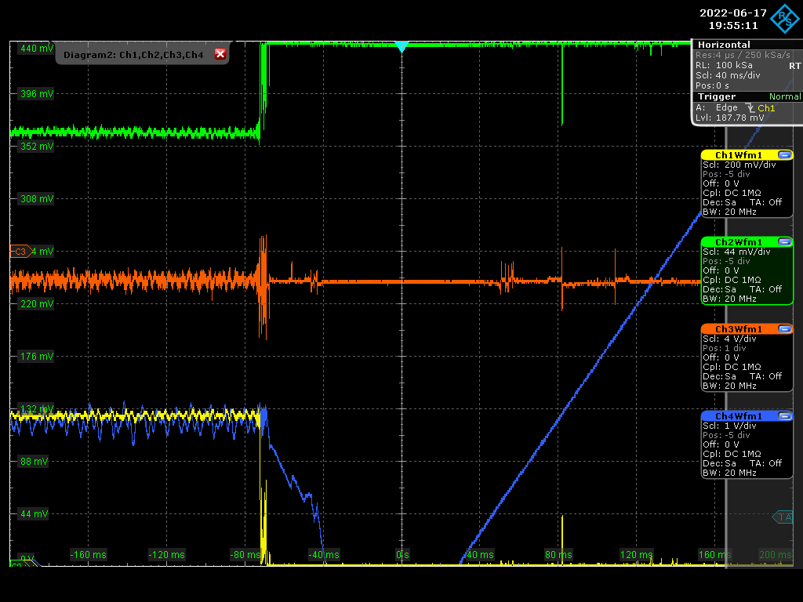
Change of Mirror for Higher Finesse – Lock Error signal
The coupling between the transmission and reflection ~ 20%
The error signal at the point were the lock is lost
Yellow: transmission
Green: Reflection
Red: Error Signal
Blue: Piezo feedback Voltage

Slide 21
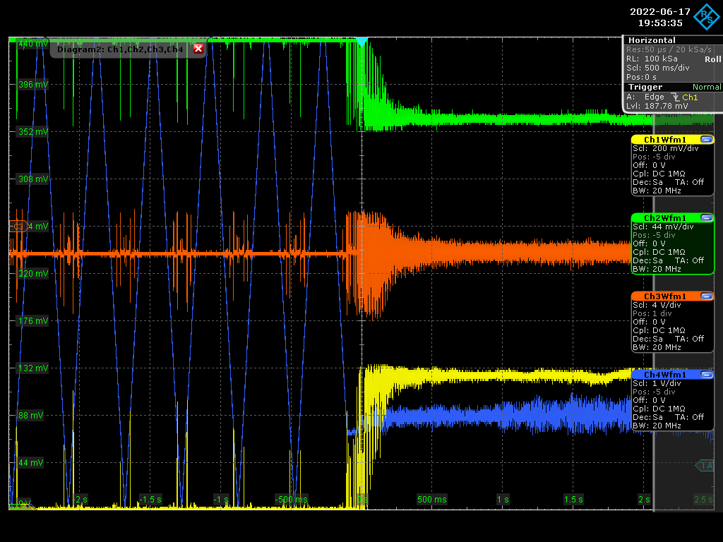
Change of Mirror for Higher Finesse 1 – Lock Error signal
Yellow: transmission
Green: Reflection
Red: Error Signal
Blue: Piezo feedback Voltage

Slide 22
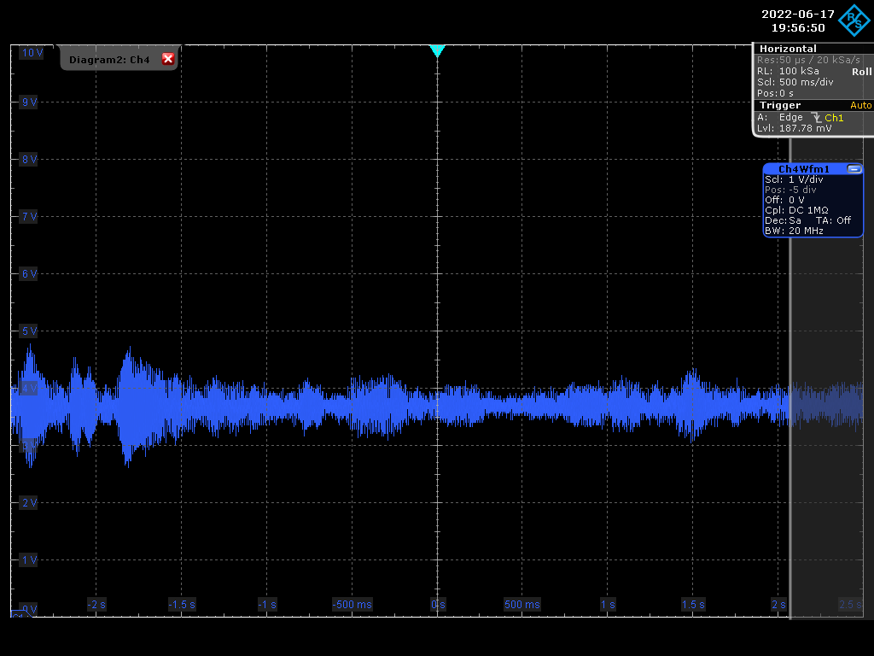
Lock of MENHIR - Piezo Sound Extraction
Vibrations on Blue signal is the compensation for when we where taking near the laser
Blue: Piezo feedback Voltage

Slide 23
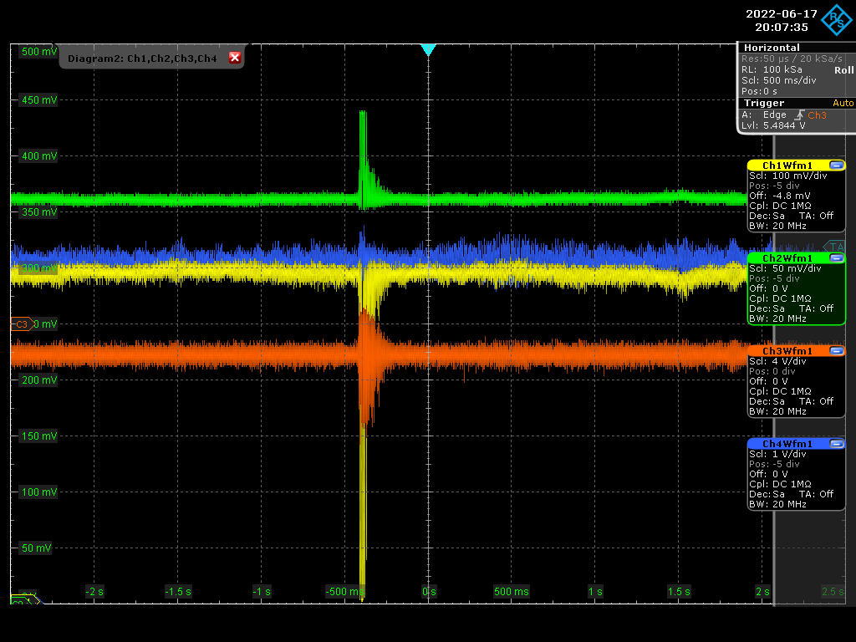
Change of Mirror for Higher Finesse 1 – Clap effect
Clap
Yellow: transmission
Green: Reflection
Red: Error Signal
Blue: Piezo feedback Voltage

Slide 24
Change of Mirror for Higher Finesse 2
Changed mirror from Transmission 500 ppm to 120 ppm , from ThomX mirrors and cleaning of the other 3 mirrors (M3/M4 2 spherical from Sbox, M2 Plan mirror from Sbox spare)

Slide 25
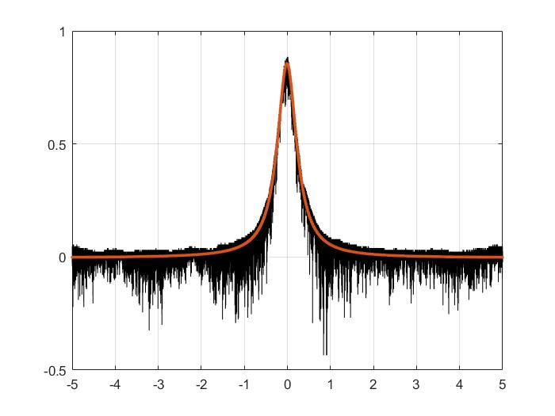
Finesse Measurement – using CW laser
Sweep time = 10 sec
Range = 200 KHz
FWHM = 10.9046 KHz
Finesse = 19868.7469

Slide 26
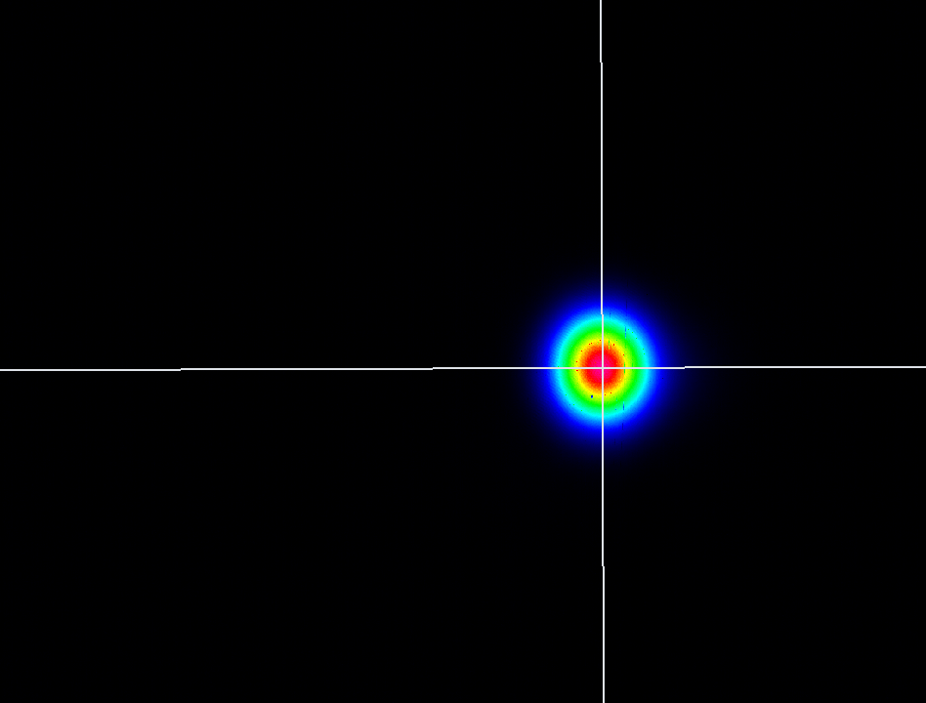
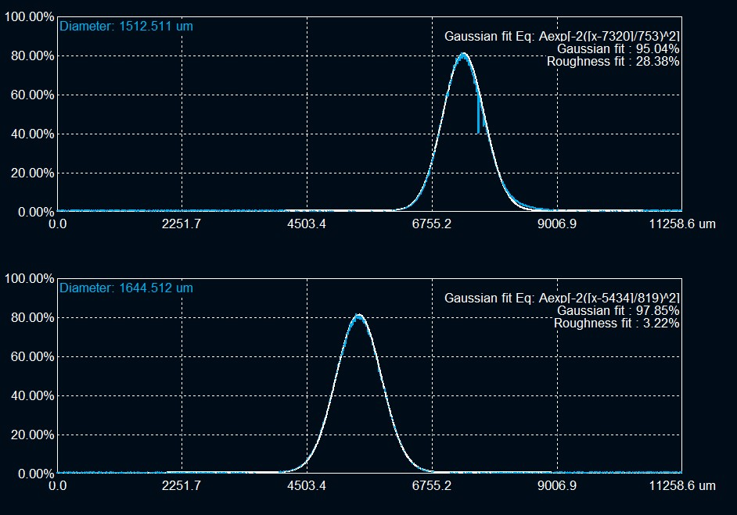
Change of Mirror for Higher Finesse 2 – 00 Mode
Locking of the MEHNIR Laser
Cavity under pressure 1*10-2 mbar
cavity FSR ~ 216.6625 MHz
Fundamental mode

Slide 27
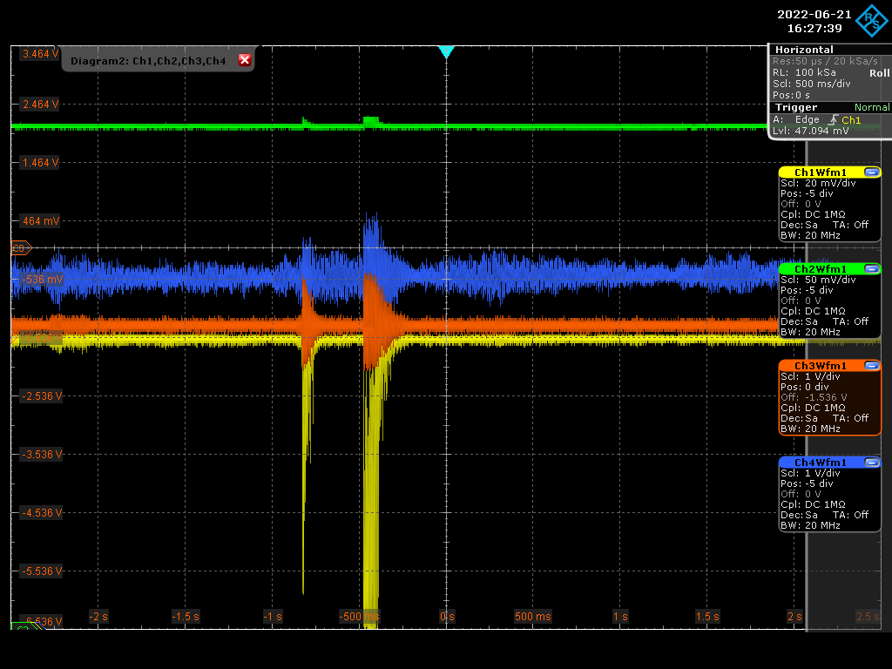
Change of Mirror for Higher Finesse 2 – Clap effect
The effect seen in the middle of the lock is a clap where the lock is able to almost instantaneously come back from it and not lose the lock.
the coupling for the pulsed laser in comparison to the CW laser (~ 50 %) is very low
  One of the reasons could be the Carrier Phase Envelop (CEP) of the laser!
Yellow: transmission
Green: Reflection
Red: Error Signal
Blue: Piezo feedback Voltage

Slide 28
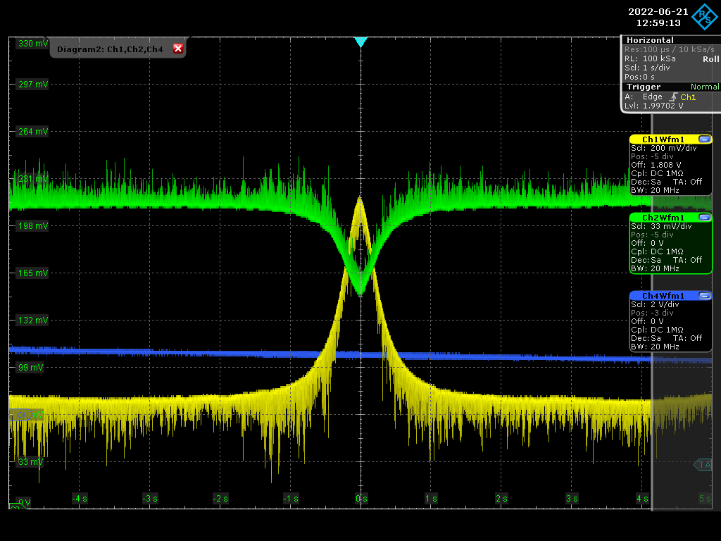
Change of Mirror for Higher Finesse 2
Transmission and Reflection Airy Peaks
Yellow: transmission
Green: Reflection

Slide 29
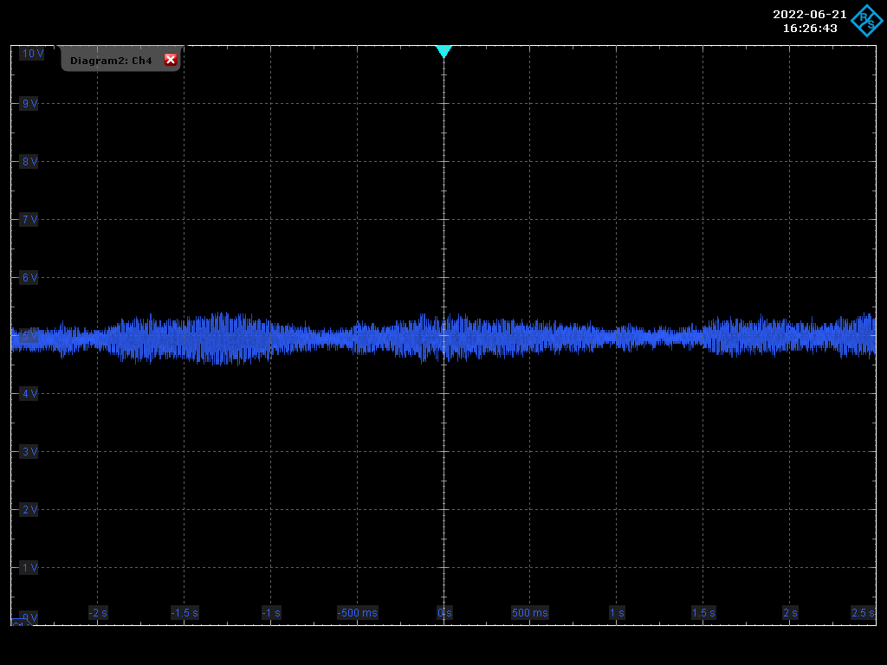
Change of Mirror for Higher Finesse 2
Vibrations on Blue signal is the compensation for when we where taking near the laser
Blue: Piezo feedback Voltage

Slide 30
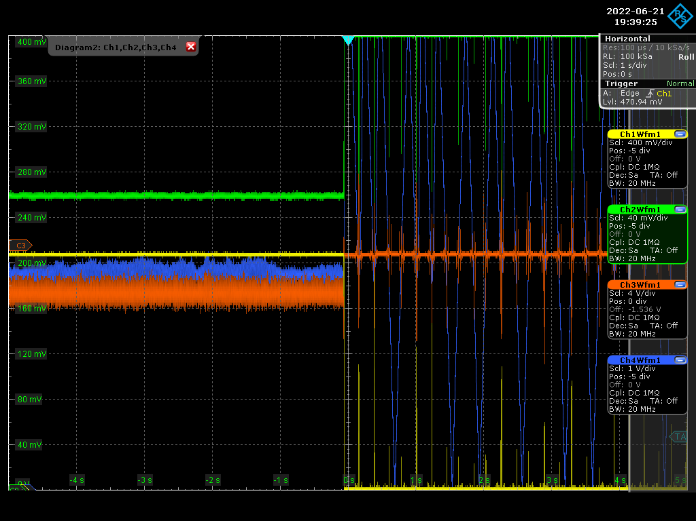
Change of Mirror for Higher Finesse 2
Change in the coupling due to a change on the Carrier Phase Envelop of the Pulsed laser
  We clearly see an increase in the coupling to ~ 35 %
Yellow: transmission
Green: Reflection
Red: Error Signal
Blue: Piezo feedback Voltage

