Slide 1
Images of Sbox Mirrors before and after cleaning
09/05/2022

Slide 2
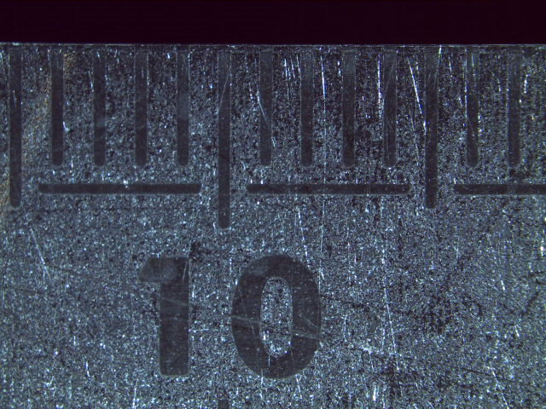
Calibration image

Slide 3
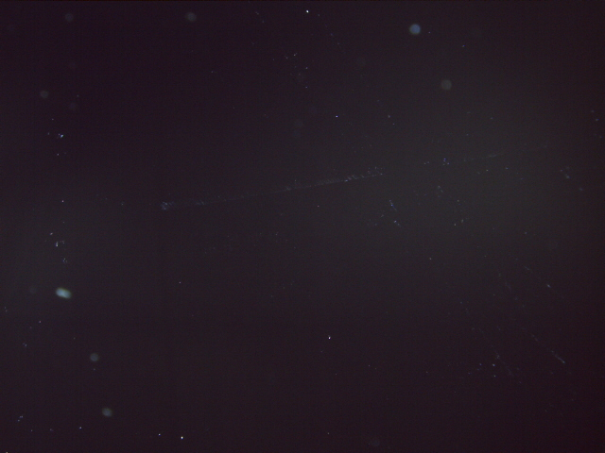
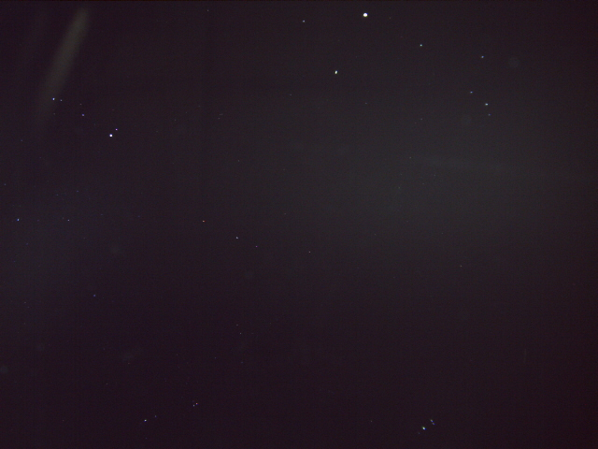
M2 before cleaning
Back
Front

Slide 4

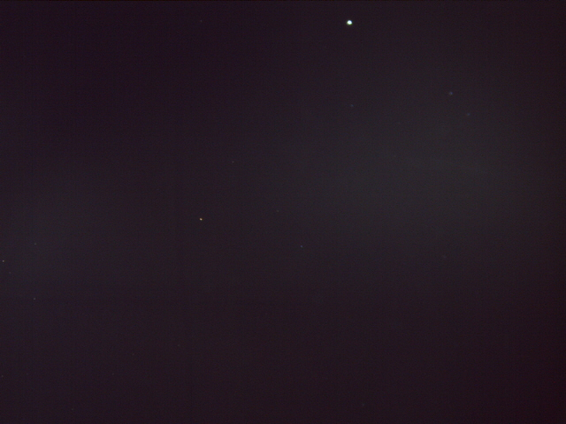
M2 after cleaning
Back
Front

Slide 5
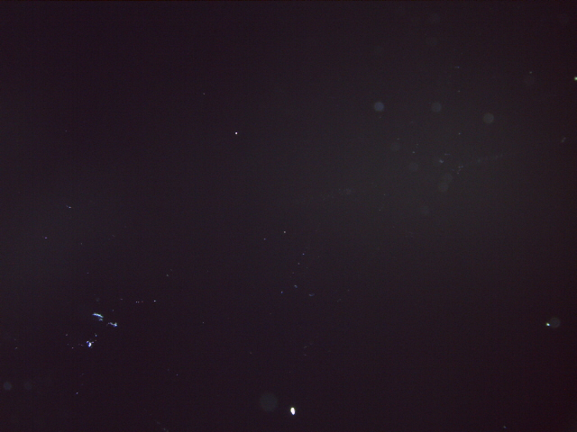
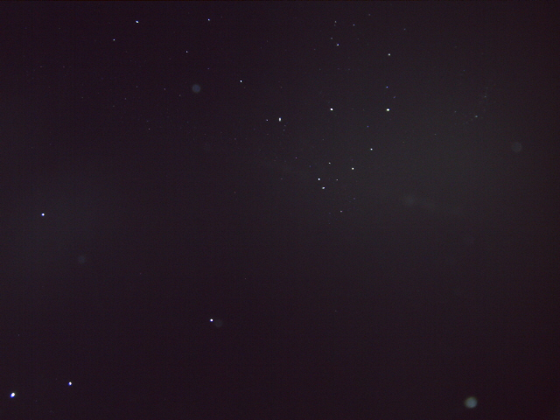
M3 before cleaning
Back
Front

Slide 6
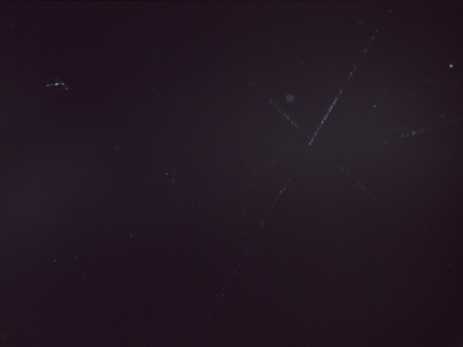
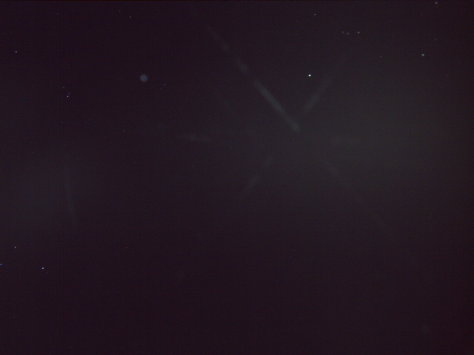
M3 after cleaning
Back
Front

Slide 7
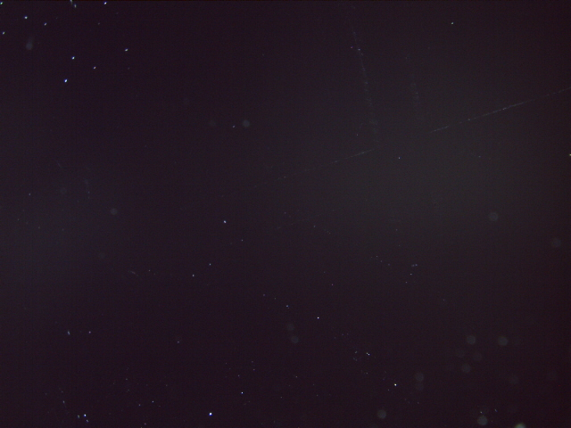
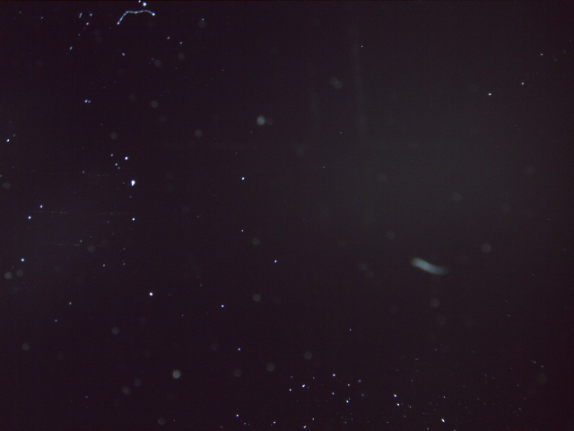
M4 before cleaning
Back
Front

Slide 8


M4 after cleaning
Back
Front

Slide 9

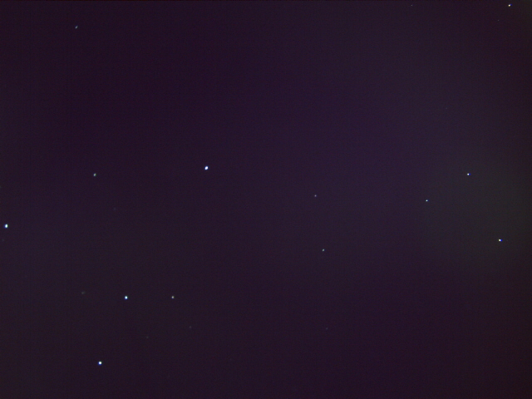
M1 Gamma Factory before cleaning
Back
Front

Slide 10


M1 Gamma Factory after cleaning
Back
Front

