Slide 1
Images of Sbox Mirrors before and after cleaning
27/04/2022
Note the lighting on M2 at the start was not proper which showed glowing of the dust under the surface !!!
To be checked the best way to take images

Slide 2
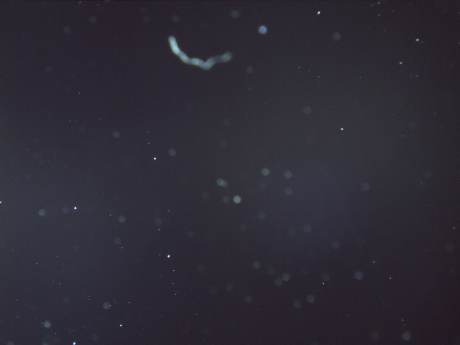
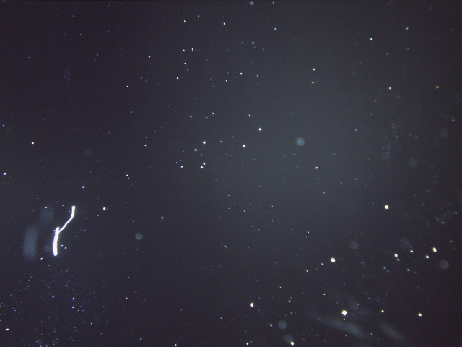
M2 before cleaning
Back
Front

Slide 3
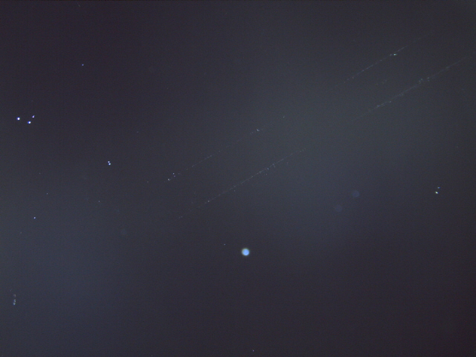
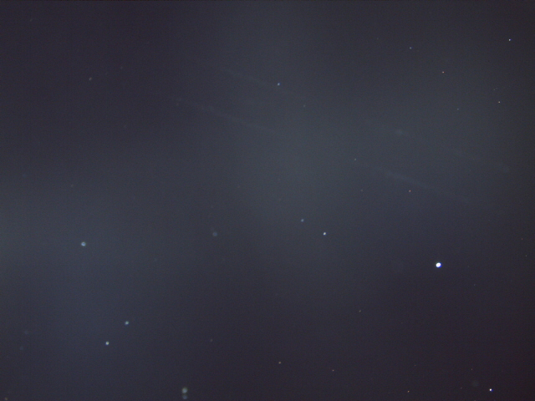
M2 after cleaning
Back
Front

Slide 4
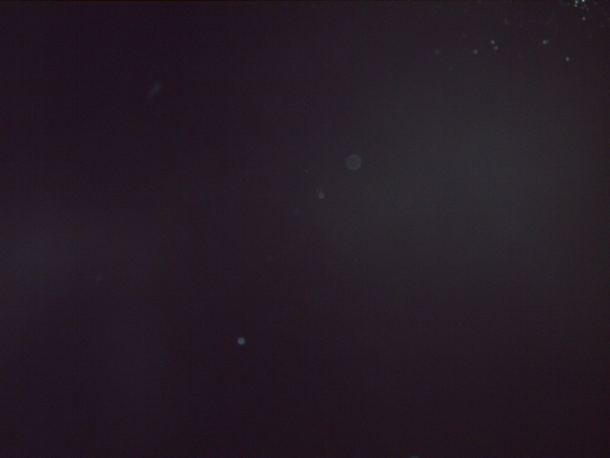
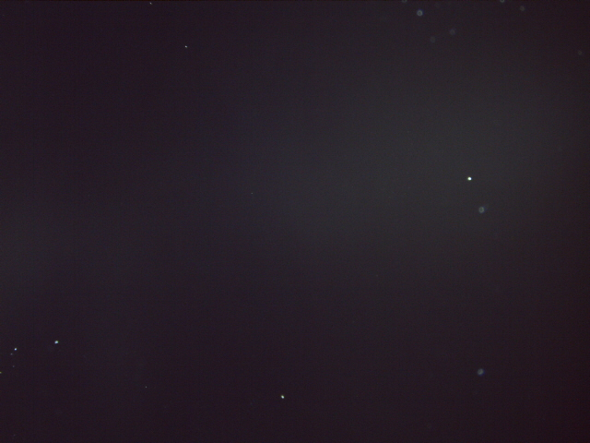
M3 before cleaning
Back
Front

Slide 5
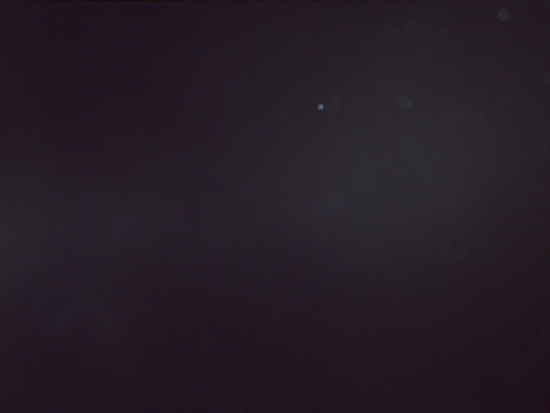

M3 after cleaning
Back
Front

Slide 6
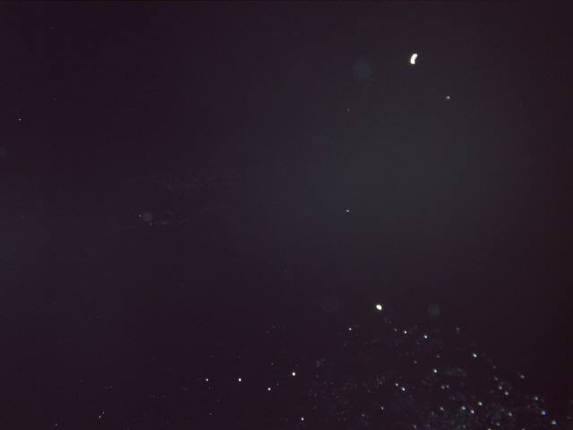
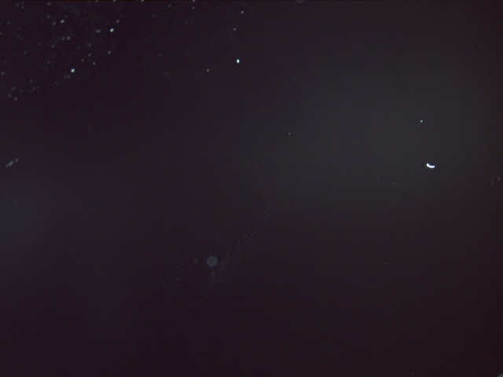
M4 before cleaning
Back
Front

Slide 7
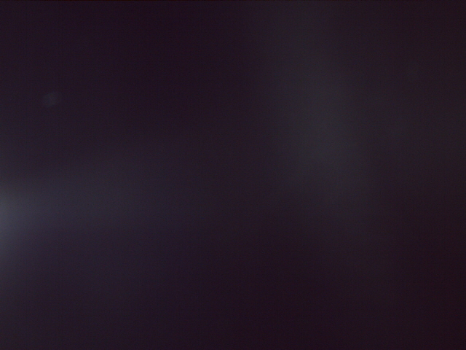

M4 after cleaning
Back
Front

