Slide 1
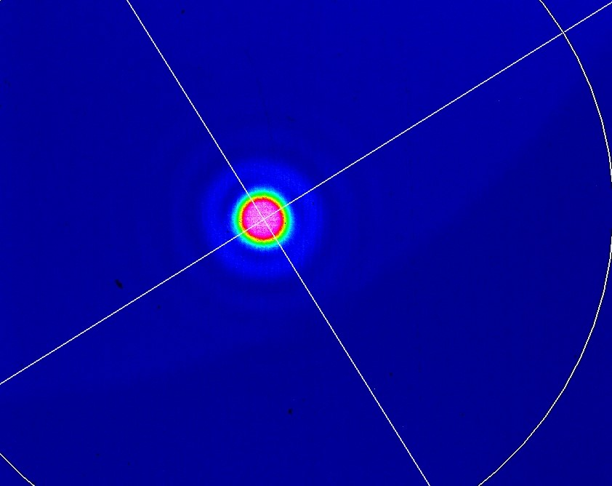
27/04/2022
Thursday "M2 here is from Sbox, will change to Gamma factory tomorrow“
  Removed the Iris placed after M2 window , only kept the one before M1 window
  M1 was placed from yesterday, we align it using diffraction passing through M4
Since we will do the alignment with M1 placed from the start we need to align it to M4 which will be difficult at the end, so we introduce a new reflected line just behind M2 window we let it pass through the pinhole of M2 on the way back , hit M1 and then reflect toward M4 , we align it though the M2 pinhole by looking at its diffraction image on the beam profiler
Using that reflection we adjust M1 mount to have it pass through M4 pinhole , we adjust it the same using diffraction patterns
M2 out of box took images before and after cleaning and placed in M2 mount
M2 alignment
Placing an iris on M3 mirror and a beam viewer just behind it's window, adjust the axis on M2 mount and observe the diffraction patters from M3 pinhole.
Took Image
Image between pinhole and beam profiler
50 cm

Slide 2
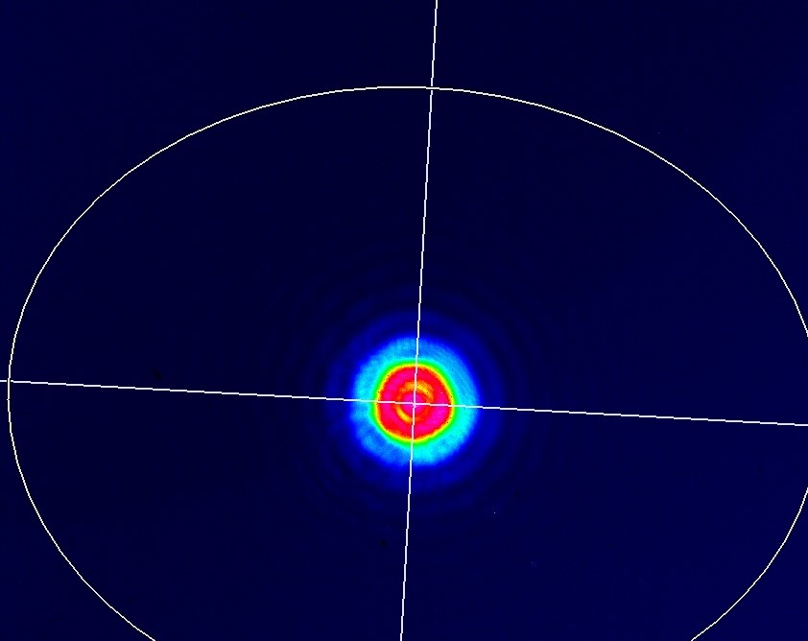
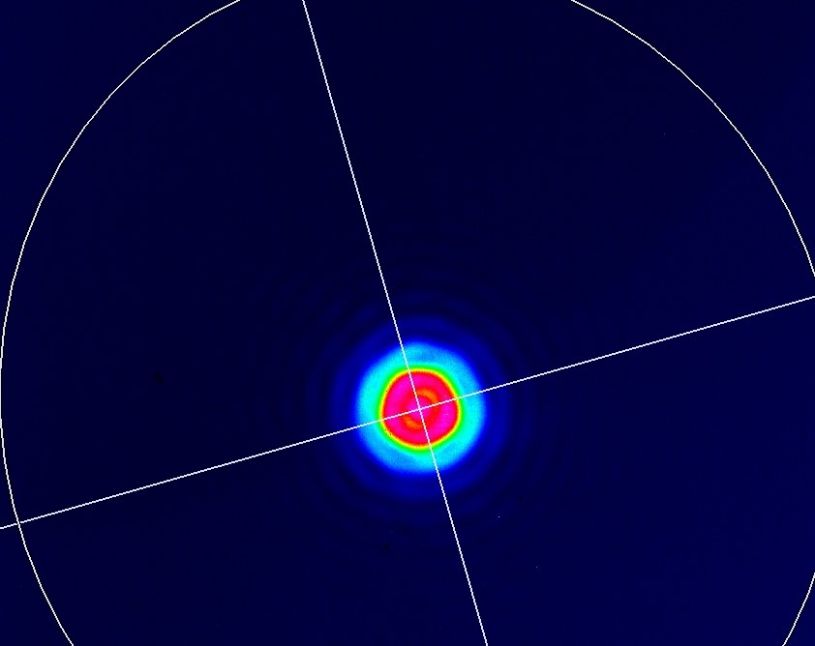
M3 out of box took images before and after cleaning and placed in M3 mount
M3 alignment
Same as M2 with having pinhole on M4 and a beam profiler after the window.
But here since we are reflecting of a spherical mirror the shape of the diffraction changes.
Took Image
Image between pinhole and beam profiler
30 cm

Slide 3
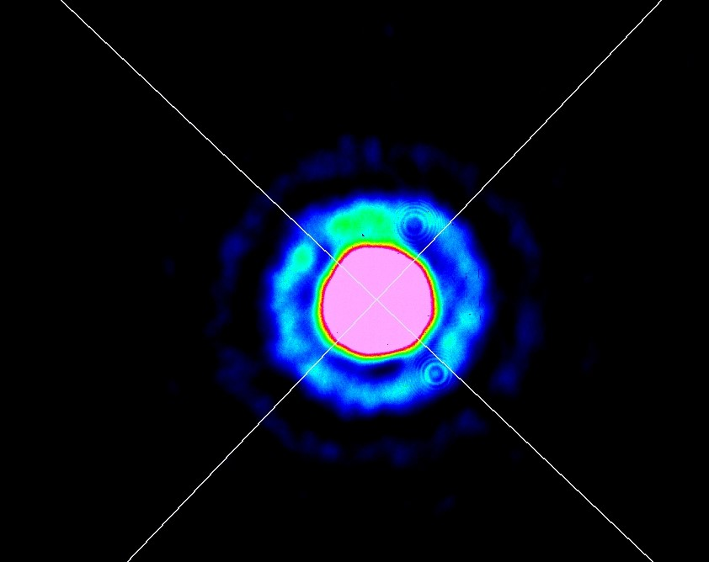
M4 out of box took images before and after cleaning and placed in M4 mount
Here the alignment was done by removing M1 mirror placing the pinhole then looking at the beam going though from M4 reflection , I observed the diffraction patterns by directing the beam out from the reflection window and looking at the beam profiler, I clearly see the diffraction patterns from the M1 pinhole , aligned M4 using them.
Image between pinhole and beam profiler
70 cm

Slide 4
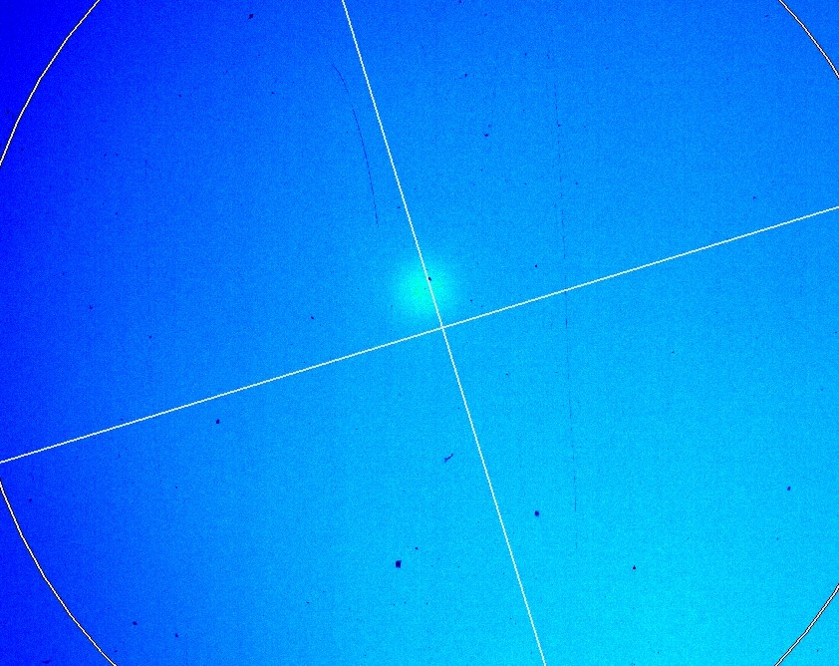
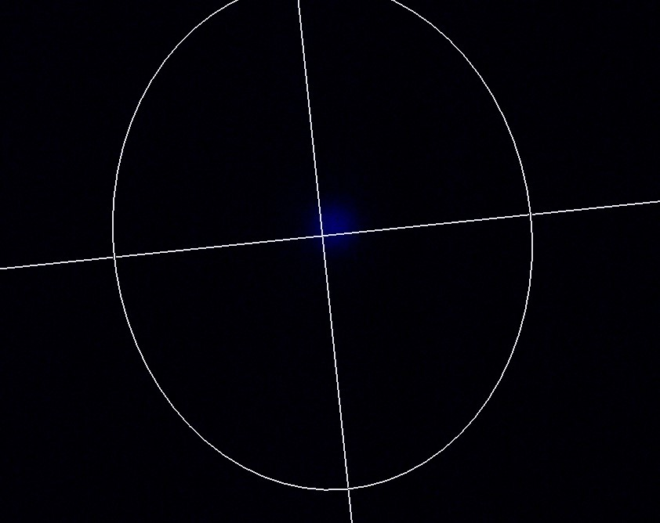
Placed M1 mirror in it's mount
Observed the transmitted beam after M2 , there is a hint of a beam to be confirmed tomorrow
Took image
After closing the Sbox

Slide 5
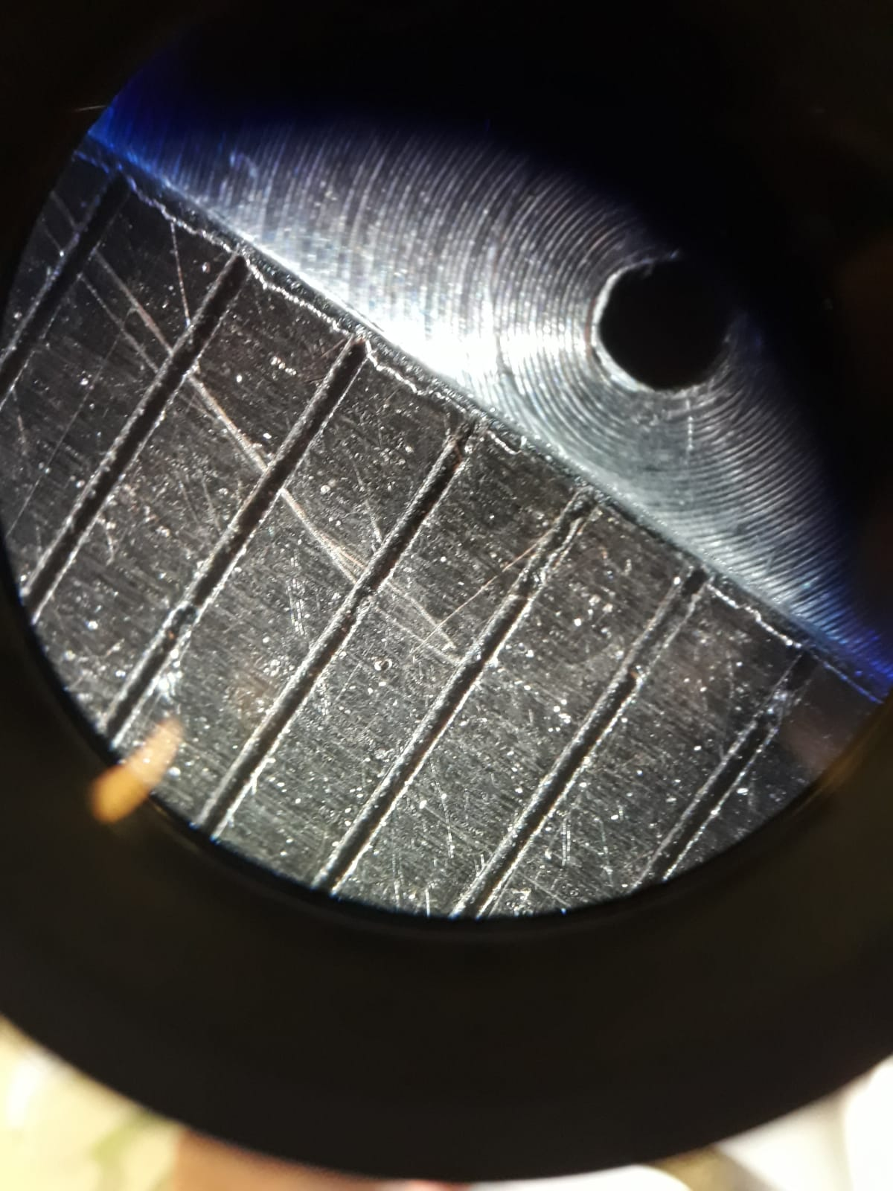
Size of the pinhole next to it is a ruler with 1 mm distance between lines
Estimate the diameter of the pinhole to be ~ 1 mm

