Slide 1
Locking with the GHz
Frédéric BLANC
08/10/2021

Slide 2
Summary
01
02
03
Setup
Results
Forecasts
[p.3]
[p.5]
[p.11]

Slide 3
Setup
01

Slide 4
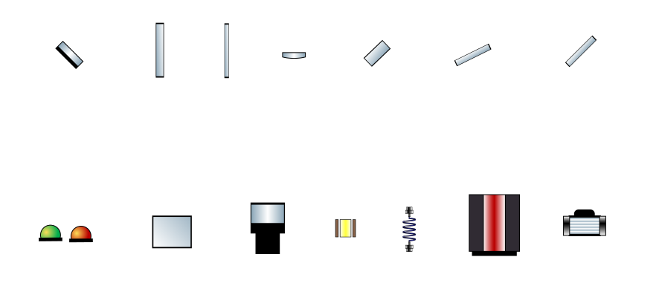
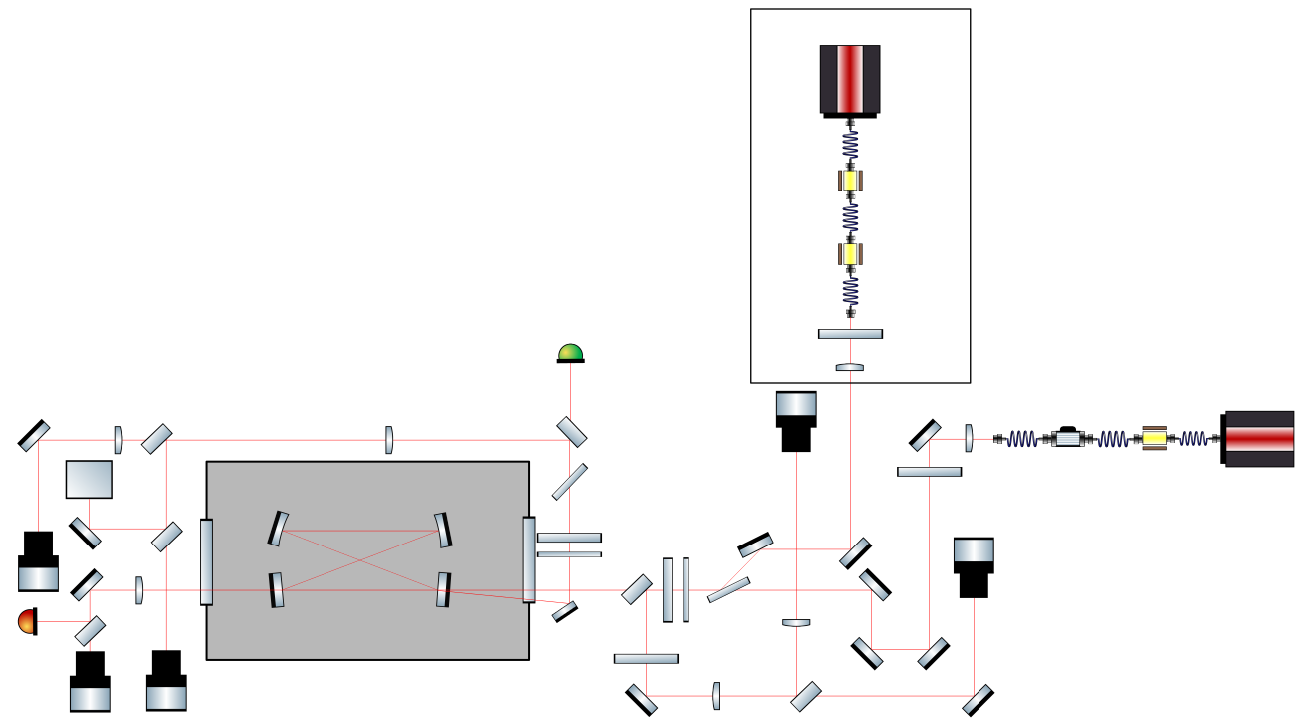
Setup for GHz locking
Unused (lock line)
Mirror
λ/2
λ/4
Lens
Splitter
Combiner
Polarizer
PhDs
PDH
Camera
EOM
Fiber
LASER
AOM
GHz
04
Setup

Slide 5
Results
02

Slide 6
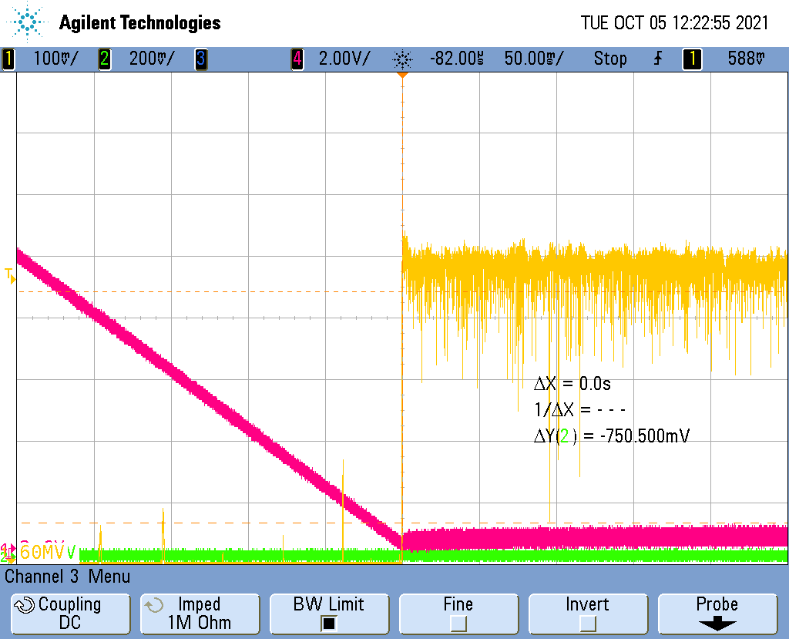
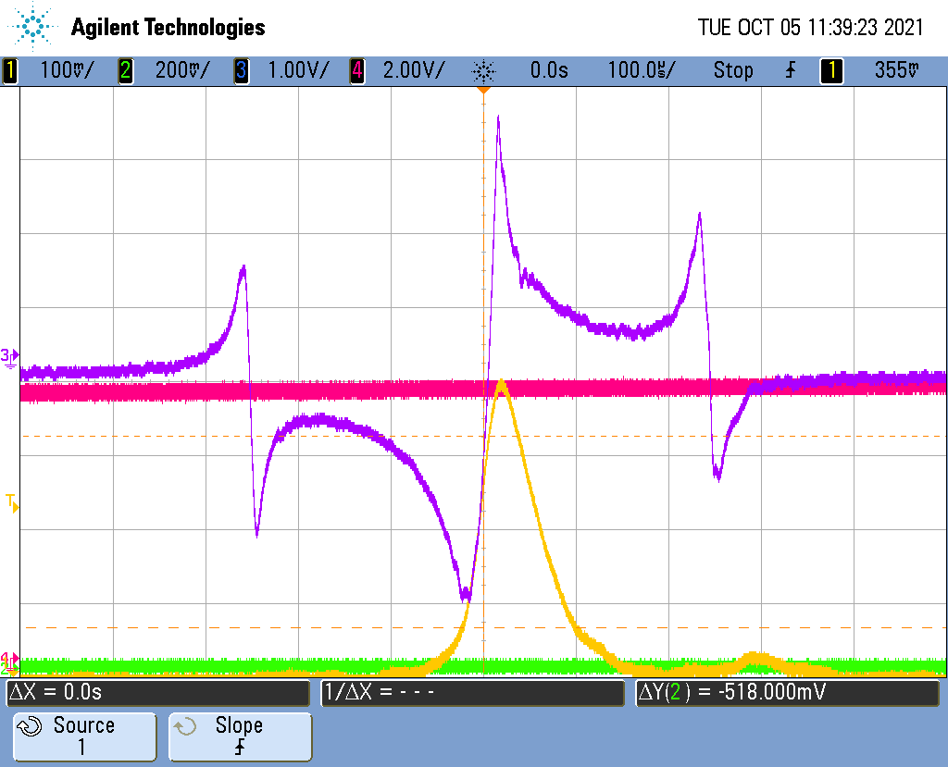
Lock GHz
Lock of the GHz
Error signal of the PDH, unlocked
06
Results

Slide 7
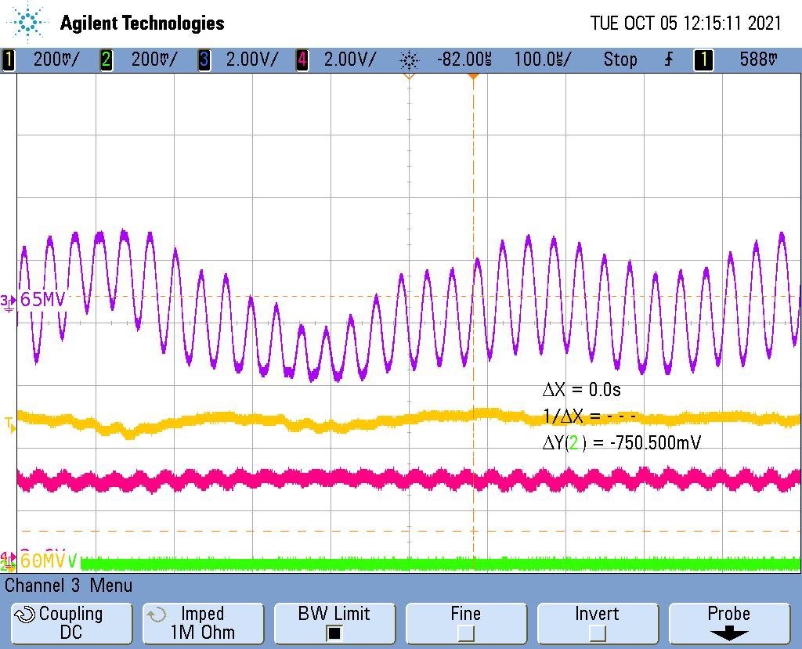
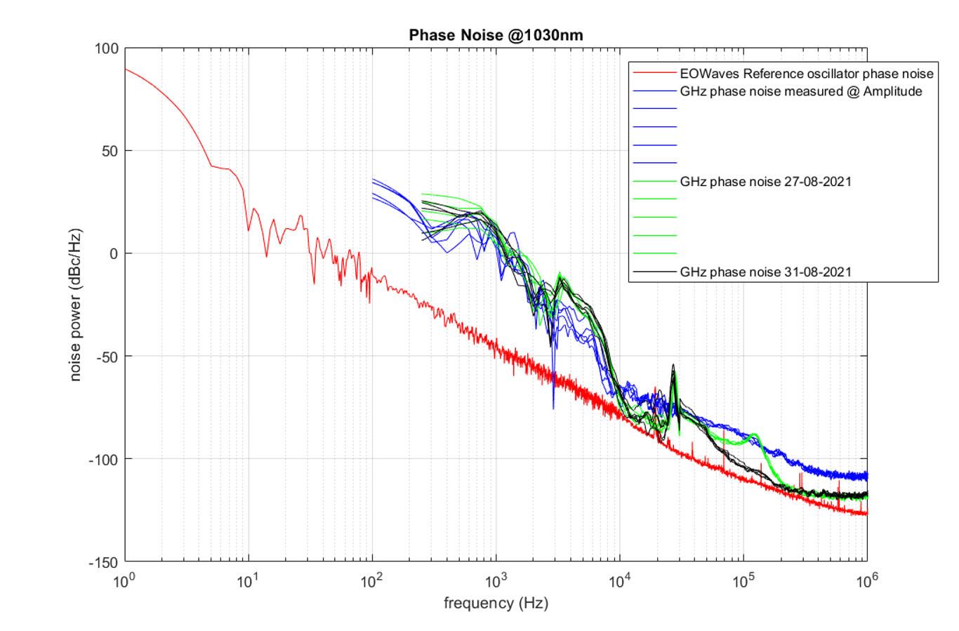
Resonnance Piezo
Phase noise and modulations.
We can see a peak at 30 kHz which produce these modulations.
Resonnance of the Piezo (30 kHz)
07
Results

Slide 8
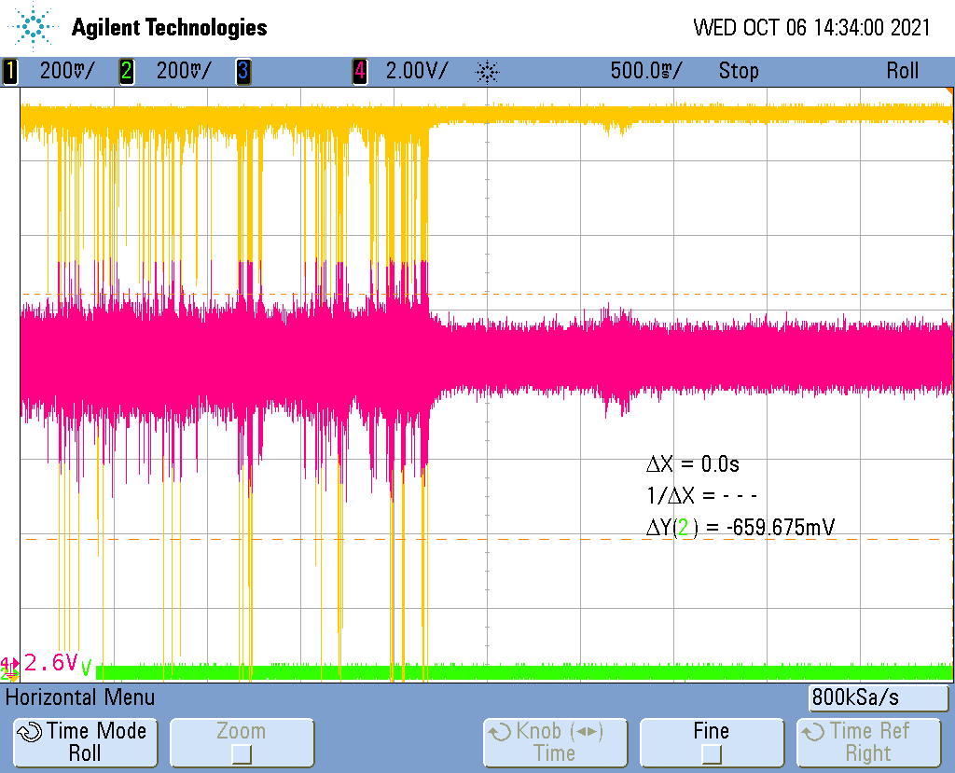
Lock signal with 2 types of loop
Differences between open loop and closed loop for motors on the cavity.
Peaks due to motors vibrations on close loop.
08
Results

Slide 9
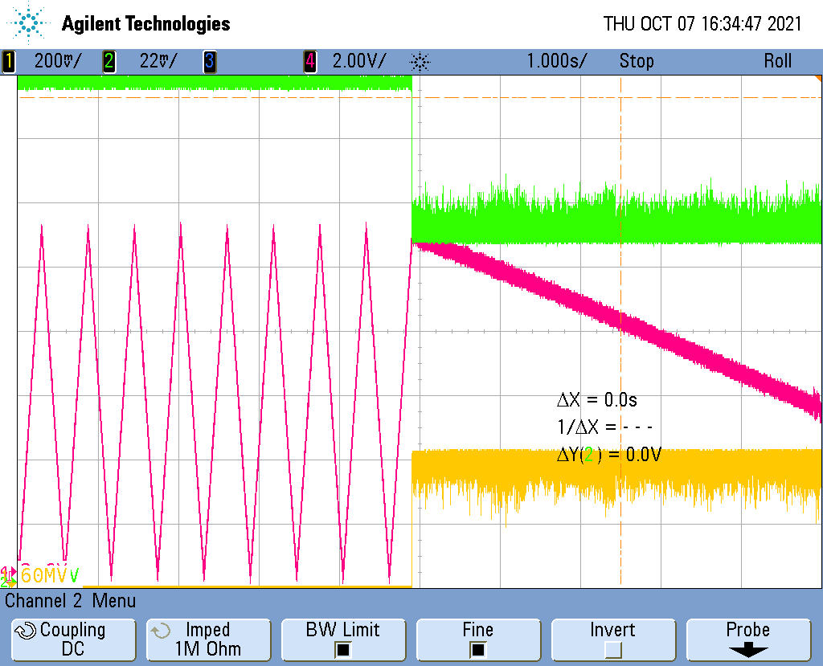
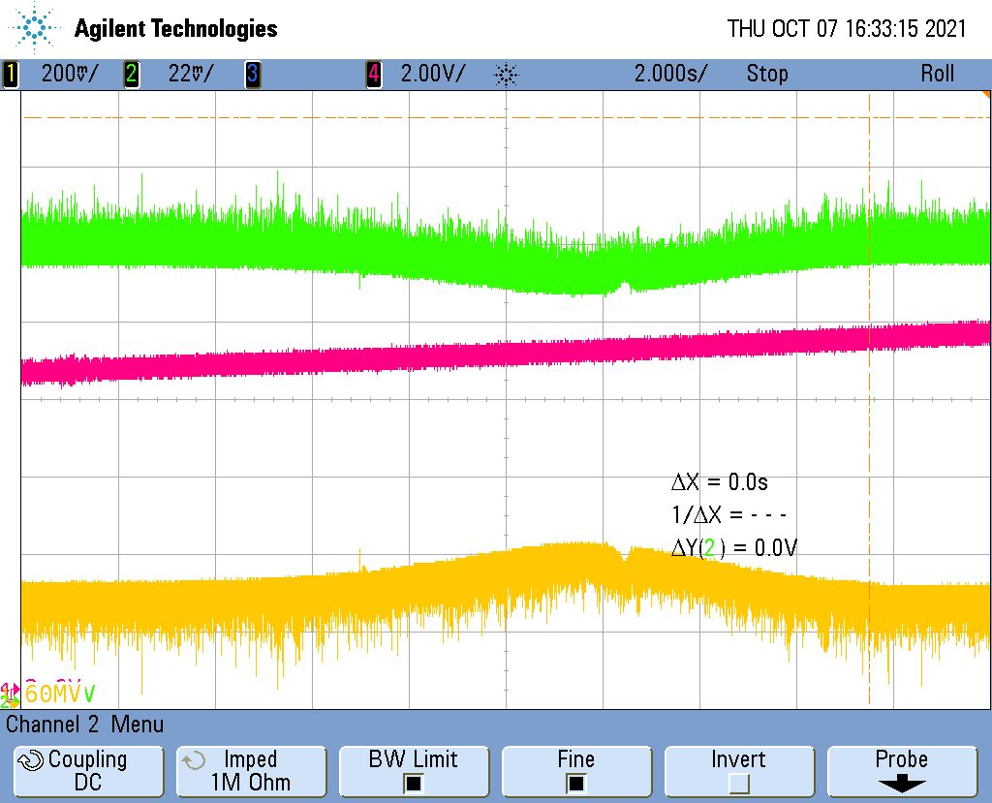
Coupling and finess
We measure the linewitdth between 879,67MHz and 880,1MHz, with a center frequency at 879,88MHz.
=> So the finess is around 2000.
The coupling is around 20% (Green curve)
09
Results

Slide 10
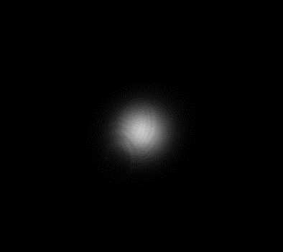
Beam imagery
Beam in transmission
10
Results

Slide 11
Forecasts
03

Slide 12
Forecasts
1) GHz
Phase noise measurement
Coupling the GHz with the Tangor
Align the Tangor with the cavity
2) Lock line
Receive the lock line from Amplitude
12
Forecasts

Slide 15



































Toolbox
1
2
3
…
1
2
3
…
1
2
3
…
Triangles
Coins de page
Bloc pour insérer des images

