Slide 1
Polarization measurment
Frédéric BLANC
27/09/2021

Slide 2
Summary
01
02
03
Polarization setups
Setup change
Forecasts
[p.3]
[p.14]
[p.17]

Slide 3
Polarization setups
01

Slide 4
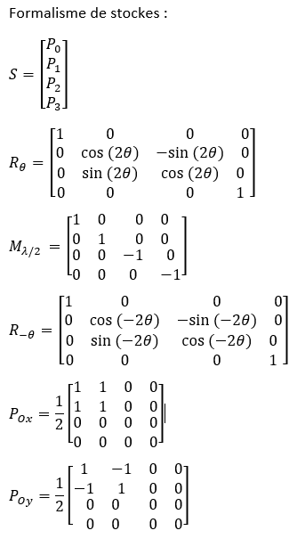

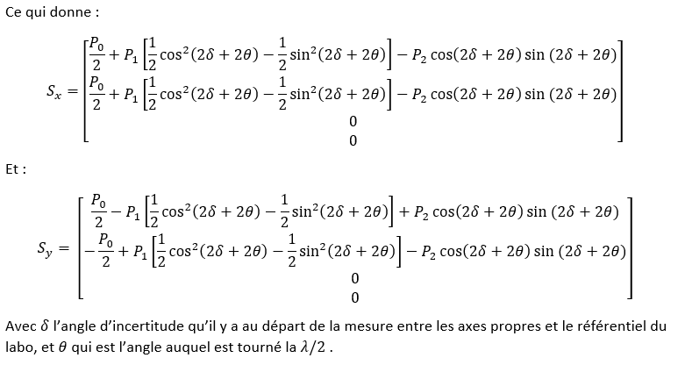
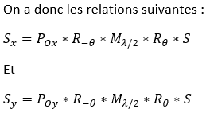
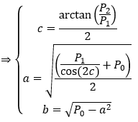

Equations
M2
S
M1
M3
S’
SO
04
Polarization setups

Slide 5
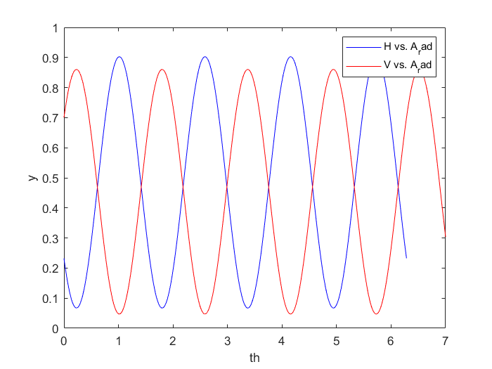
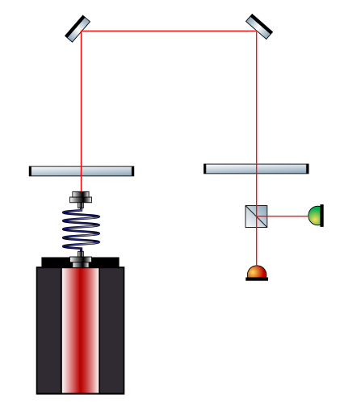
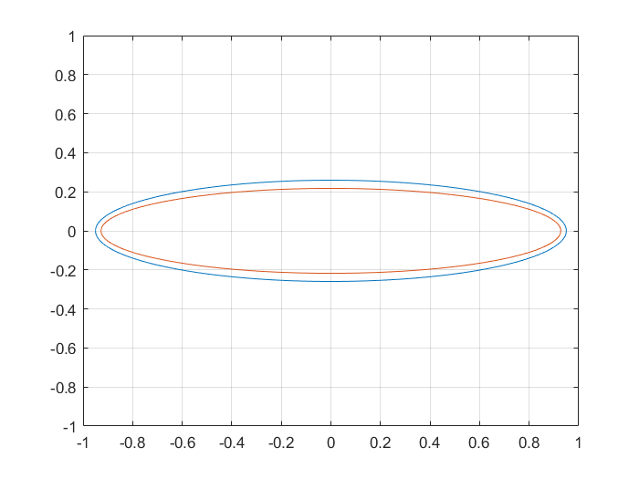
Mesures of the NKT
Ellipticité H: 0,2730
DOCP H: 0,5081
DOLP H: 0,8613
Ellipticité V: 0,2345
DOCP V: 0,4446
DOLP V: 0,8957
05
Polarization setups

Slide 6
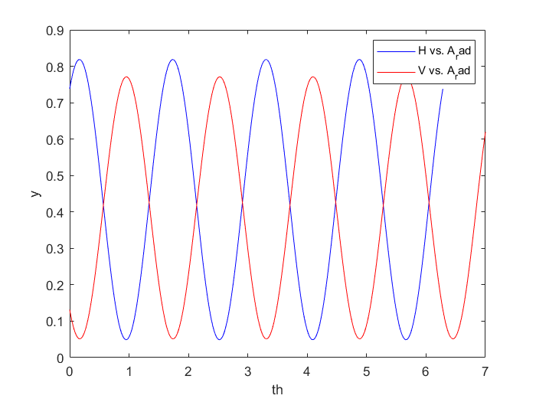
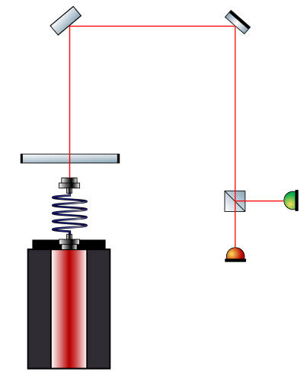
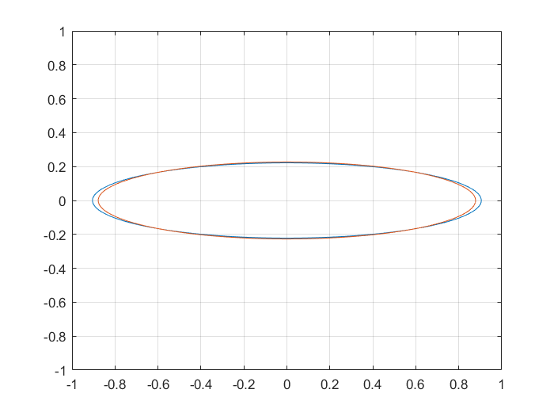
Mesures of the splitter at 45°
Ellipticité H: 0,2452
DOCP H: 0,4625
DOLP H: 0,8866
Ellipticité V: 0,2585
DOCP V: 0,4847
DOLP V: 0,8747
06
Polarization setups

Slide 7
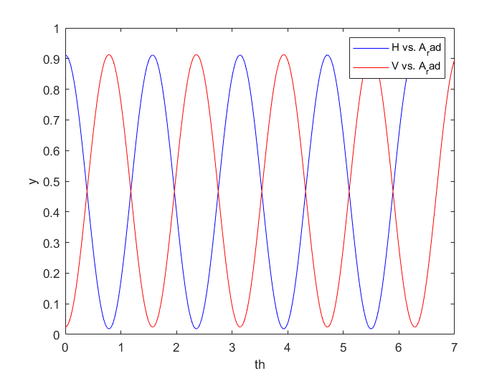
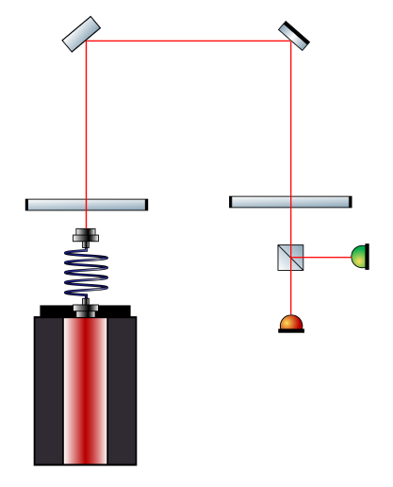
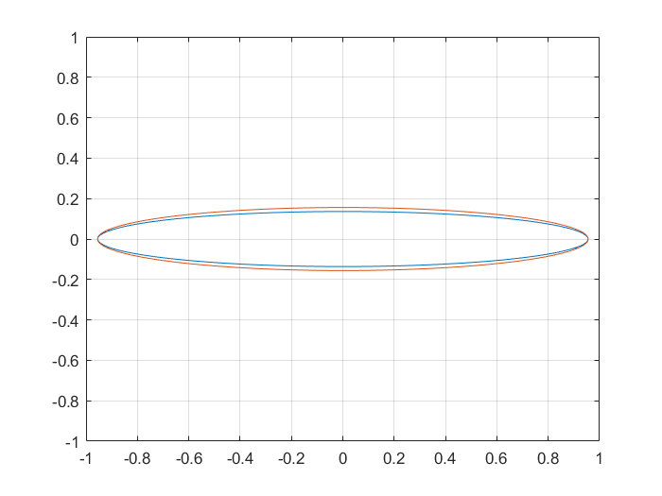
Mesures of the splitter at 45°
Ellipticité H: 0,1427
DOCP H: 0,2796
DOLP H: 0,9601
Ellipticité V: 0,1633
DOCP V: 0,3181
DOLP V: 0,9480
07
Polarization setups

Slide 8
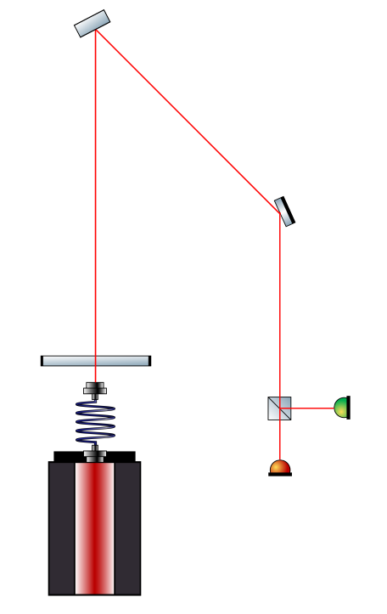
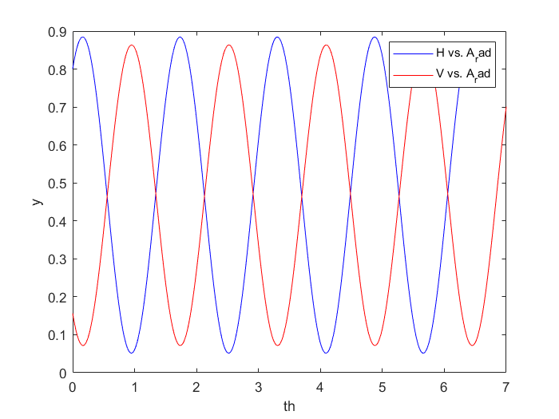
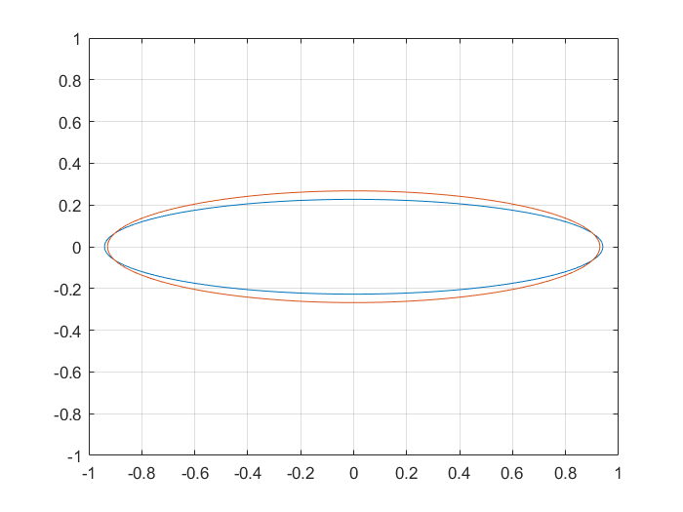
Mesures of the splitter at 22,5°
Ellipticité H: 0,2415
DOCP H: 0,4563
DOLP H: 0,8898
Ellipticité V: 0,2881
DOCP V: 0,5320
DOLP V: 0,8468
08
Polarization setups

Slide 9
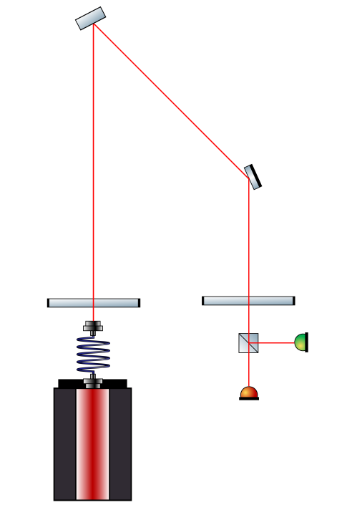
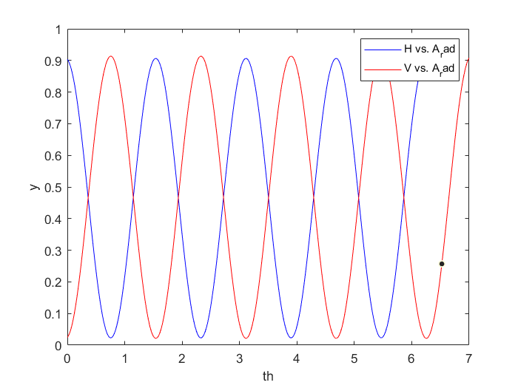
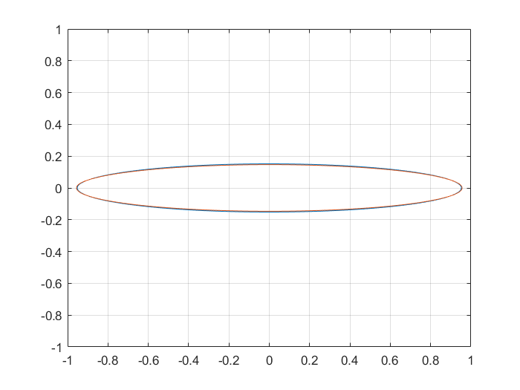
Mesures of the splitter at 22,5°
Ellipticité H: 0,1595
DOCP H: 0,3111
DOLP H: 0,9504
Ellipticité V: 0,1534
DOCP V: 0,2998
DOLP V: 0,9540
09
Polarization setups

Slide 10
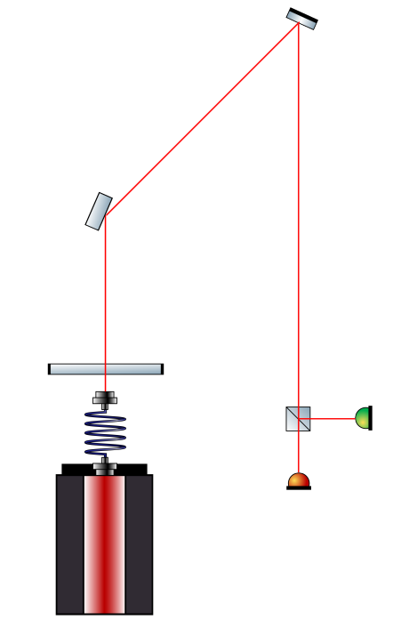
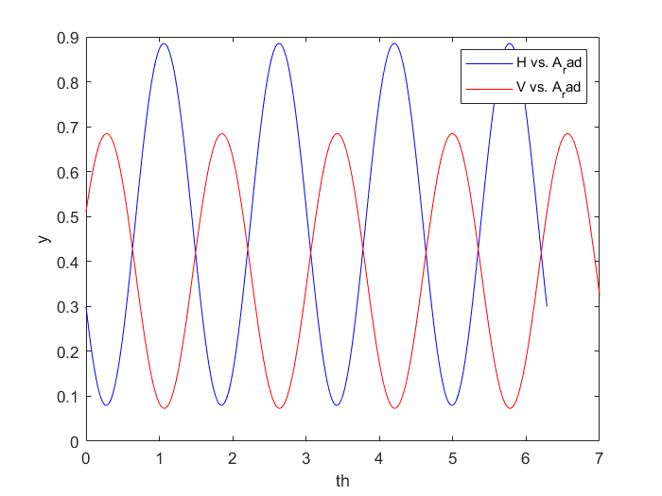
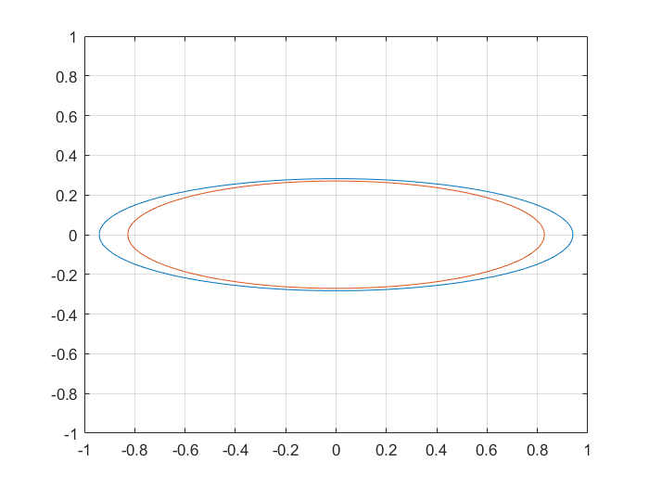
Mesures of the splitter at 67,5°
Ellipticité H: 0,3001
DOCP H: 0,5506
DOLP H: 0,8348
Ellipticité V: 0,3270
DOCP V: 0,5908
DOLP V: 0,8068
10
Polarization setups

Slide 11
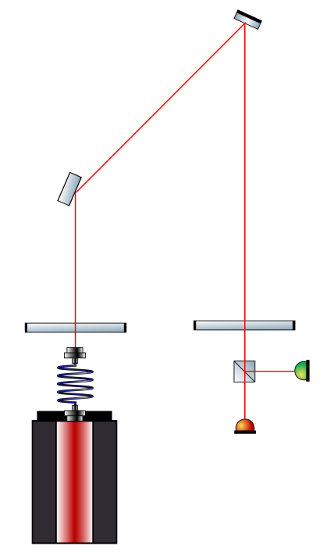
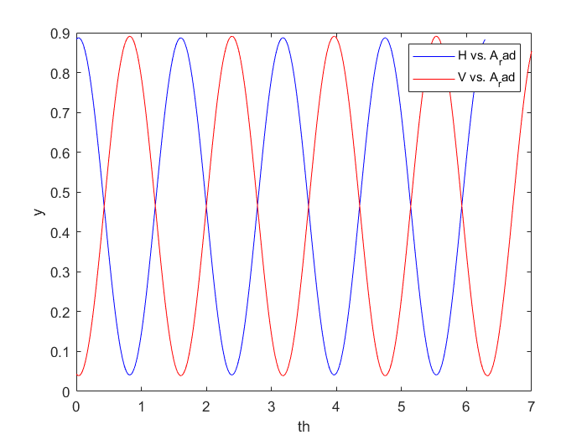
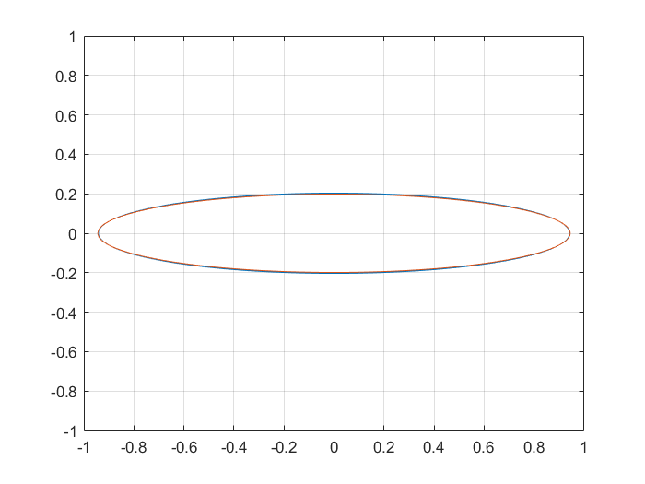
Mesures of the splitter at 67,5°
Ellipticité H: 0,2160
DOCP H: 0,4127
DOLP H: 0,9109
Ellipticité V: 0,2105
DOCP V: 0,4031
DOLP V: 0,9151
11
Polarization setups

Slide 12
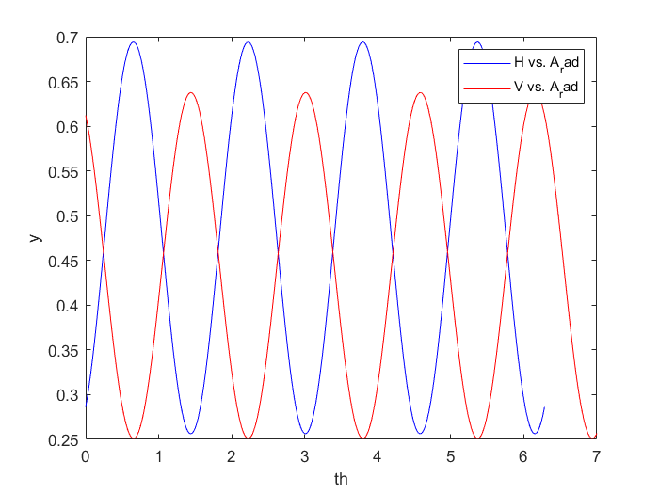
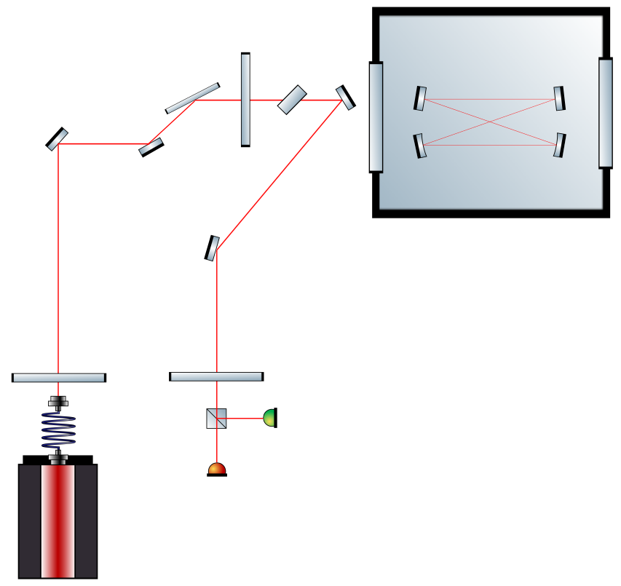
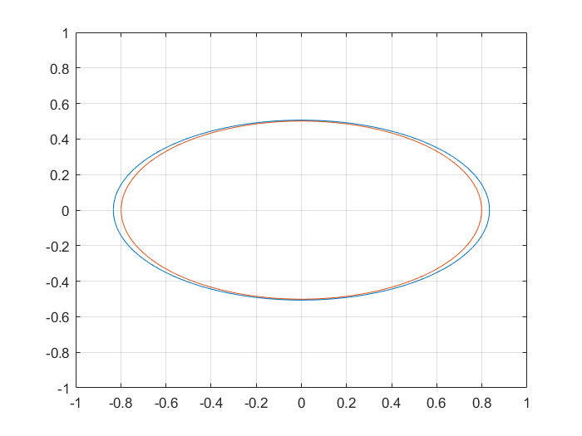
Mesures of the injection
Ellipticité H: 0,6077
DOCP H: 0,8877
DOLP H: 0,4605
Ellipticité V: 0,6276
DOCP V: 0,9005
DOLP V: 0,4349
12
Polarization setups

Slide 13
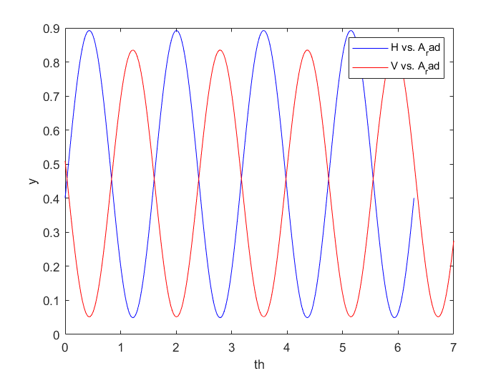
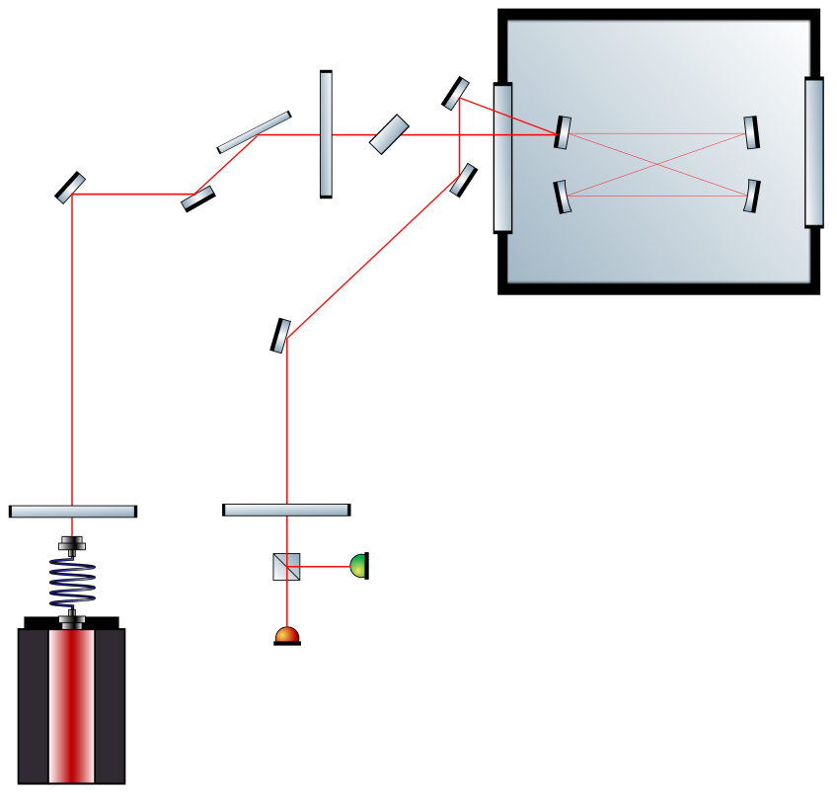
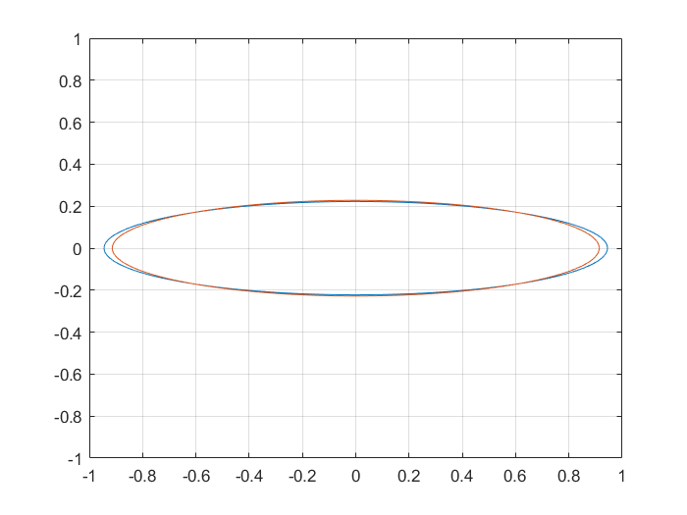
Mesures of the reflexion
Ellipticité H: 0,2353
DOCP H: 0,4460
DOLP H: 0,8950
Ellipticité V: 0,2493
DOCP V: 0,4694
DOLP V: 0,8830
13
Polarization setups

Slide 14
Setup change
02

Slide 15
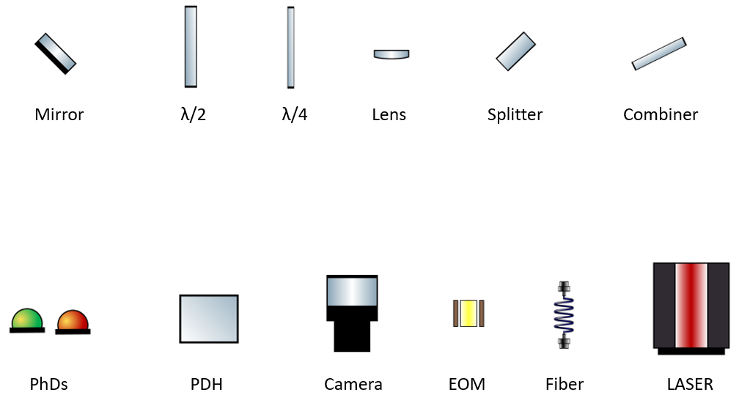
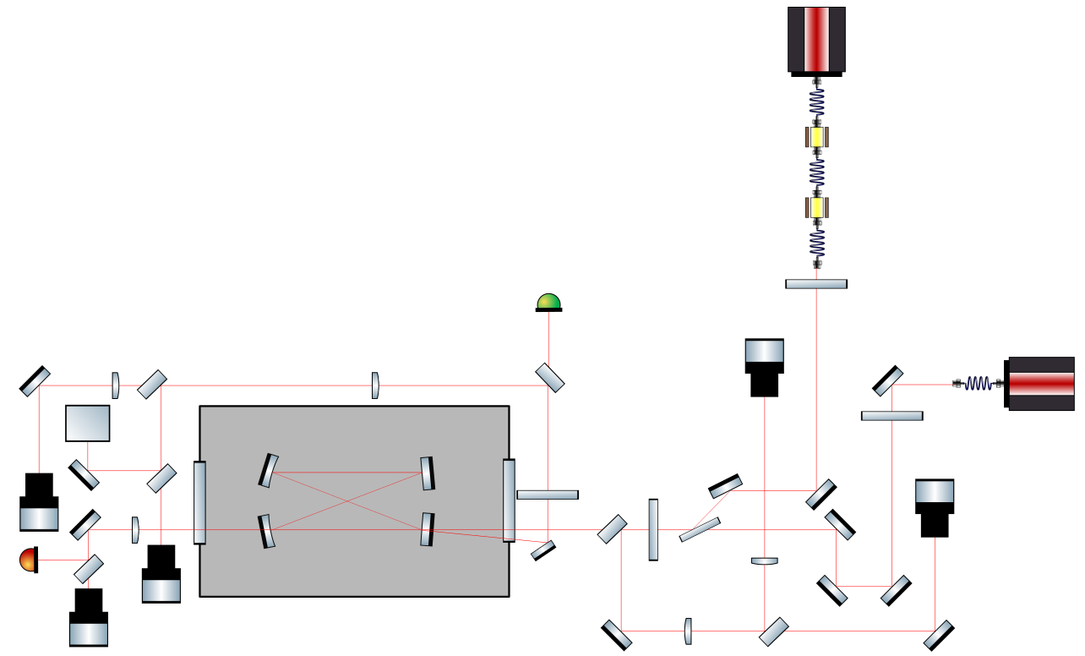
Current setup
15
Setup change

Slide 16
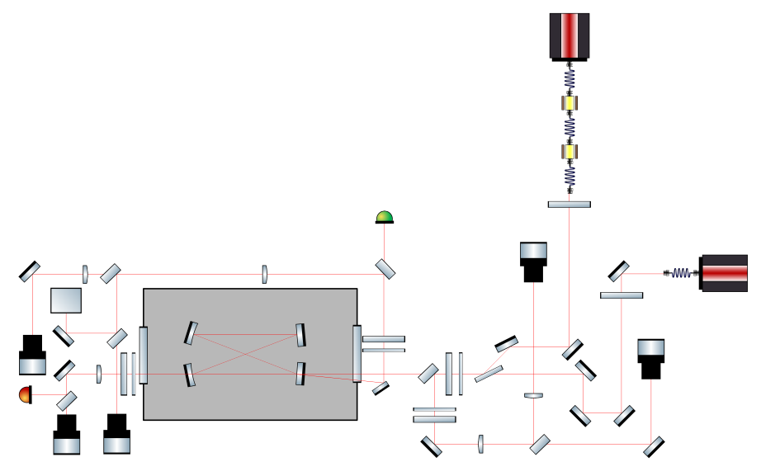
Futur setup
16
Setup change

Slide 17
Forecasts
03

Slide 18
Forecasts
1) GHz
Align the burst line
Repair the GHz
Lock with GHz
2) Polarisation
Complete the system to manage the polarization
18
Forecasts

Slide 21



































Toolbox
1
2
3
…
1
2
3
…
1
2
3
…
Triangles
Coins de page
Bloc pour insérer des images

