Slide 1
Experiment on the Fabry-Perot cavity
Frédéric BLANC
28/06/2021

Slide 2
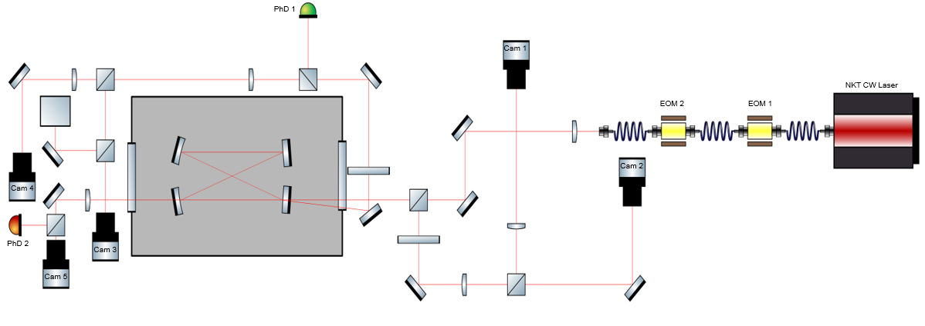





Current setup around the F-P cavity
With :
Convex lens
Concave mirror
Plane mirror
Polarized beam splitter
Lambda/2

Slide 3
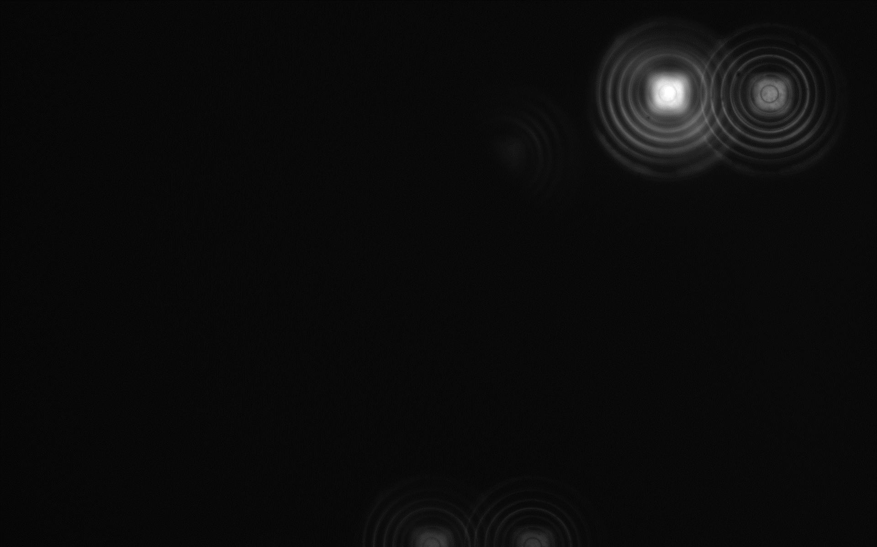

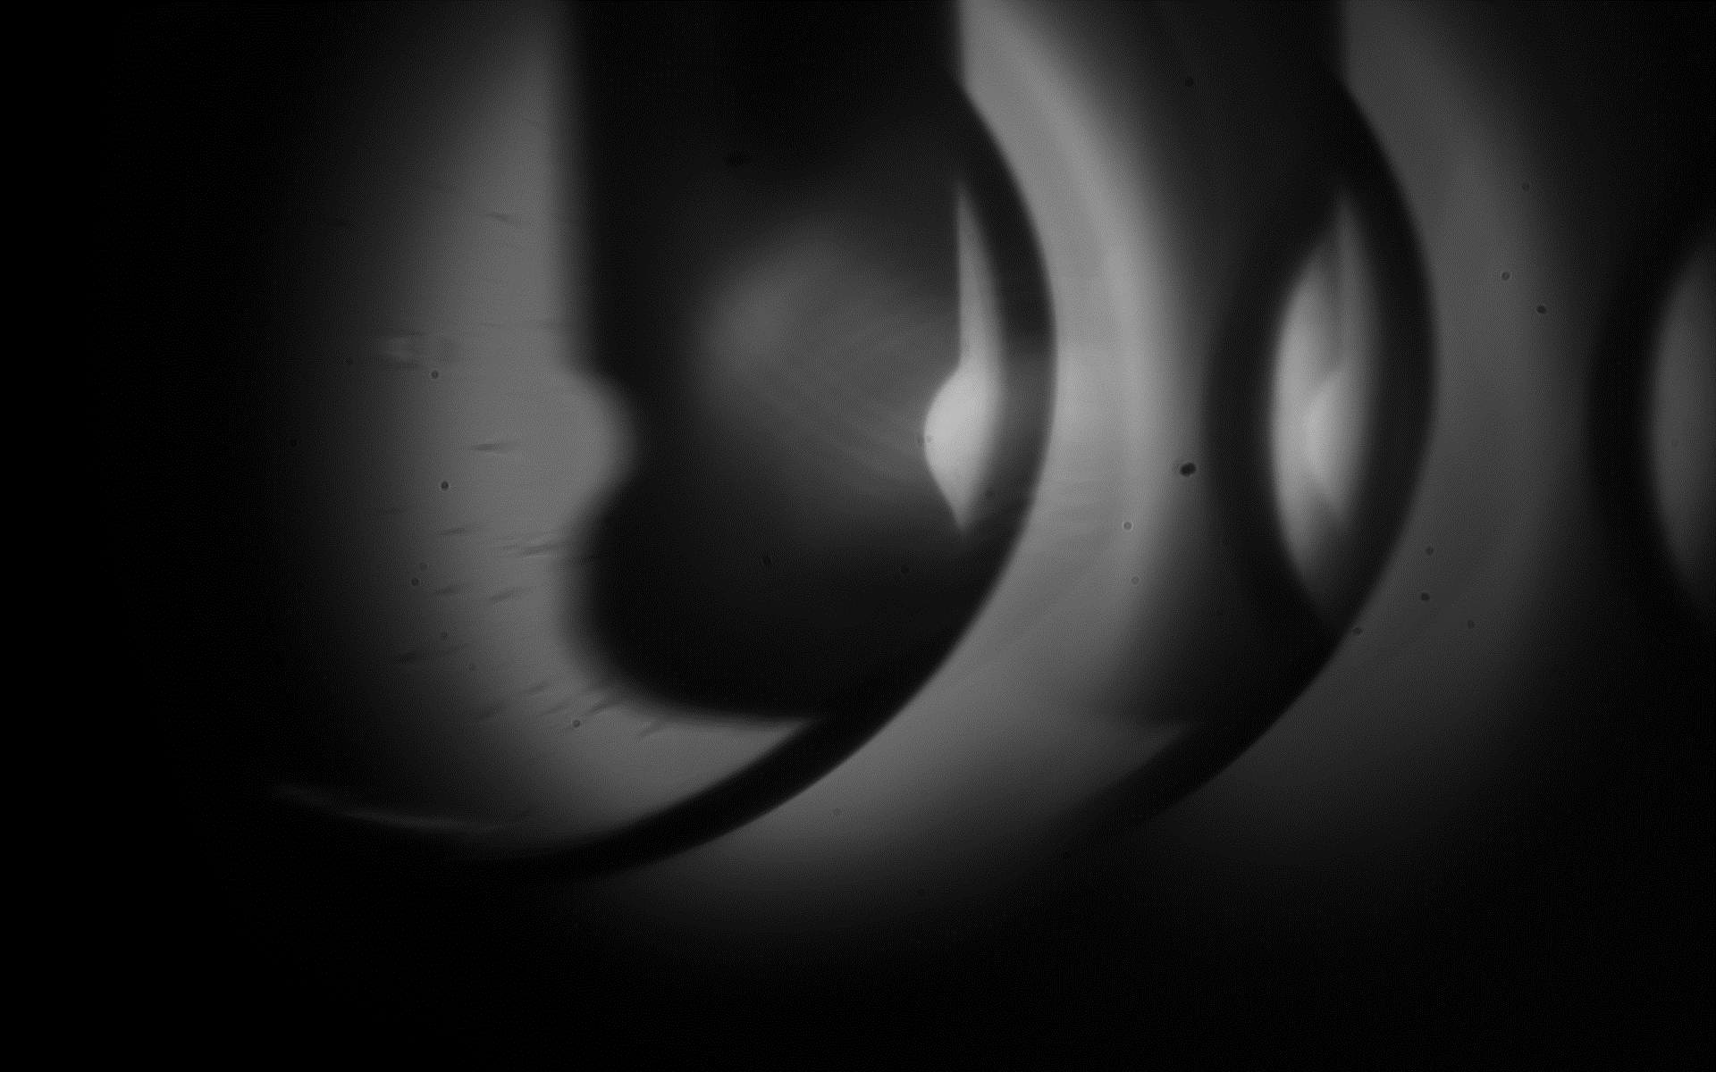
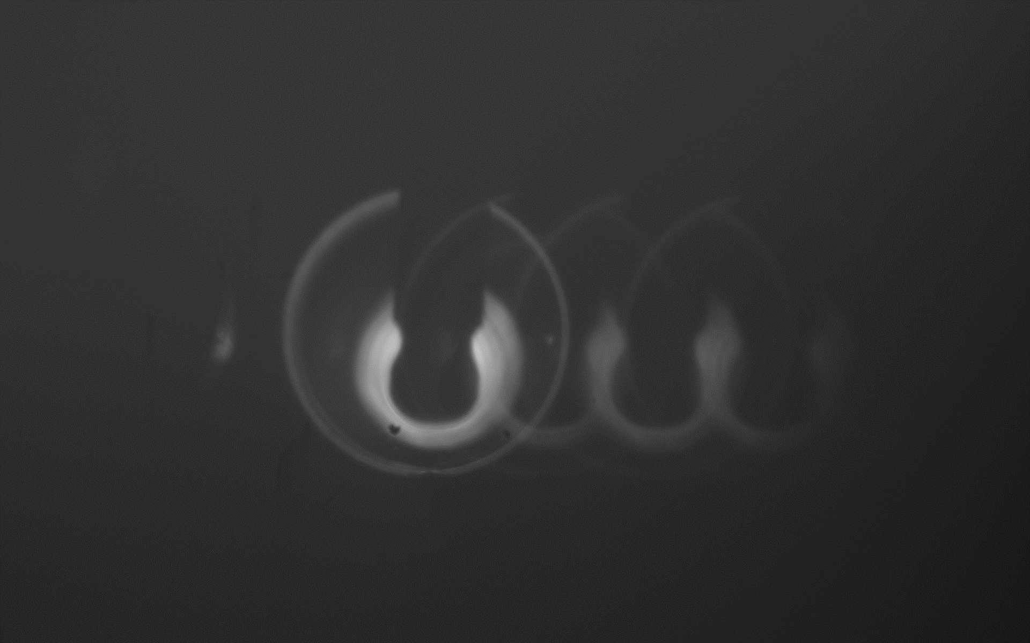
Pictures taken for cameras imagery calibration
Images for the calibration of the injection
Image for the calibration
of the transmission
Image for the calibration
of the reflection
Magnification : 1,32
Magnification : [0,53 ; 0,56]

Slide 4
Picture of the TEM0,0 mode
Pulsating beam of the TEM0,0 mode

Slide 5
Forecasts
Prepare the setup for the GHz laser.
Lock the cavity.

