Slide 1
Conditions
¼ inch mirrors
900MHz (I allow a range 850Mhz->1GHz), assuming that we want to tune it in the future)
ROC is either free (blue points) or fixed (+-0.5%) to 85mm as currently procured (green points)
Among those, the solutions not too elliptic (abs(wP1-wP2)/(wP1+wP2)<0.3) is in dark blue or dark green.
Among the dark green points those having also an expeceted event rate of Compton photons are in red.

Slide 2
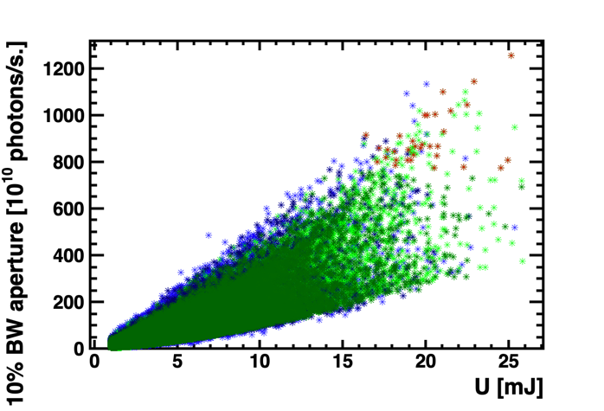
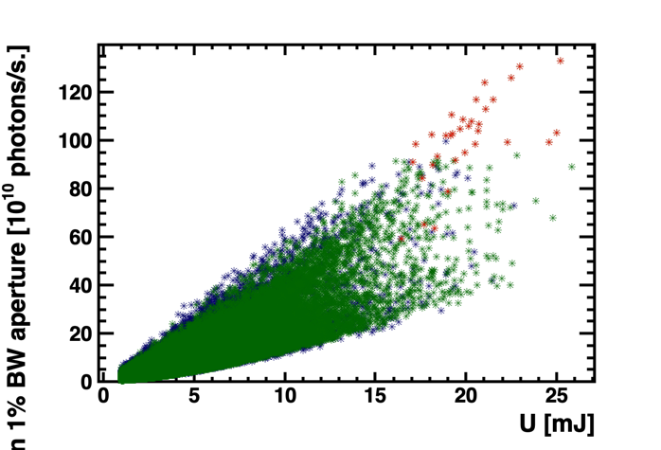
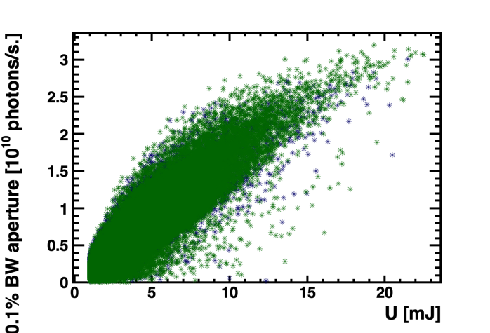
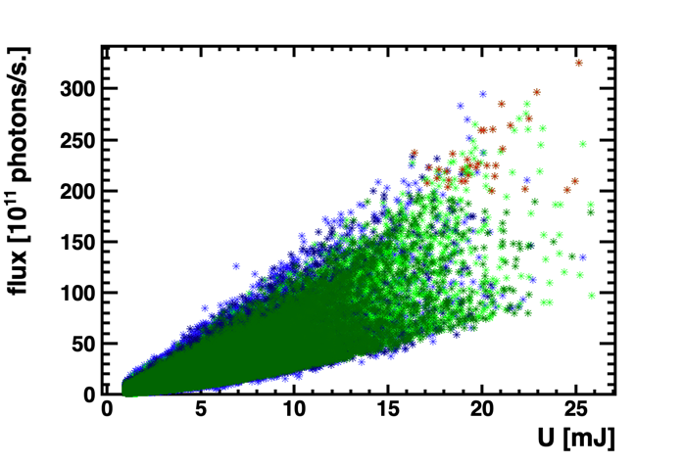
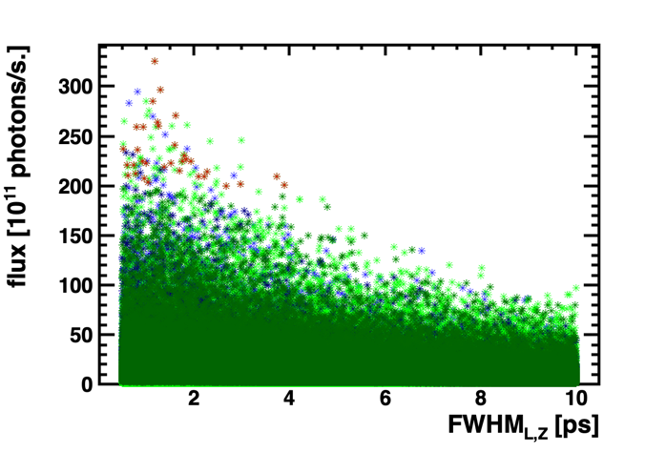
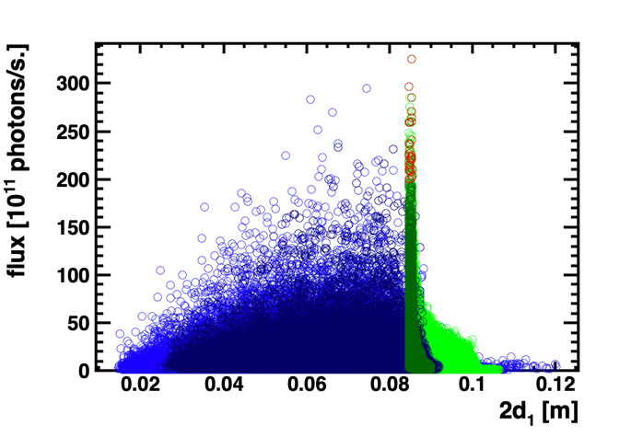
Event rates: do not target anymore the 0.1%BW

Slide 3
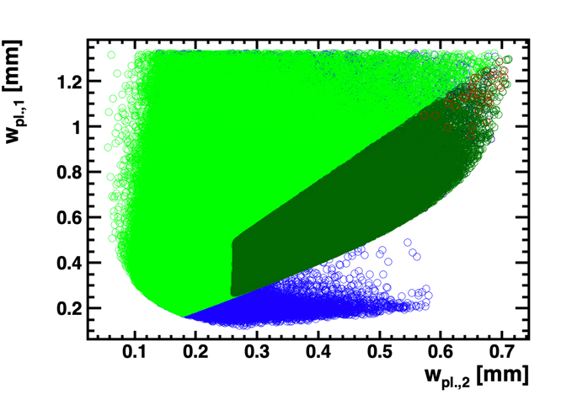
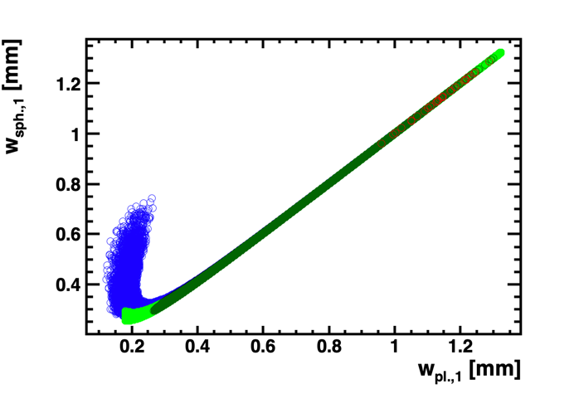
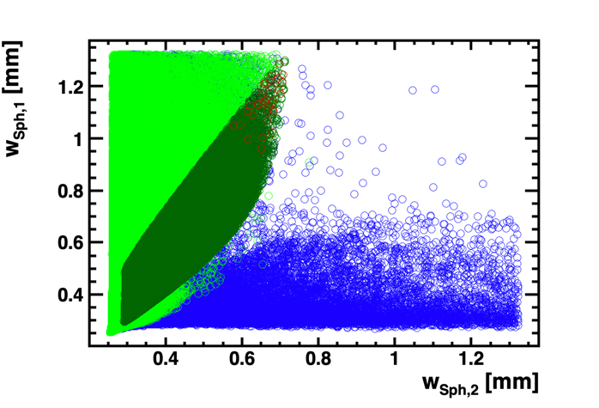
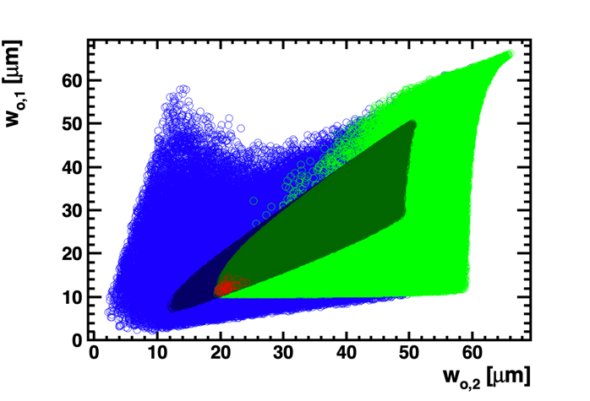
Beam sizes

Slide 4
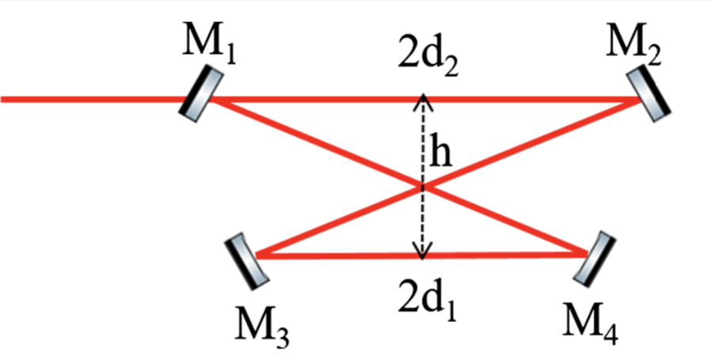
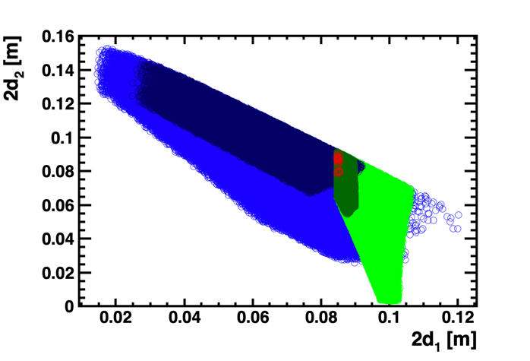
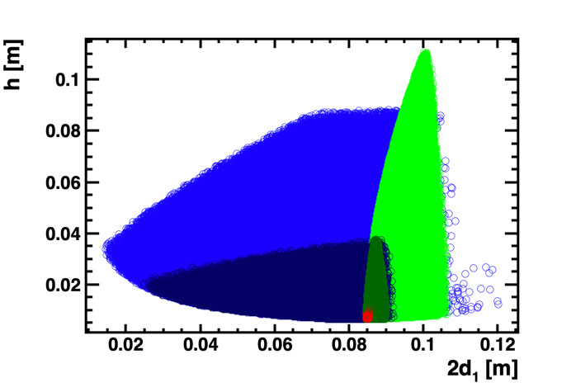
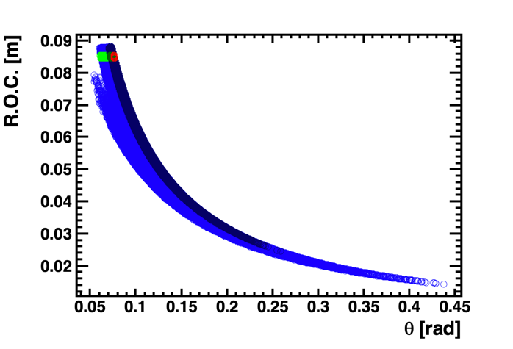
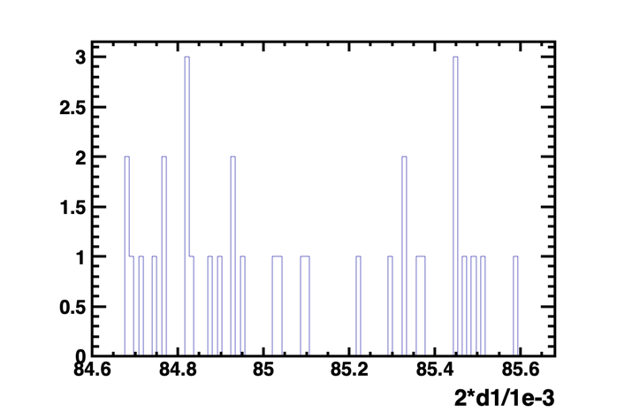
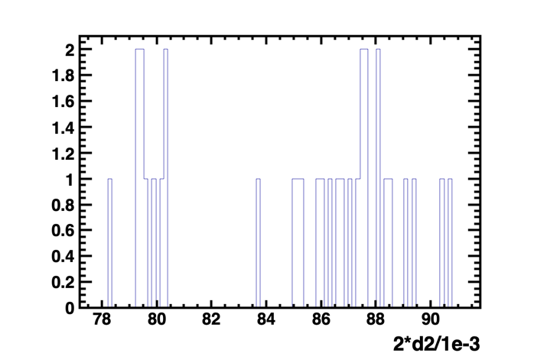
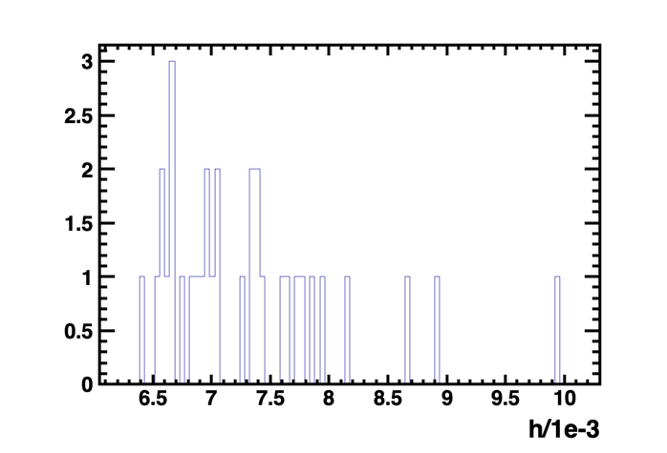
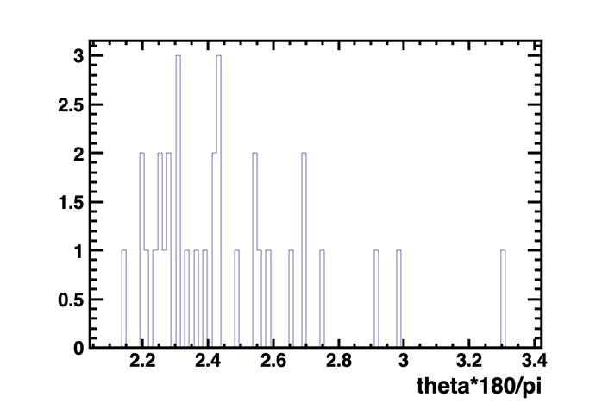
Geometry
wP1 = 1.2115mm wP2 = 0.6547mm
2d1 = 84.689554mm 2d2 = 88.029443mm h = 7.7275472mm theta=2.5566370 deg
To be checked: reducing 2d2 is mechanically OK. Yann with 3D ?

Slide 5
Fixing the angle to 2.557degree

Slide 6
And also Frep=875MHz

Slide 7
Event rate evolution versus form factor

